Slide 1
Solar / Geophysics
23 Feb 2015
Dr. Spinrad Visit
W. Denig, Chief
Solar & Terrestrial Physics Division
NOAA/NESDIS/NGDC
william.denig@noaa.gov

Slide 2
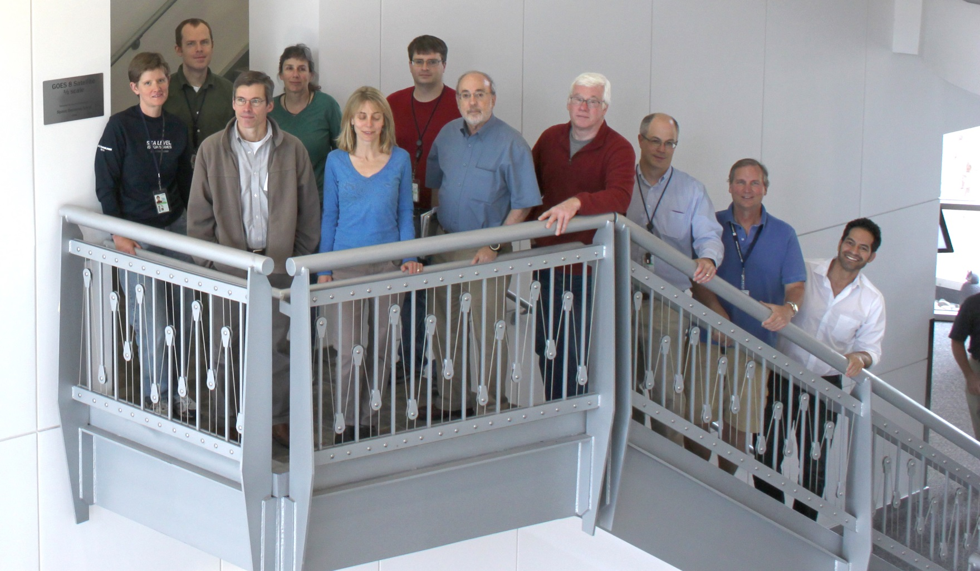
Solar / Geophysics
Space Weather Team

Slide 3
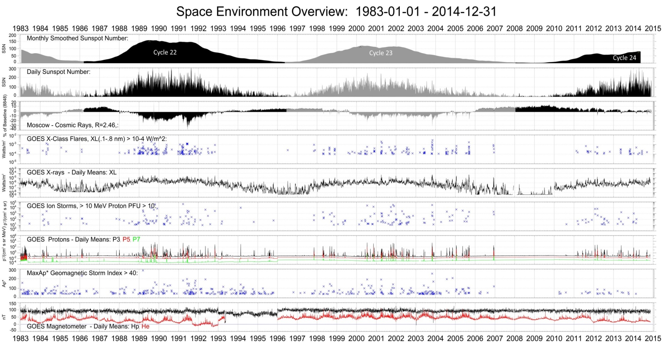
Solar / Geophysics
Managing NOAA’s Space Weather Data
http://www.ngdc.noaa.gov/stp/satellite/goes/index.html

Slide 4
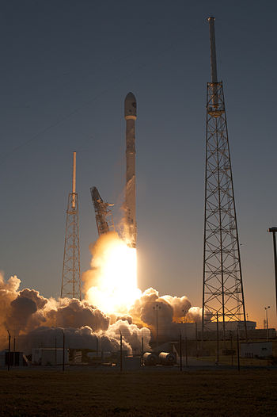
Solar / Geophysics
DSCOVR Data Stewardship/Archive
Launch: 11 February 2015
Status: Early-orbit ops (all nominal)
Current Location: 820,000 km
Final Location: 1,500,000 km (L1)
Operations: L+105 days
Space Weather Sensor Suite
Plasma-Magnetometer (PlasMag) measures solar wind for space weather predictions.
Sensors:
Magnetometer (magnetic field).
Faraday cup (positive ions)
Electrostatic analyzer (electrons)
Archive Status – Ready to receive, archive and disseminate DSCOVR space weather products.
Improving scientific data access
Deep Space Climate Observatory (DSCOVR)
Launch Video

Slide 5
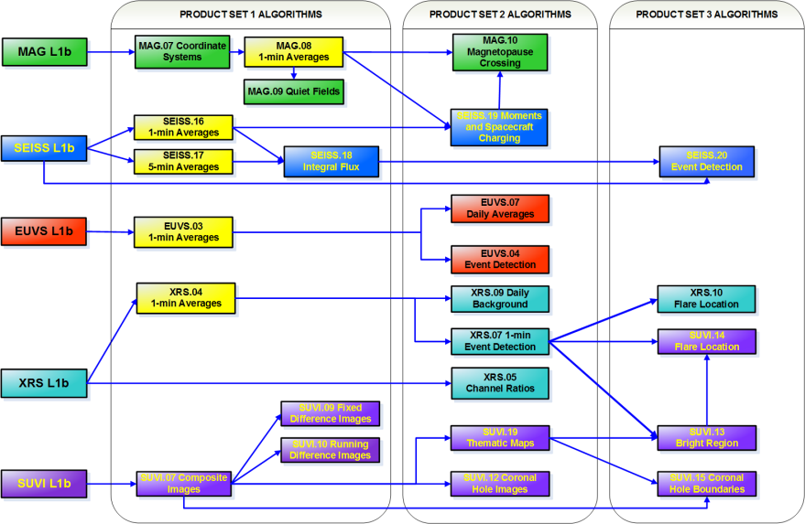
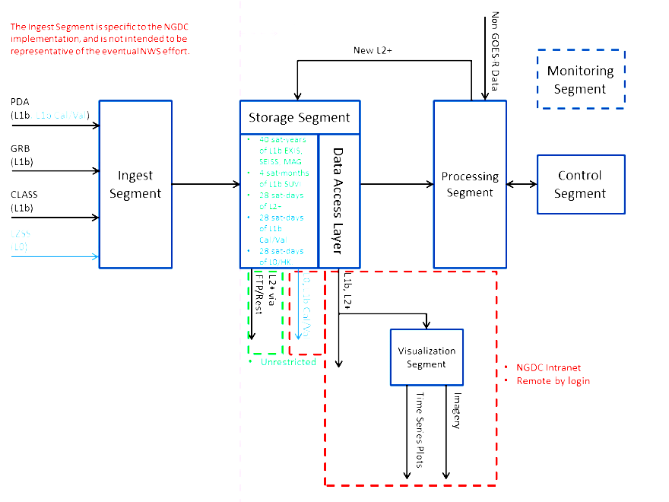
Solar / Geophysics
GOES-R Pre-Post Launch Support
GOES-R Launch: March 2016
Space Weather Sensors:
SUVI – Solar UltraViolet Imager
MAG – Magnetometer
EXIS – EUV and X-Ray Irradiance Sensors
SEISS – Space Environment In-Situ Sensors
Assigned Responsibility:
Vendor oversight, including calibration
Pre-launch technical planning
Post-Launch tests & product assessment
L1b product calibration/validation
L2+ algorithm development & demonstration
Long-term Operations & Maintenance (O&M)
Data stewardship / archive
GOES-R / S / T / U – Through 2036
SPADES PDR (P/W: Spades2014## )
Satellite Product Analysis & Distribution Enterprise System (SPADES)

Slide 6
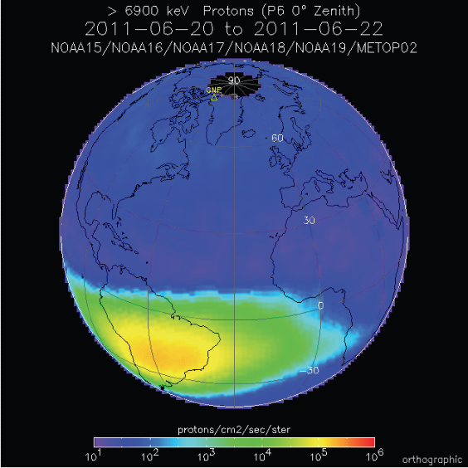
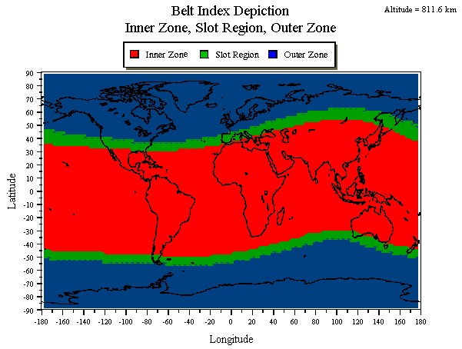
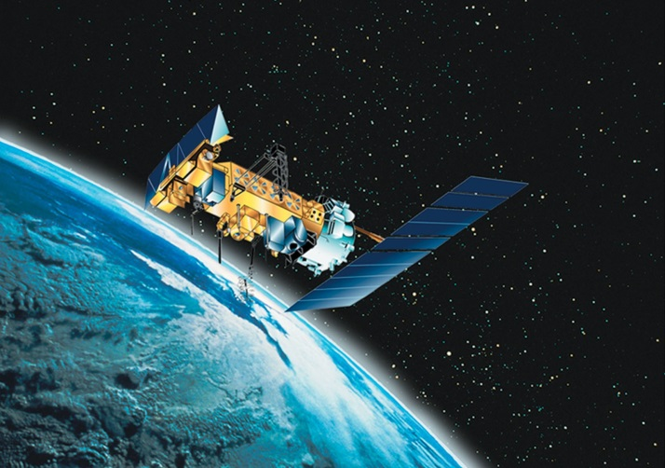
Solar / Geophysics
POES/MetOp – Processing / Archive / Products
Space Environment Monitor (POES/MetOp)
Roles and Responsibilities:
Real-time Data Processing
Daily “Belt Indices” (AFWA)
Archive and Dissemination
Satellite Anomaly Resolution
http://www.ngdc.noaa.gov/stp/satellite/poes/index.html

Slide 7
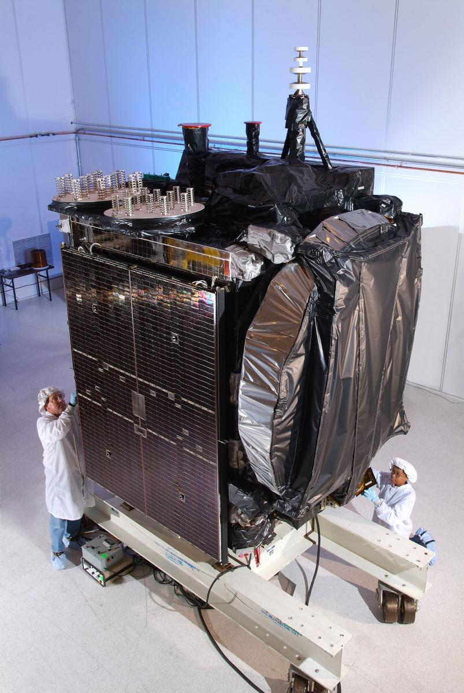
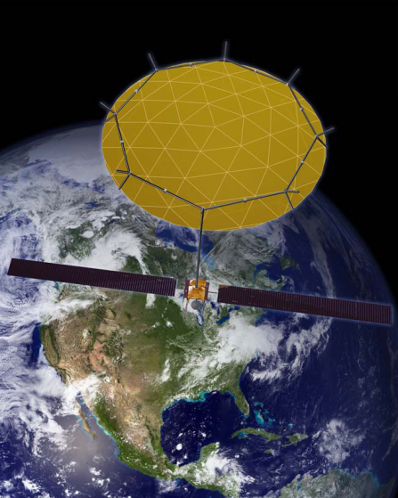
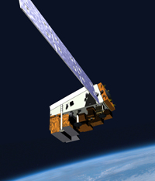
Solar / Geophysics
Satellite Anomaly Support – Environment
Case 1 – Galaxy-15
Orbit: Geosynchronous
Anomaly Date:
05 April 2010 @09:48
Probable Cause:
Internal Charging/ESD
Report
Case 2 – SkyTerra-1
Orbit: Geosynchronous
Anomaly Date:
07 March 2012 @14:43
Probable Cause:
Single-Event Upset
Report
Case 3 – NPP/VIIRS
Orbit: Polar LEO
Anomaly Date:
Various
Probable Cause:
Single-Event Upsets
Report
Notes:
Important Points:
These examples are event reports put out by NOAA-SAIS showing how space weather data and tools can be used to define the relationship between space weather and satellite anomalies.
The goal for the future is to automate and present these tools so that anyone can get a complete environmental assessment with just a date, time, and location

Slide 8
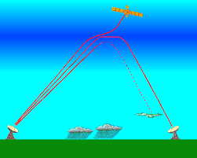
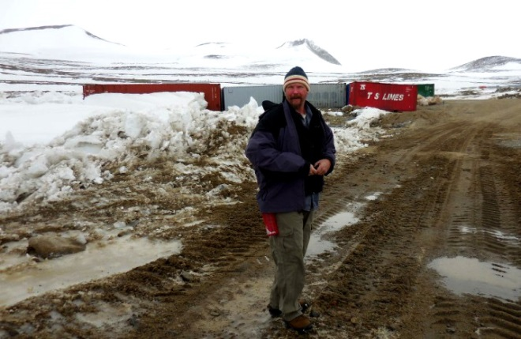
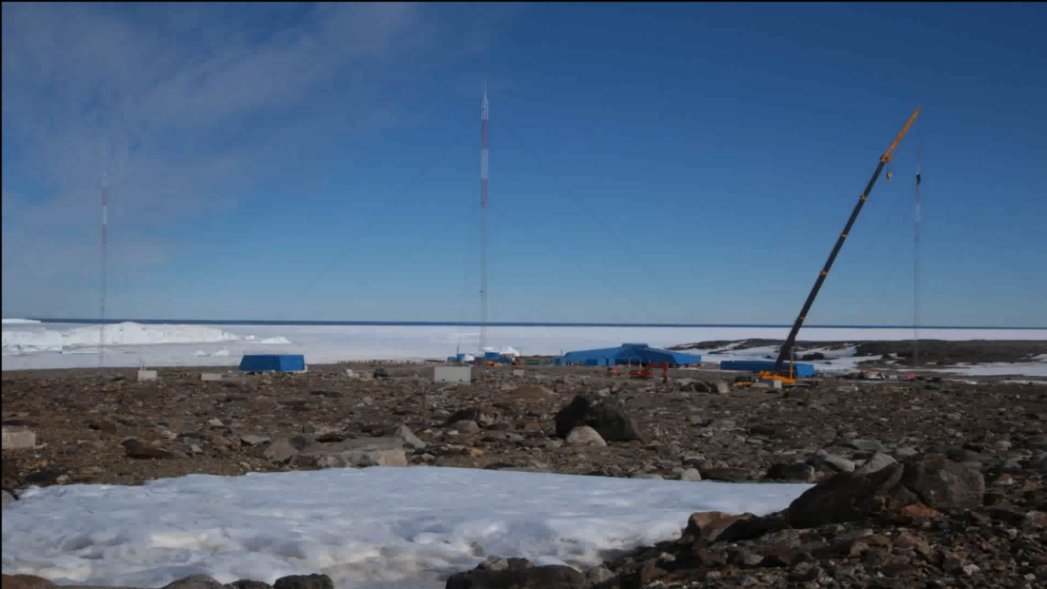
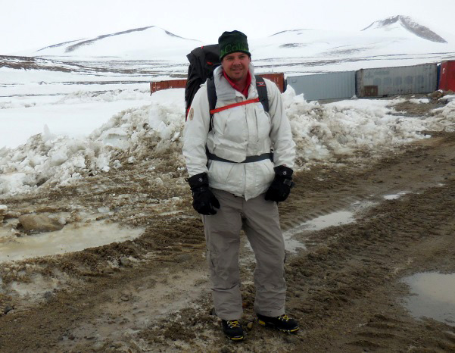
Solar / Geophysics
Ionospheric Sounder Construction
Sensor: Vertical Incidence Pulsed Ionospheric Radar
Location: Jang Bogo Station (South Korea), Antarctica
Construction Movie
NESDIS News: http://www.nesdis.noaa.gov/news_archives/ionoshere.html
Antarctic Blog: http://ciresblogs.colorado.edu/spaceweather/
Notes:
NOAA Affiliates Help Improved Air Traffic Communication near the Antarctic
Across the globe, we continually bounce high-frequency (HF) radio waves off the ionosphere to communicate across long distances. Earth’s upper atmosphere—the ionosphere—may be invisible to most of us, but it is critical to everyday activities on the surface of the planet. Moreover, at Earth’s poles in particular, scientists, aircraft pilots and others rely on those HF radio signals to maintain contact with safety and emergency staff. To better understand the ionosphere near the South Pole and improve local communications there, the Cooperative Institute for Research in Environmental Sciences (CIRES) scientists working at NOAA’s National Geophysical Data Center in Boulder, Colorado, are deploying a state-of-the art ionospheric sounder at South Korea’s Jang Bogo Station in Antarctica.
The ionosphere—like other regions of the atmosphere—is a changeable beast. It fluctuates in response to space weather sent toward the planet by our active sun, and those fluctuations can affect radio signals. After two years of planning, Dr. Terry Bullett and Justin Mabie are on the ground down south, in the middle of a three-month field campaign to assemble the massive instrument at Jang Bogo Station. The scientists are also blogging about their Antarctic exertions. The project is scheduled to continue through March 2015.
The ionospheric sounder, commonly referred to as an ionosonde, incorporates new technologies into its design and fabrication that will reveal in exquisite detail the structure and dynamics of the local polar ionosphere. That information should significantly improve local communications in Antarctica. Research teams in the Antarctic rely on HF radio communications to remain in contact with base operators for their safety. And the increasing use of southern polar routes for efficient air transport has increased air traffic controllers’ demand for reliable and continuous Antarctic communications.
How it works is that an ionosonde transmits radio waves at multiple frequencies into the atmosphere, and those signals reflect off large-scale ionospheric structures and return to the ground where they can be detected and analyzed. Scientists can use the time delay and frequency of a reflected radio signal to determine the electron density height profile of the ionospheric F-region, critical information for facilitating local and long-range communications. Dr. Bullett’s team has deployed similar instruments across the United States, including Puerto Rico, and in South America. A key ionosonde located at Wallops Island in Virginia is used to actively monitor the effects of rocket plumes, including those from International Space Station resupply missions, on the local ionosphere.
In recent years, South Korea has increased their international participation in operational space weather. They have worked closely with NOAA’s Space Weather Prediction Center to foster improved data sharing and model developments. This new ionosonde at Jang Bogo will be a key component of Korea’s focused space weather activities in the Antarctic.
The new ionosonde on the shores of Terra Nova Bay should become operational in early 2015. The radar system is for the Korean Polar Research Institute, but the data collected will be in the public domain and will likely draw the interest of scientists around the world who study sun-Earth connections. CIRES' Nikolay Zabotin is a co-principal investigator on the project, supporting the work from Boulder with critical software and data analysis.
Read more about the team’s adventures at http://ciresblogs.colorado.edu/spaceweather/.
Learn about NGDC’s Ionosphere Program at http://www.ngdc.noaa.gov/stp/iono/ionohome.html.

Slide 9
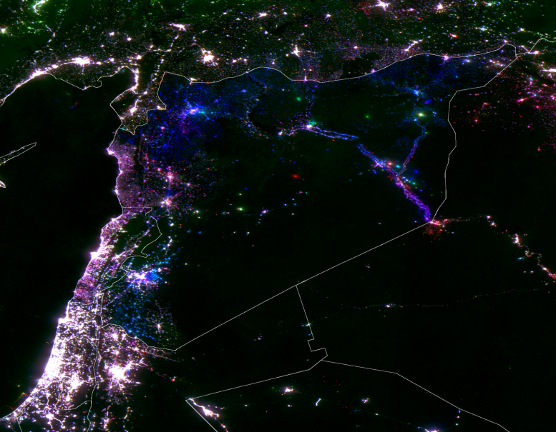
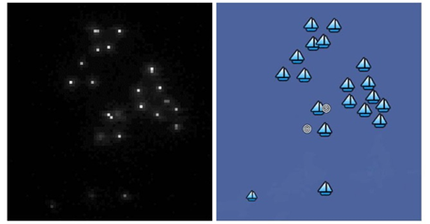
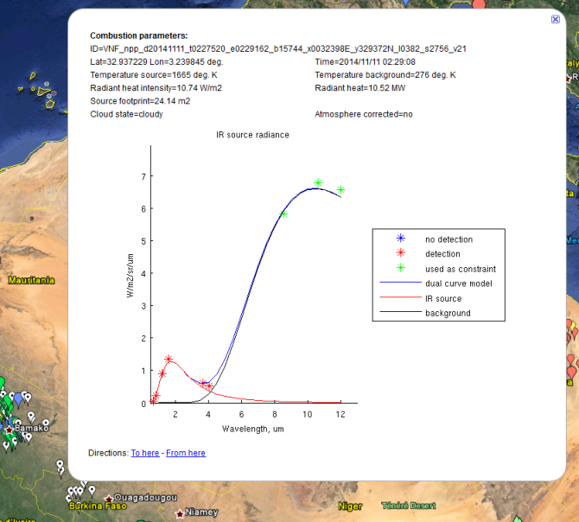
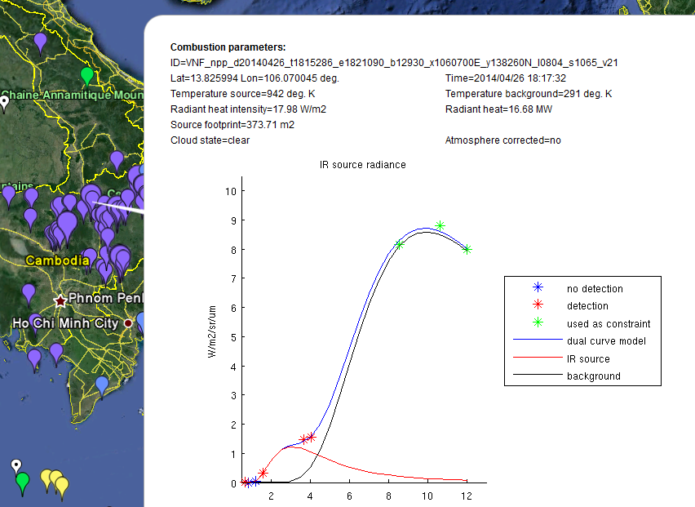
Solar / Geophysics
Earth Observations
Monitoring Urban Conditions
(Syria)
Boat Detection
VIIRS DNB
201204 = blue 201301 = green 201405 = red
VIIRS DNB
Data
Product
VIIRS
Nightfire
Applications
Global Gas Flaring
Biomass Burning
http://ngdc.noaa.gov/eog/
Notes:
Top Left - VIIRS data can be used to analyze expansion and contraction of electric power services Color composite of three monthly average DNB products (201204 = blue / 201301 = green / 201405 = red). Blue indicates power outages in 2013 and 2014. Purple indicates power outage in 2013. EOG is funded by NASA to develop algorithms and produce research quality global nighttime lights from VIIRS data.
Top Right - Automatic system to report the date, time, location and radiance of boat detections. Output as csv, kml and kmz / Kml and kmz for contrast enhanced DNB image / Prototyping was sponsored by USAID-Jakarta in support of Indonesia Ministry of Marine Affairs and Fisheries / System works well when moonlight is low / Second round of development will focus on high lunar conditions
Lower Left - VIIRS Nightfire (VNF): a global multispectral fire product with four hour temporal latency. Gas flare detections have high temperature and small source size. EOG is working on a calibration to estimate flared gas volumes worldwide. VNF was developed with funding from the JPSS Proving Ground Program.
Lower Right - Typical Biomass Burning Detection. Lower temperature and large source size as compared to gas flaring. VNF is the only global satellite fire product reporting temperature and source size.

Slide 10
END

