Slide 1
NCEI Seminar Series
GOES-R Space Weather (SWx) Mission
William Denig
NCEI/CCOG
303 497-6323
William.Denig@noaa.gov

Slide 2
GOES-R Space Weather Mission
Abstract
Space weather refers to the variable conditions on the sun, throughout space, and in the earth’s magnetic field and upper atmosphere that can influence the performance of space-borne and ground-based technological systems and endanger human life or health. Since 1974 the GOES system of spacecraft has been NOAA’s sentinel in geostationary orbit, continuously monitoring the near-earth and solar environments for hazardous space weather. These data are used within the National Weather Service’s Space Weather Prediction Center (SWPC) to assess the near-earth status of space weather and to issue, when necessary, space weather alerts, watches and warnings. The GOES-R space environmental sensors are an evolutionary improvement in capability for monitoring and forecasting space weather. However it is perhaps more appropriate to view the contributions of GOES-R within the context of NOAA’s overall space weather program. In this talk I will discuss the GOES-R space weather mission using the “real world” scenario of a severe geomagnetic storm that occurred on Saint Patrick’s Day 2015 and illustrate how various assets, including GOES, are used to better understand the drivers and consequences of space weather.

Slide 3
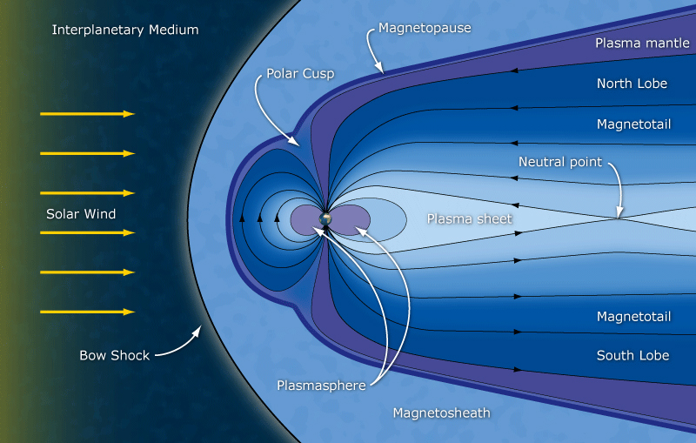
GOES-R Space Weather Mission
GOES-R is Located within the Magnetosphere
GOES-R Spacecraft Location (~6.6 R_{e})
Distance to L1 (DSCOVR): 240 R_{e} / Distance to sun: 23,481 R_{e}

Slide 4
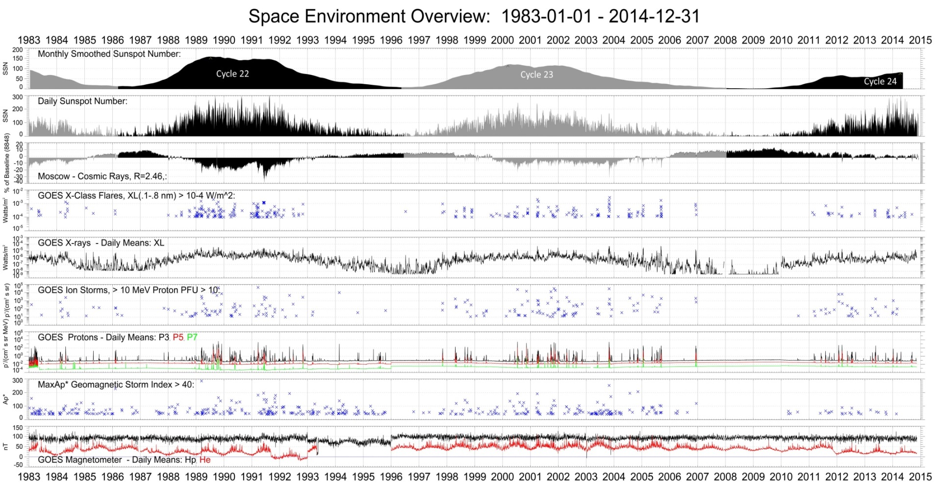
GOES-R Space Weather Mission
GOES - Maintaining a Long-term Record of SWx

Slide 5
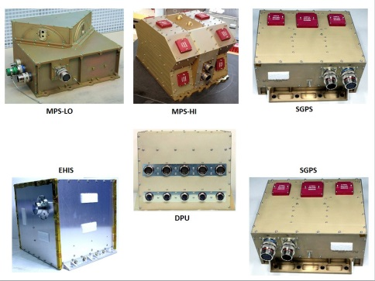
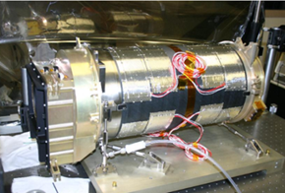
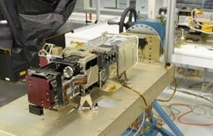
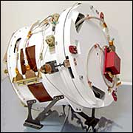
GOES-R Space Weather Mission
Sensor Overview – SEISS/SUVI/EXIS/MAG
GOES-R includes of a complement of in-situ particle/field and solar-viewing sensors providing a synoptic assessment of space weather.
SENSOR
Space Environmental In-Situ Suite (SEISS)
Solar Ultra-Violet Imager (SUVI)
EUV and X-ray Irradiance Sensors (EXIS)
Magnetometer (MAG)
IMPROVEMENT
Improved energy range / contamination rejection
Multi-wavelength solar imagery
Improved accuracy and precision
Gradiometer rejection of satellite generated fields
APPLICATION
Spacecraft charge models for electrostatic discharge
Surface features and thermal height profiles
Solar backgrounds/events impacting climate models
Geomagnetic field data with improved fidelity
SEISS
SUVI
EXIS
MAG

Slide 6
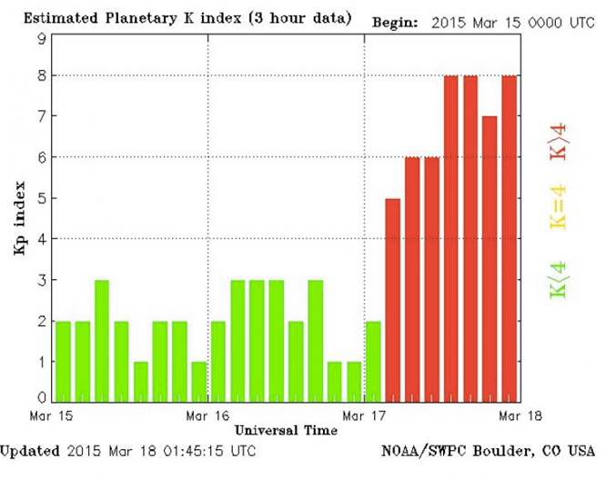
GOES-R Space Weather Mission
Saint Patrick’s Day Storm – 17 Mar 2015
Background: On 17 Mar the earth experienced a severe geomagnetic storm associated with a modest C9.1 solar flare originating from active region (AR) 2297 on 15 Mar @02:13 UT (max). The remarkable auroras resulting from this geomagnetic storm could be viewed at higher latitudes in the western hemisphere.
G4
Storm
Index

Slide 7
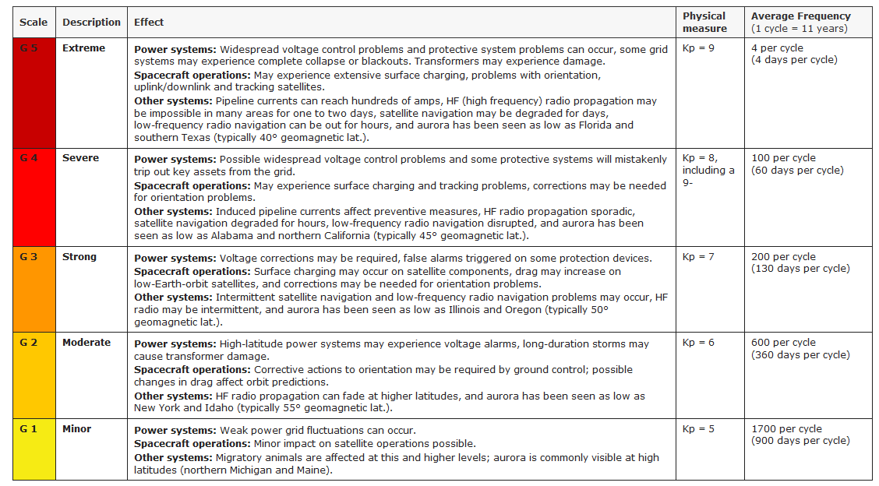
GOES-R Space Weather Mission
NOAA SWx Scales – Geomagnetic Storms
A G4 geomagnetic storm is rated as “severe” on the NOAA storm scales – Deleterious impacts to the power grids, satellite operations, and radio communications are expected. (Radio Blackouts / Solar Radiation Storm)

Slide 8
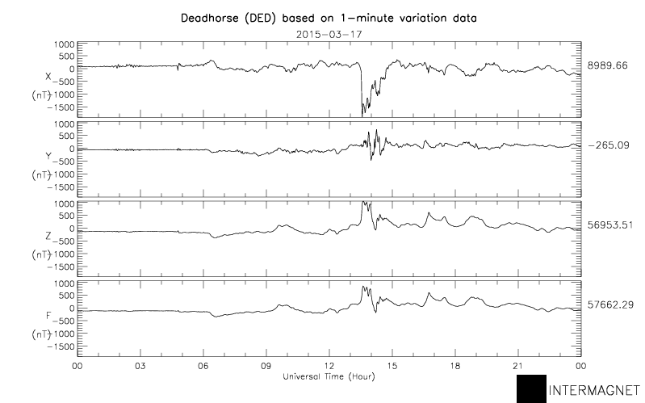
GOES-R Space Weather Mission
Kp Index is a SWx Situational Awareness Metric
Impressive deflection of the earth’s main field by ~4%
ΔB_{x}
2000 nT
ΔB_{y}
ΔB_{z}
ΔB_{T}
Shock
Arrival

Slide 9
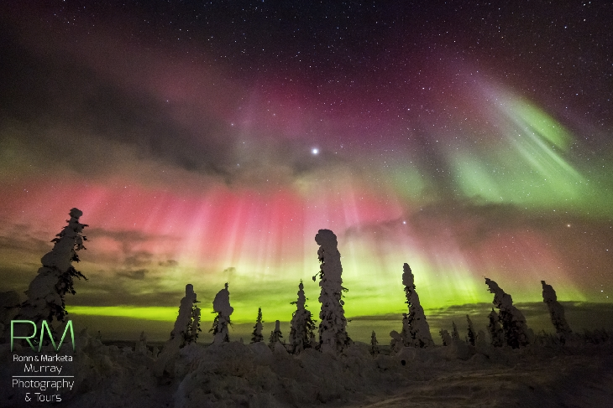
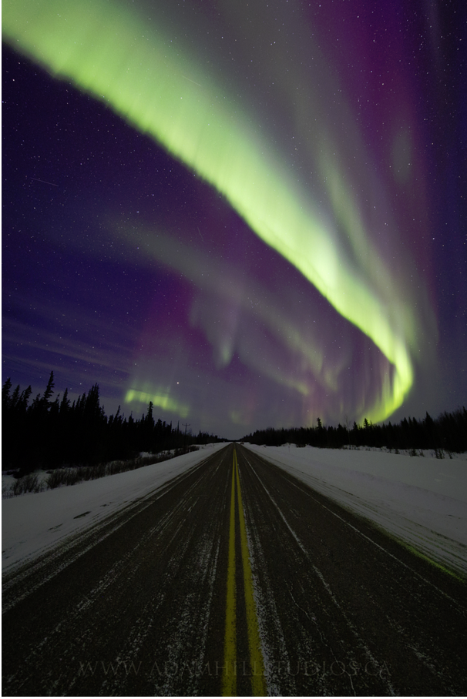
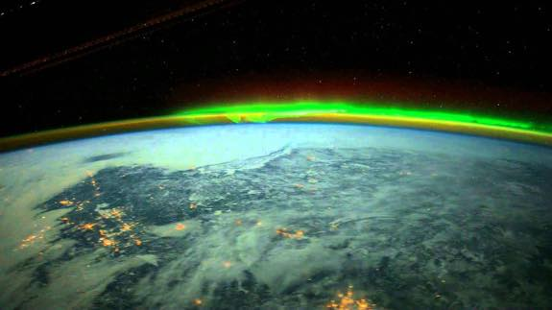
GOES-R Space Weather Mission
Auroras are a More Impressive Metric – 17 Mar
Dalton Highway Alaska
Photo by Adam Hill
Northwest Territories, Canada
Imternational Space Station

Slide 10
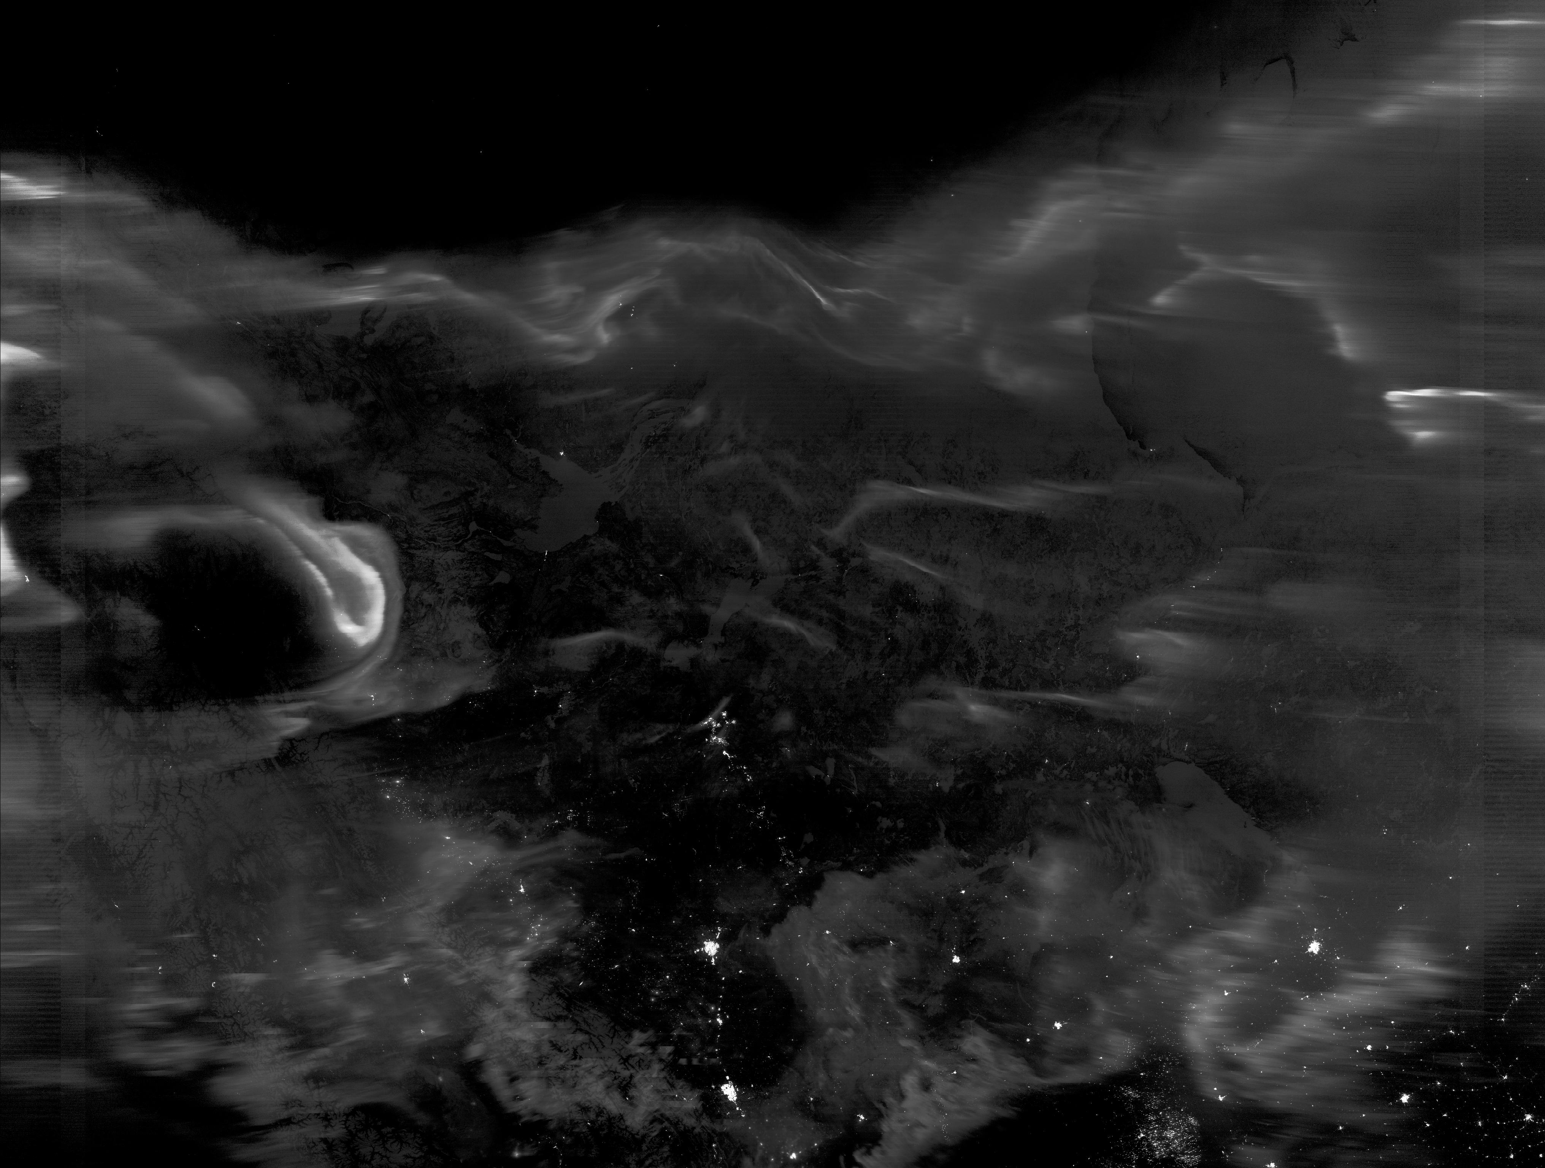
GOES-R Space Weather Mission
Aurora Over Alberta – NPP/VIIRS – 17 Mar
09:40 UT / 17 Mar 2015
Edmonton
Calgary
North Dakota

Slide 11
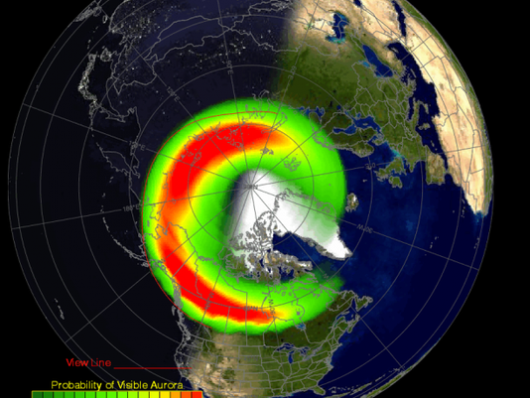
GOES-R Space Weather Mission
NOAA Predictions of Global Aurora
http://www.swpc.noaa.gov/products/30-minute-aurora-forecast

Slide 12
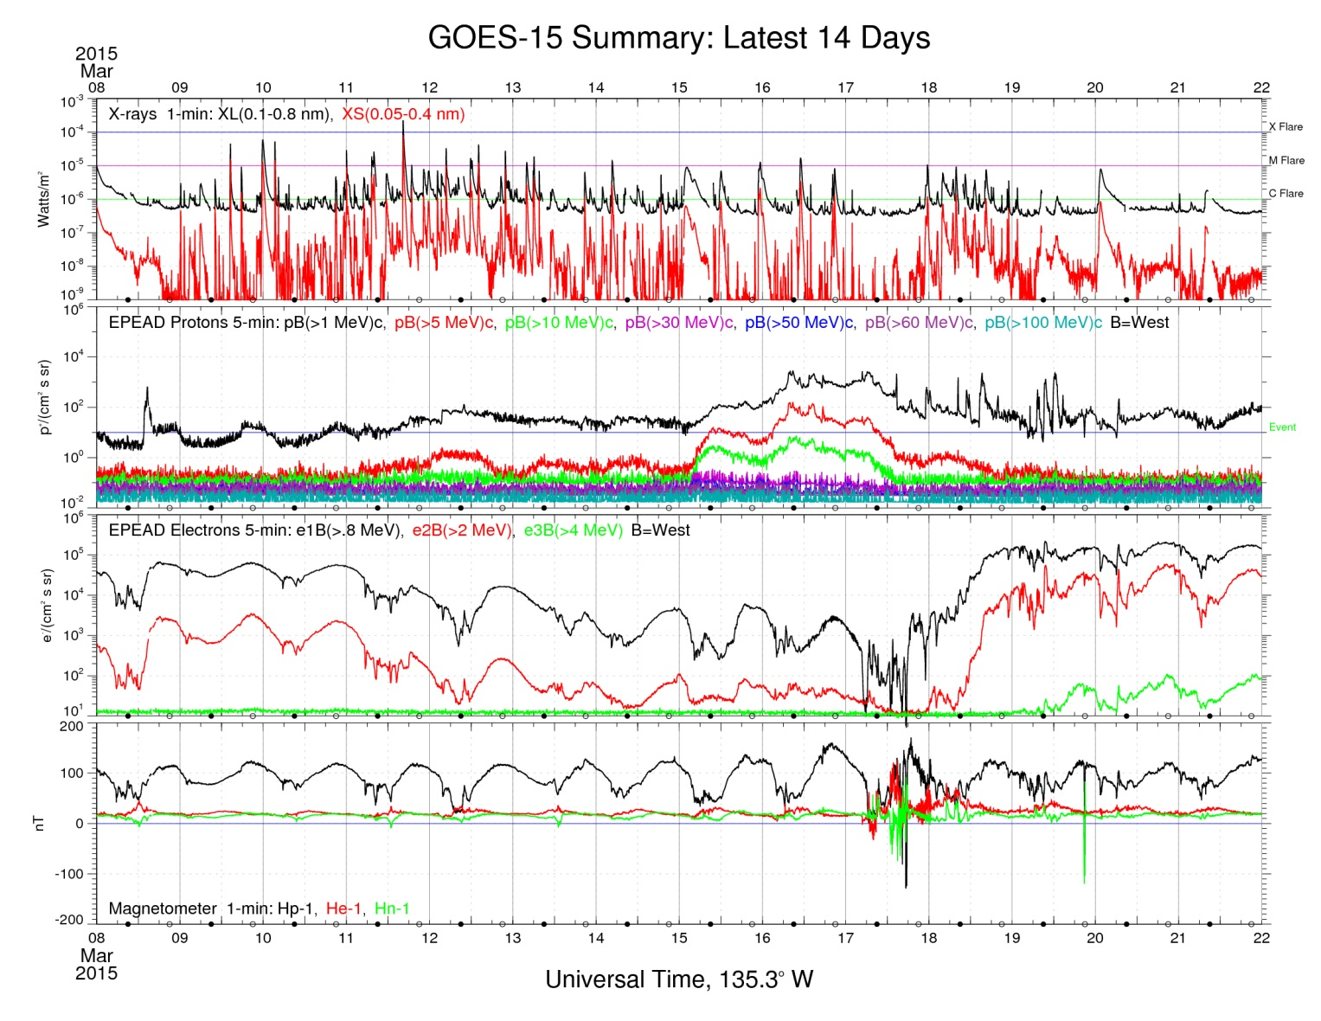
GOES-R Space Weather Mission
GOES-15 Overview of Space Weather Conditions
X-ray Flare
C9.1
-Weak-
Energetic
Protons
-Modest-
Energetic
Electrons
-Substorm-
B-Field at GEO
14-Day View
17 Mar

Slide 13
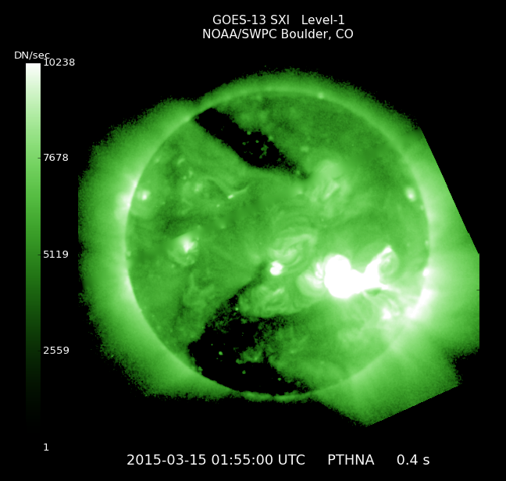
GOES-R Space Weather Mission
Let’s Back Up and Look at the Sun – 15 March
C9 flare from AR 2297 at 01:55 UT
Filter – Thin Poly (poly/Ai/Ti): 0.6 – 6 nm
Exposure: 0.4 s
GOES-13 Solar X-Ray Imager – Current Capability

Slide 14
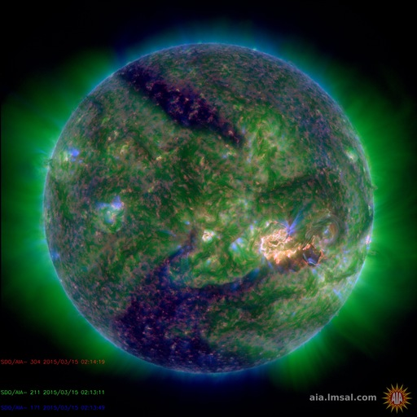
GOES-R Space Weather Mission
NASA Solar Imagery – SUVI Proxy Data
C9 flare from AR 2297 at 02:14 UT
Solar Dynamics Observatory
AIA Composite: 30.4 nm / 21.1 nm / 17.1 nm
Future Capability – GOES-R Solar UltraViolet Imager

Slide 15
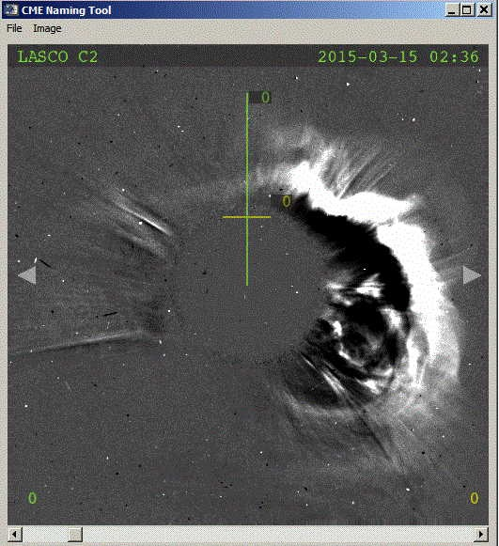
GOES-R Space Weather Mission
Coronal Mass Ejection – NASA SOHO Image
Coronal Mass Ejection (CME) detected at 02:36 on 15 Mar 2015
Occluded Sun
NOTE
NOAA plans to included a coronagraph as a part of the DSCOVR follow-on mission

Slide 16
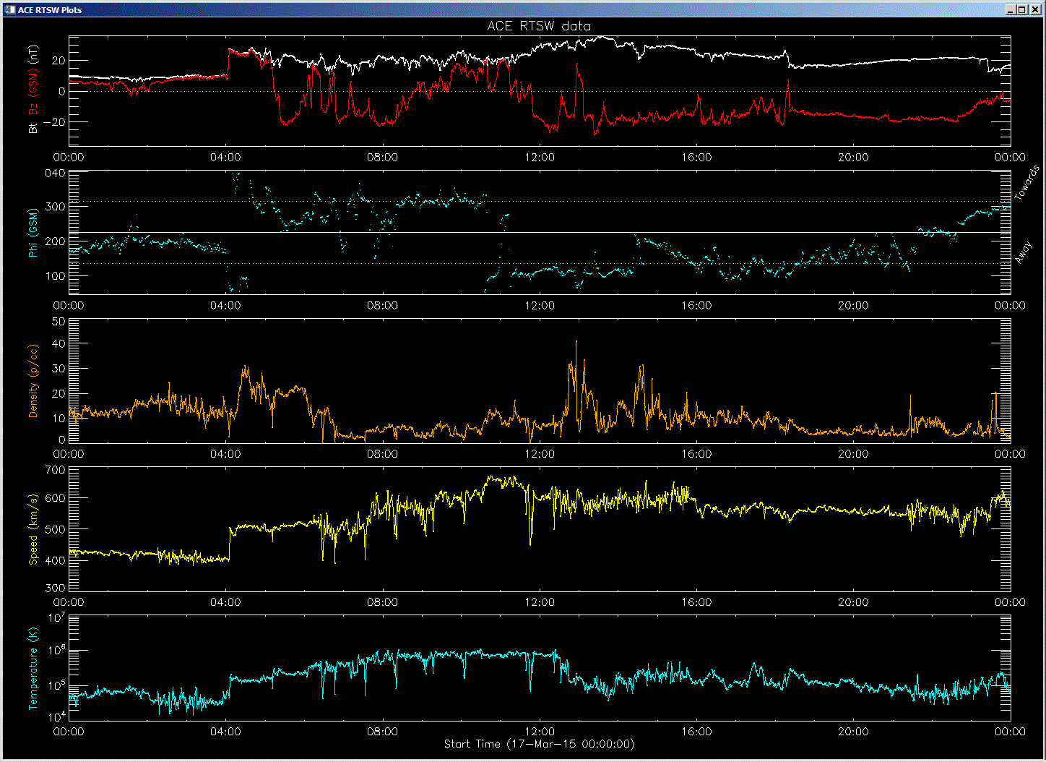
GOES-R Space Weather Mission
Solar-Wind Measurements – aka DSCOVR (ACE)
Shock arrival
Sustained B_{z} < 0
B_{z}
φ_{Β}
n_{e}
v_{SW}
T_{SW}
04:02 (L1)
11:45 (L1)
24 hours of Interplanetary Data (@240 Re)
Note: Add ~30 minutes to account for transit time (L1 to earth)

Slide 17
GOES-R Space Weather Mission
Monitoring the Magnetopause Location
Just after 12:00 UT on Mar 17th the GOES-13 spacecraft left the protective bubble of the magnetosphere and was exposed to interplanetary space. MAG fluctuations indicate crossing of the earth’s magnetopause.

Slide 18
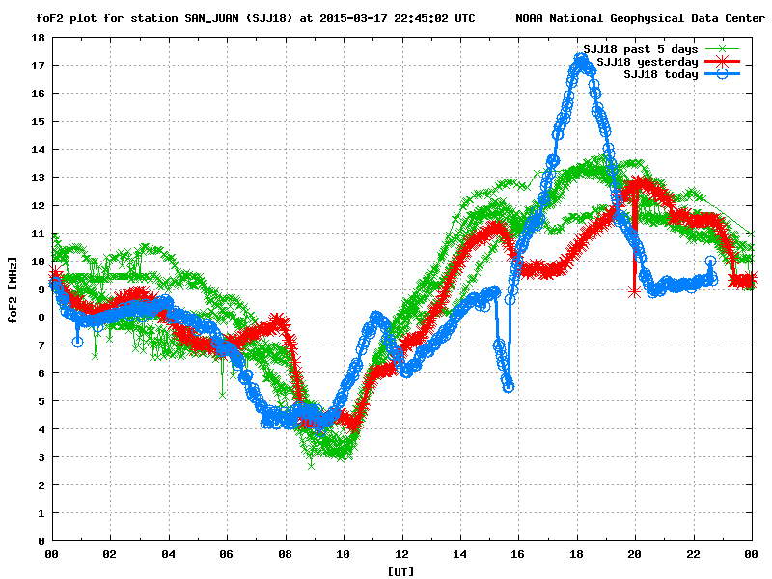
GOES-R Space Weather Mission
Ionospheric Sounding – San Juan
Ionospheric
Enhancement
Ionospheric
Dropout

Slide 19
GOES-R Space Weather Mission
US Total Electron Content (US-TEC)
Data Driven Models of the Ionosphere:
Ionospheric density gradients are interesting but not striking
Modest increase in radiowave absorption for HF users

Slide 20
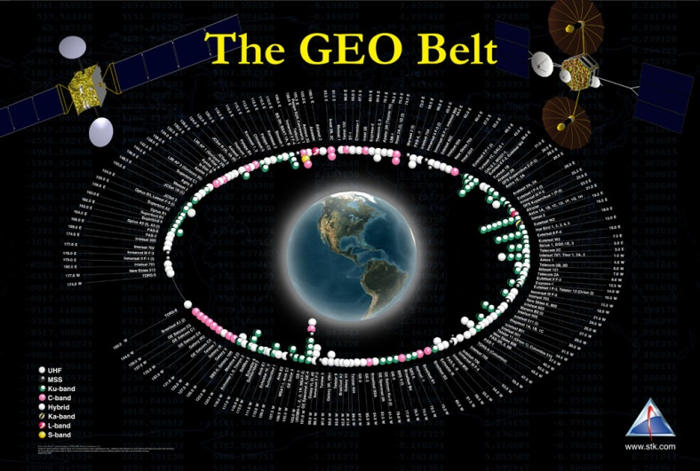
GOES-R Space Weather Mission
Concluding Thoughts
Today’s Technology Infrastructure is Vulnerable to Space Weather (SWx)
Satellite Systems (Galaxy-15)
Power Grids (March 1989)
Manned Spaceflight (EVA)
Radio Communications (Polar Flights)
GOES-R is a Key Component of NOAA’s SWx Program
Continuing a 40-year Tradition
In-situ / Remote Sensing
Improved Sensors/Capabilities
Launch – 1QFY17

