Slide 1
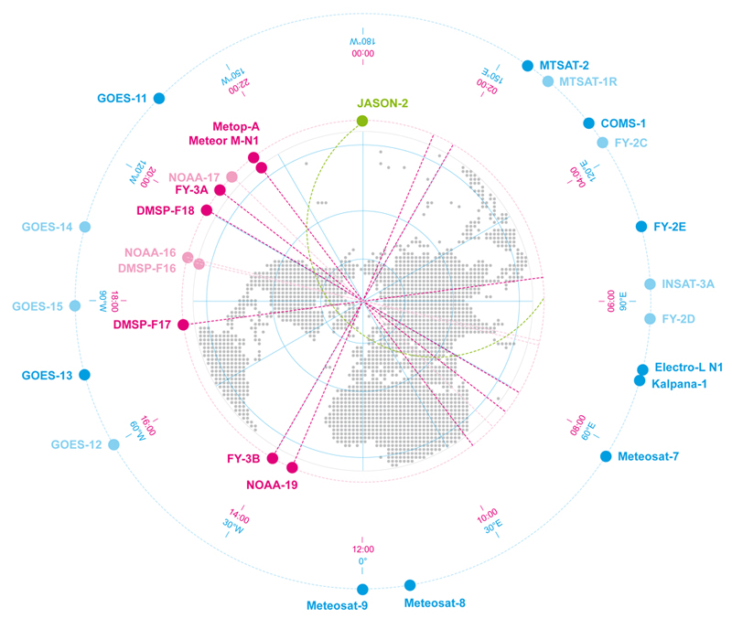
Spacecraft Anomaly Database NOAA
Presented to CGMS-43 ad-hoc meeting on space weather, agenda item [3]
William Denig
NOAA National Centers for Environmental Information (NCEI)

Slide 2
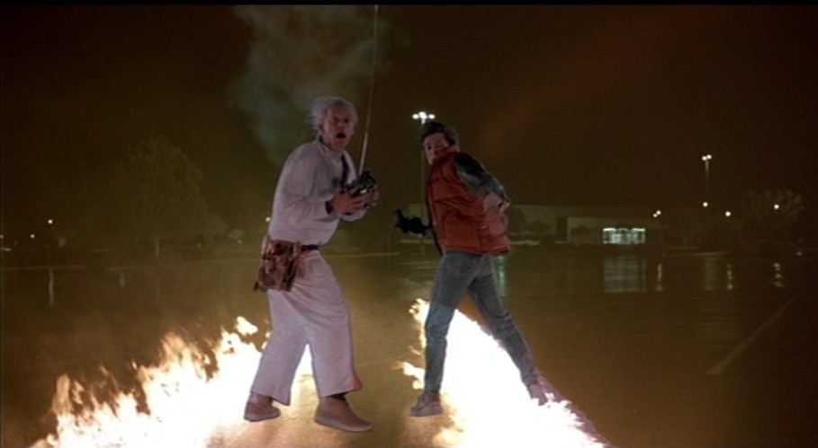
Prior to 1993 the NOAA National Geophysical Data Center¹ (NGDC) managed a spacecraft anomaly database. The success of this database was the personal trust placed in the manager to safeguard technical information provided by numerous satellite operators.
Is it possible to re-establish this trust within NOAA or within another 3rd party organization?
¹In April 2015 the NOAA data centers, including NGDC, merged to become the National Centers for Environmental Information (NCEI).

Slide 3
NOAA Spacecraft Anomaly Database (1984-1993)
A database of spacecraft anomalies was established within the Solar-Terrestrial Physics (STP) Division of the National Geophysical Data Center in 1984. Information included the date, time, location, and other pertinent information about incidents of spacecraft operational irregularity due to the environment. The events ranged from minor operational problems which can be easily corrected to permanent spacecraft failures. The data base included spacecraft anomalies in interplanetary space and in near-earth orbit but the main contributions were from geostationary spacecraft.
Many spacecraft were identified by aliases in order to preserve confidentiality which were prefaced with the "@" character.
The original database exists and is still available online to the user community. The data contained in the database is woefully out of date.
Joe Allen
STP Chief
1981-1995
www.ngdc.noaa.gov/stp/satellite/anomaly/
Notes:
SPACECRAFT ANOMALY DATA FORMAT
Version 5 / September 2, 1988
Column Fmt Description
----------------------------------------------------------------------------
1 A1 Format version.
2- 9 I8 Date that this anomaly report was entered (CCYYMMDD)
10- 19 A10 Spacecraft identification, i.e GOES-2, @AA0301, @AA0302.
Alias spacecraft identifications should be 7 digits:
1 = @, Digit 2-3 = Contributors ID,
4-5 = spacecraft family, 6-7 = sequence # within the family.
20- 27 I8 Date of anomaly (CCYYMMDD Universal Time)
28- 31 A4 Start time of anomaly, 9999 = no time (HHMM Universal Time)
32- 34 I3 Uncertainty in time (Minutes)
35- 38 I4 Duration (Minutes)
39- 42 A4 Time of anomaly (HHMM Local Time)
43 A1 Orbit type, G= geostationary, P= polar circular,
E= elliptical, I= inclined, etc.
44 A1 N= North, S= South for following latitude, blank => no Lat.
45- 46 I2 Geographic latitude of sub-orbit point at anomaly start.
47- 48 I2 Uncertainty in latitude (Degrees)
49 A1 E= east, W= west for following longitude, blank => no Lat.
50- 52 I3 Geographic longitude of sub-orbit point at anomaly start.
53- 54 I2 Uncertainty in longitude (Degrees)
55- 59 I5 Altitude (Kilometers)
60- 64 A5 Anomaly type, what was the anomalous behavior?
The coded definitions will evolve as needed.
PC : Phantom Command - uncommanded status change.
PF : Part Failure.
TE : Telemetry Error.
SE : Soft Error, recoverable bit flip type error.
HE : Hard Error, permanent chip damage or Latch-Up.
SS : System Shutdown.
ESDM : ElectroStatic Discharge Measured (SCATHA specific).
ATT : Attitude Control Problem.
UNK : Unknown.
65- 69 A5 Anomaly diagnosis, what type of event caused the anomaly?
The coded definitions will evolve as needed.
ECEMP : Electron Caused ElectroMagnetic Pulse.
Internal, Deep dielectric charging
ESD : ElectroStatic Discharge.
Surface charging
SEU : Single Event Upset, Solar or Galactic Cosmic Rays.
MCP : Mission Control Problem, human induced or software
error.
RFI : Radio Frequency Interference.
UNK : Unknown diagnosis.
70-148 A79 Comment related to the anomaly
149-151 I3 Sun-Vehicle-Earth angle in degrees.
152 A1 S = spin stabilized, A = 3-Axis stabilized.

Slide 4
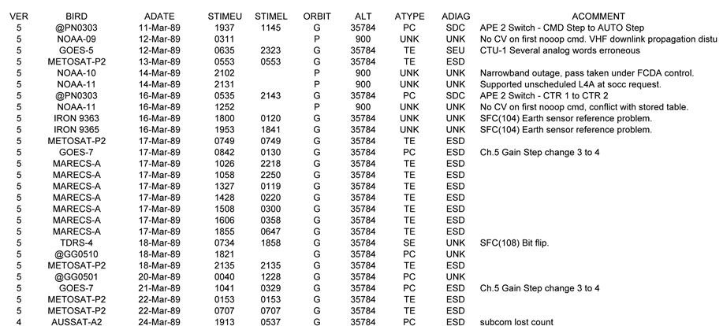
Sample of data contained in the NOAA Spacecraft Anomaly Database. This time interval includes the March 1989 great geomagnetic storm.

Slide 5
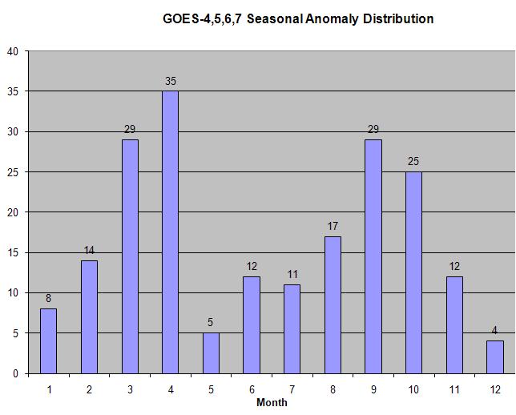
Applications for a Spacecraft Anomaly Database
“GOES Example”
Spatial distribution of GOES 4/5 anomalies at fixed local times
Seasonal distribution of GOES 4-7 spacecraft anomalies

Slide 6
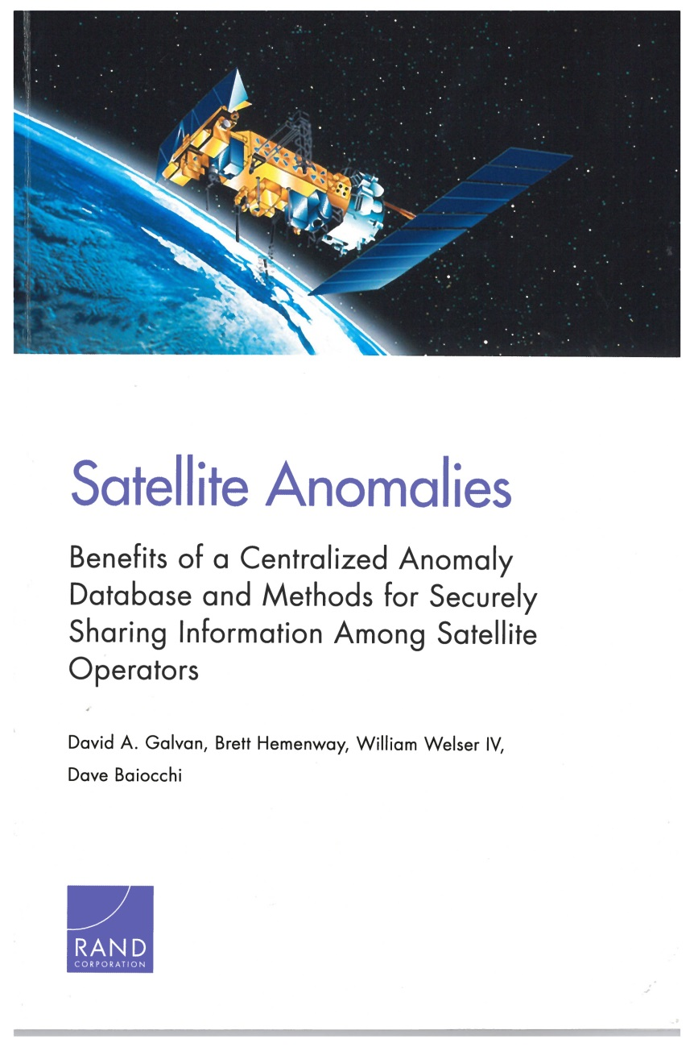
Satellite Anomalies – Benefits of a Centralized Database and Methods for Securely Sharing Information Among Satellite Operators (2014)
Book Review by W. Denig, R. Redmon, J. Rodriguez and J. Allen
“The authors point out that while satellite operators generally acknowledge the benefits of a centralized anomaly database, many are reluctant to readily contribute information to a shared database due to concerns about the inadvertent release of sensitive details regarding the performance and integrity of their respective satellite systems. The main conclusion of the volume is that a secure anomaly database that safeguards the identity of the contributor by taking advantage of modern cryptographic approaches could potentially alleviate proprietary concerns and lead to overall improved satellite operations.”
Book: http://www.rand.org/pubs/research_reports/RR560.html
Review: http://onlinelibrary.wiley.com/doi/10.1002/2014SW001100/abstract

Slide 7
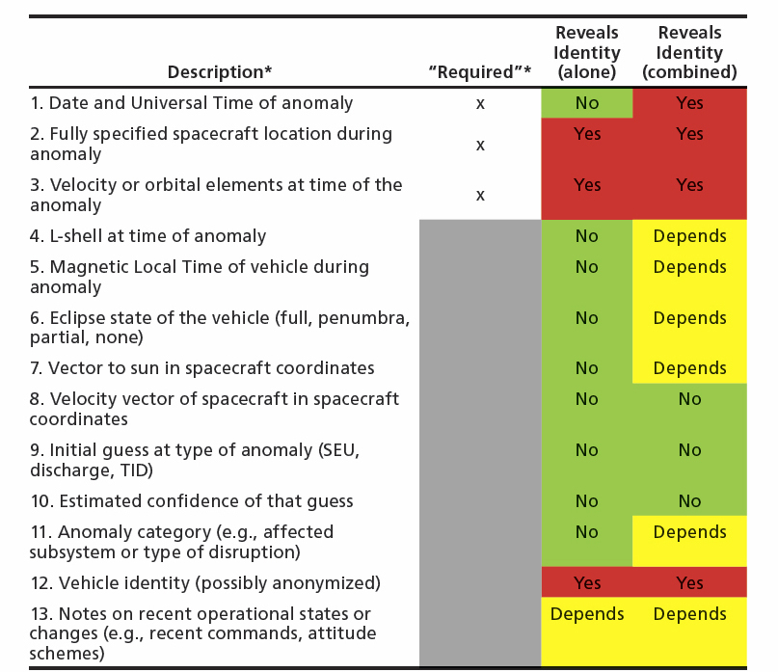
In the table to the right (after O’Brien et al [2011]), the authors list critical information that would be required in an anomaly database. They also provide an assessment as to whether the individual items in the contents of the database could be used, in principle, to reveal the identity of an anonymous source.
The authors offer potential solutions to the reluctance of satellite operations reporting anomalies by either relying on the integrity of a “trusted third party” to safeguard sensitive information or by taking advantage of modern crypto--graphic technologies which shield providers and users from unwarranted information “leakage.”
Reference: O’Brien, Paul, Joseph E. Mazur and Timothy B. Guild, Recommendations for Contents of Anomaly Database for Correlation with Space Weather Phenomena, El Segundo, Calif.: Aerospace Corporation, TOR-2011(3903)-5, November 10, 2011.
Recommended information to be included in a modern anomaly database, including information that potentially can divulge the source.

Slide 8
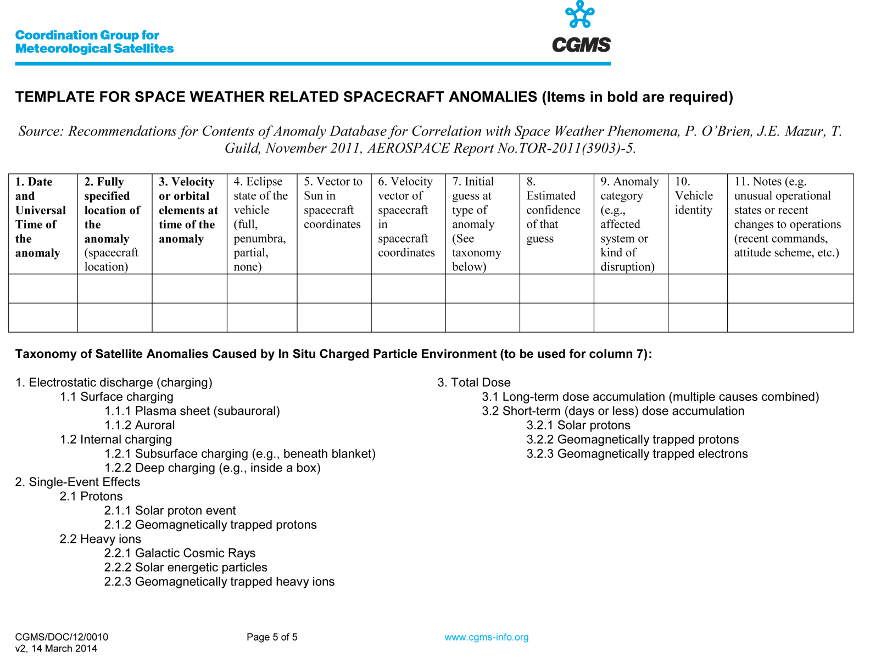
CGMS has taken the first step

Slide 9
White Paper
NCEI Spacecraft Anomaly
Mitigation Program
NOAA will enhance its spacecraft anomaly mitigation program starting in FY15 by improving the identification and classification of space weather induced spacecraft anomalies in accordance with the recommendations of the CGMS and the guidelines proposed by COPUOS.
Program Goals¹:
FY15 – Review and seek to improve the state of anomaly reporting procedures in accordance with the recommendations and proposed guidelines of the CGMS and COPUS.
FY16 – Develop the Satellite Anomaly Information System (SAIS) web portal.
FY17 – Transition, as appropriate, SAIS into an operational real-time support product.
Evolving - Develop a satellite anomaly database to assemble information regarding the occurrence of satellite anomalies and their impact on operations.
¹Pending availability of funds.

Slide 10
Concluding Thoughts:
Satellite manufacturers/operators have expressed keen interest in re-establishing a spacecraft anomaly database (reference)
Community members must be willing to share information with assurances that proprietary information is safeguarded (reference)
A “trusted agent” approach is the most straightforward approach and has precedence (reference)
Recommended Actions:
CGMS can play a key role by encouraging members to contribute to an initial spacecraft anomaly database hosted by a member organization or third-party
CGMS should establish a working group to solicit the participation of commercial satellite operators such as the Space Data Association
NOAA should pursue its enhanced Spacecraft Anomaly Mitigation Program

