Slide 1
National Centers for Environmental Information (NCEI)
NOAA Environmental Satellite Measurements of Extreme Space Weather Events
W.F. Denig¹, D.C. Wilkinson¹ and R.J. Redmon¹
¹NOAA National Centers for Environmental Information
AGU Fall 2015
SM32A-01
1
Notes:
1

Slide 2
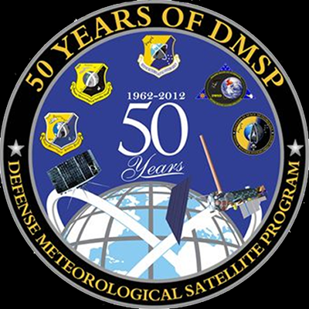
SM32A-01 – Abstract
For over 40 years the National Oceanic and Atmospheric Administration (NOAA) has continuously monitored the near-earth space environment in support of space weather operations. Data from this period have covered a wide range of geophysical conditions including periods of extreme space weather such as the great geomagnetic March 1989, the 2003 Halloween storm and the more recent St Patrick’s Day storm of 2015. While not specifically addressed here, these storms have stressed our technology infrastructure in unexpected and surprising ways. Space weather data from NOAA geostationary (GOES) and polar (POES) satellites along with supporting data from the Air Force are presented to compare and contrast the space environmental conditions measured during extreme events.
2

Slide 3
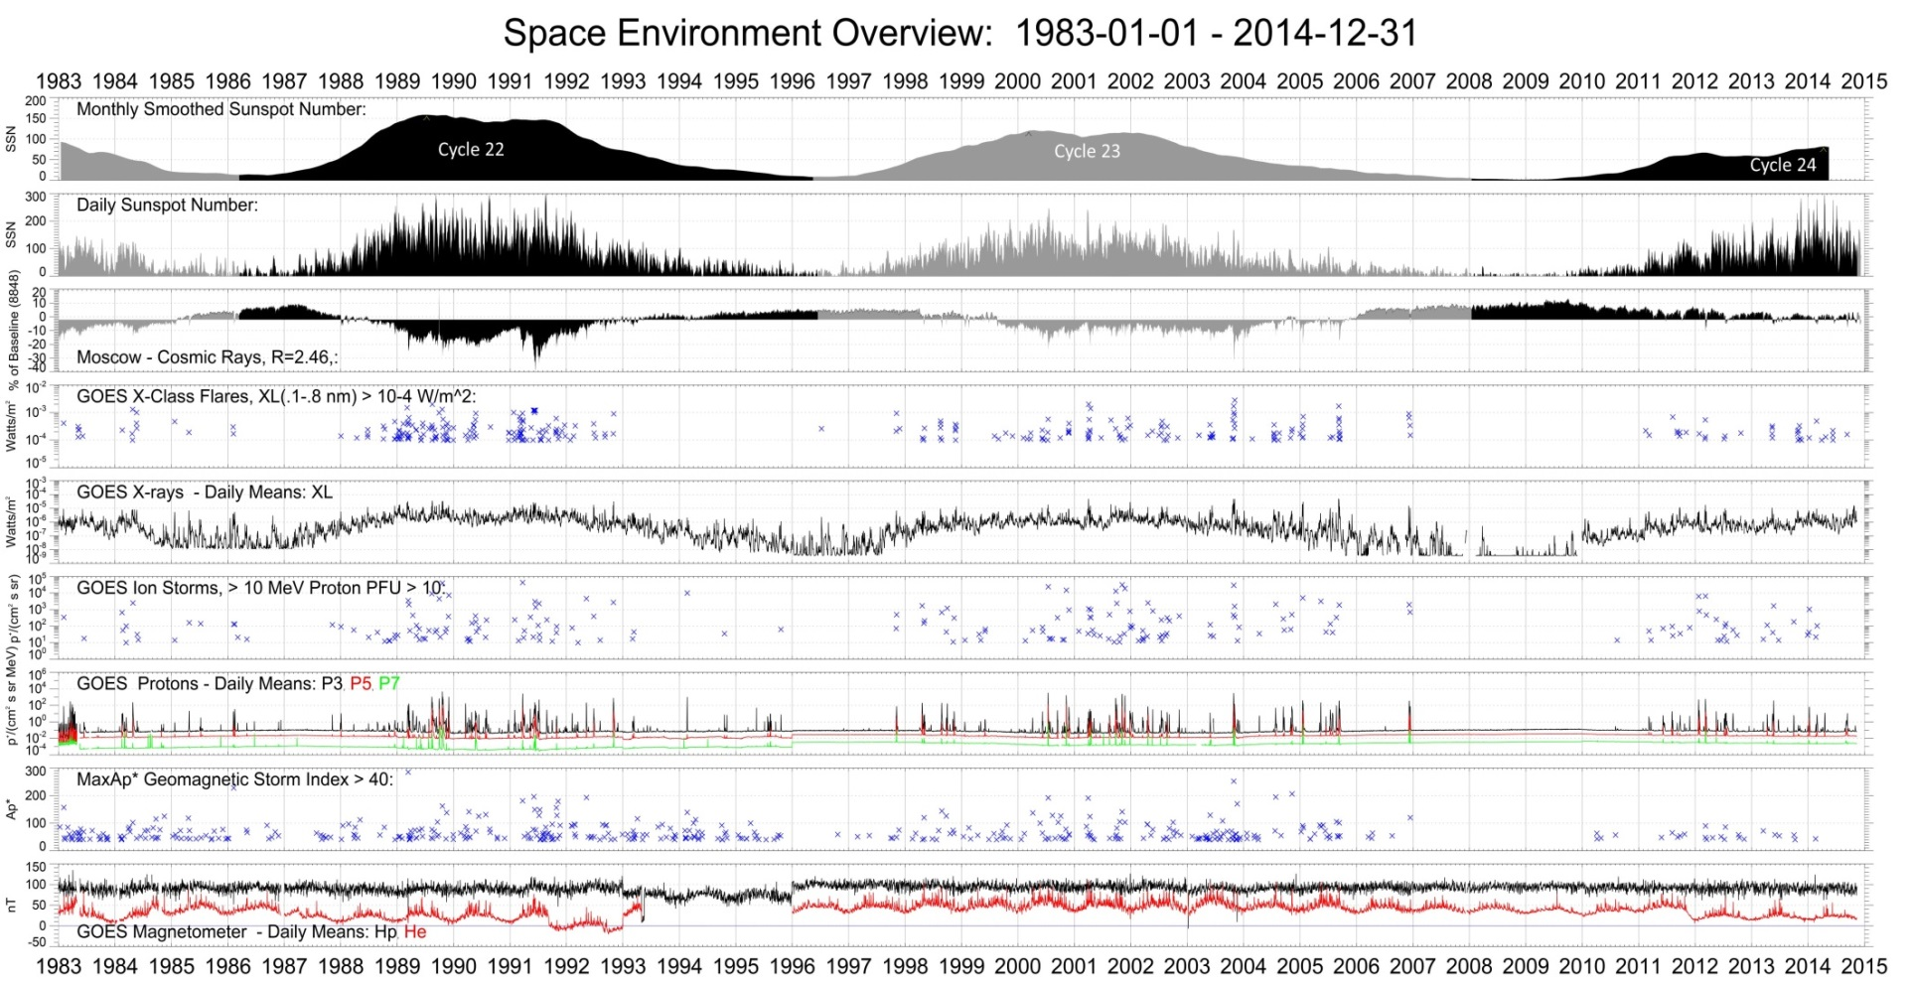
GOES Overview (1983 – 2014)
Red Lines:
Mar 1989
Jul 2000
Oct 2003
Notes:
CMG works with scientists and observing programs from all of NOAA’s LOs.
CMG develops operational magnetic and elevation models for the U.S. DoD, NATO, NWS, FAA, NOAA, and the commercial transportation industry.
CMG develops improved and updated seamless digital elevation models as called for in the National Ocean Policy to support better coastal flood forecast and community mitigation efforts.
CMG supports better coordination and collaboration on federal ocean mapping data collection, use and re-use of data.
CMG operates the International Hydrographic Office’s Data Center for Digital Bathymetry (IHO DCDB).

Slide 4
NOAA Extreme Space Wx
http://www.swpc.noaa.gov/noaa-scales-explanation

Slide 5
Extreme Events
Extreme Event | G-scale | R-scale | S-scale | Kp | Ap* | X-ray | SPE (pfu)
01-Aug – 14-Aug 1972 | G4 | >R3 | ~S5 | 8o | 223 | >X5¹ | 90000²
10-Mar – 15-Mar 1989 | G5 | R5 | S3 | 9o | 285 | X15 | 3500
26-Sep – 31-Sep 1989 | G3 | R3 | S3 | 7o | 104 | X9 | 4500
18-Oct – 31-Oct 1989 | G4 | R4 | S4 | 8+ | 162 | X13 | 40000
22-Mar – 28-Mar 1991 | G5 | R3 | S4 | 9o | 181 | X9 | 43000
01-Jun – 20-Jun 1991 | G5 | R4 | S3 | 9o | 196 / 149 | X12 / X12 | 3000 / 1400
14-Jul – 16-Jul 2000 | G5 | R3 | S4 | 9o | 192 | X5 | 24000
04-Nov – 08-Nov 2001 | G4 | R3 | S4 | 9- | 141 | X1 | 31,700
10-Oct – 06-Nov 2003 | G5 | R4/R5 | S4 | 9o | 252 | X17 / X28 | 29500 / 353
15-Jan – 24-Jan 2005 | G4 | R3 | S3 | 8o | 91 | X2 | 5040
05-Dec – 17-Dec 2006 | G4 | R3 | S3 | 8+ | 120 | X9 | 1980
08-Mar – 17-Mar 2012 | G4 | R3 | S3 | 8o | 90 | X5 | 6530
¹SOLRAD9 (Dere et al. [1973]) // ²IMP6 (Kohl et al. [ 1973]) // See UAG-28 – NGDC[1973]
Notes:
1 pfu (proton flux unit) = 1 /cm**2-ster-sec

Slide 6
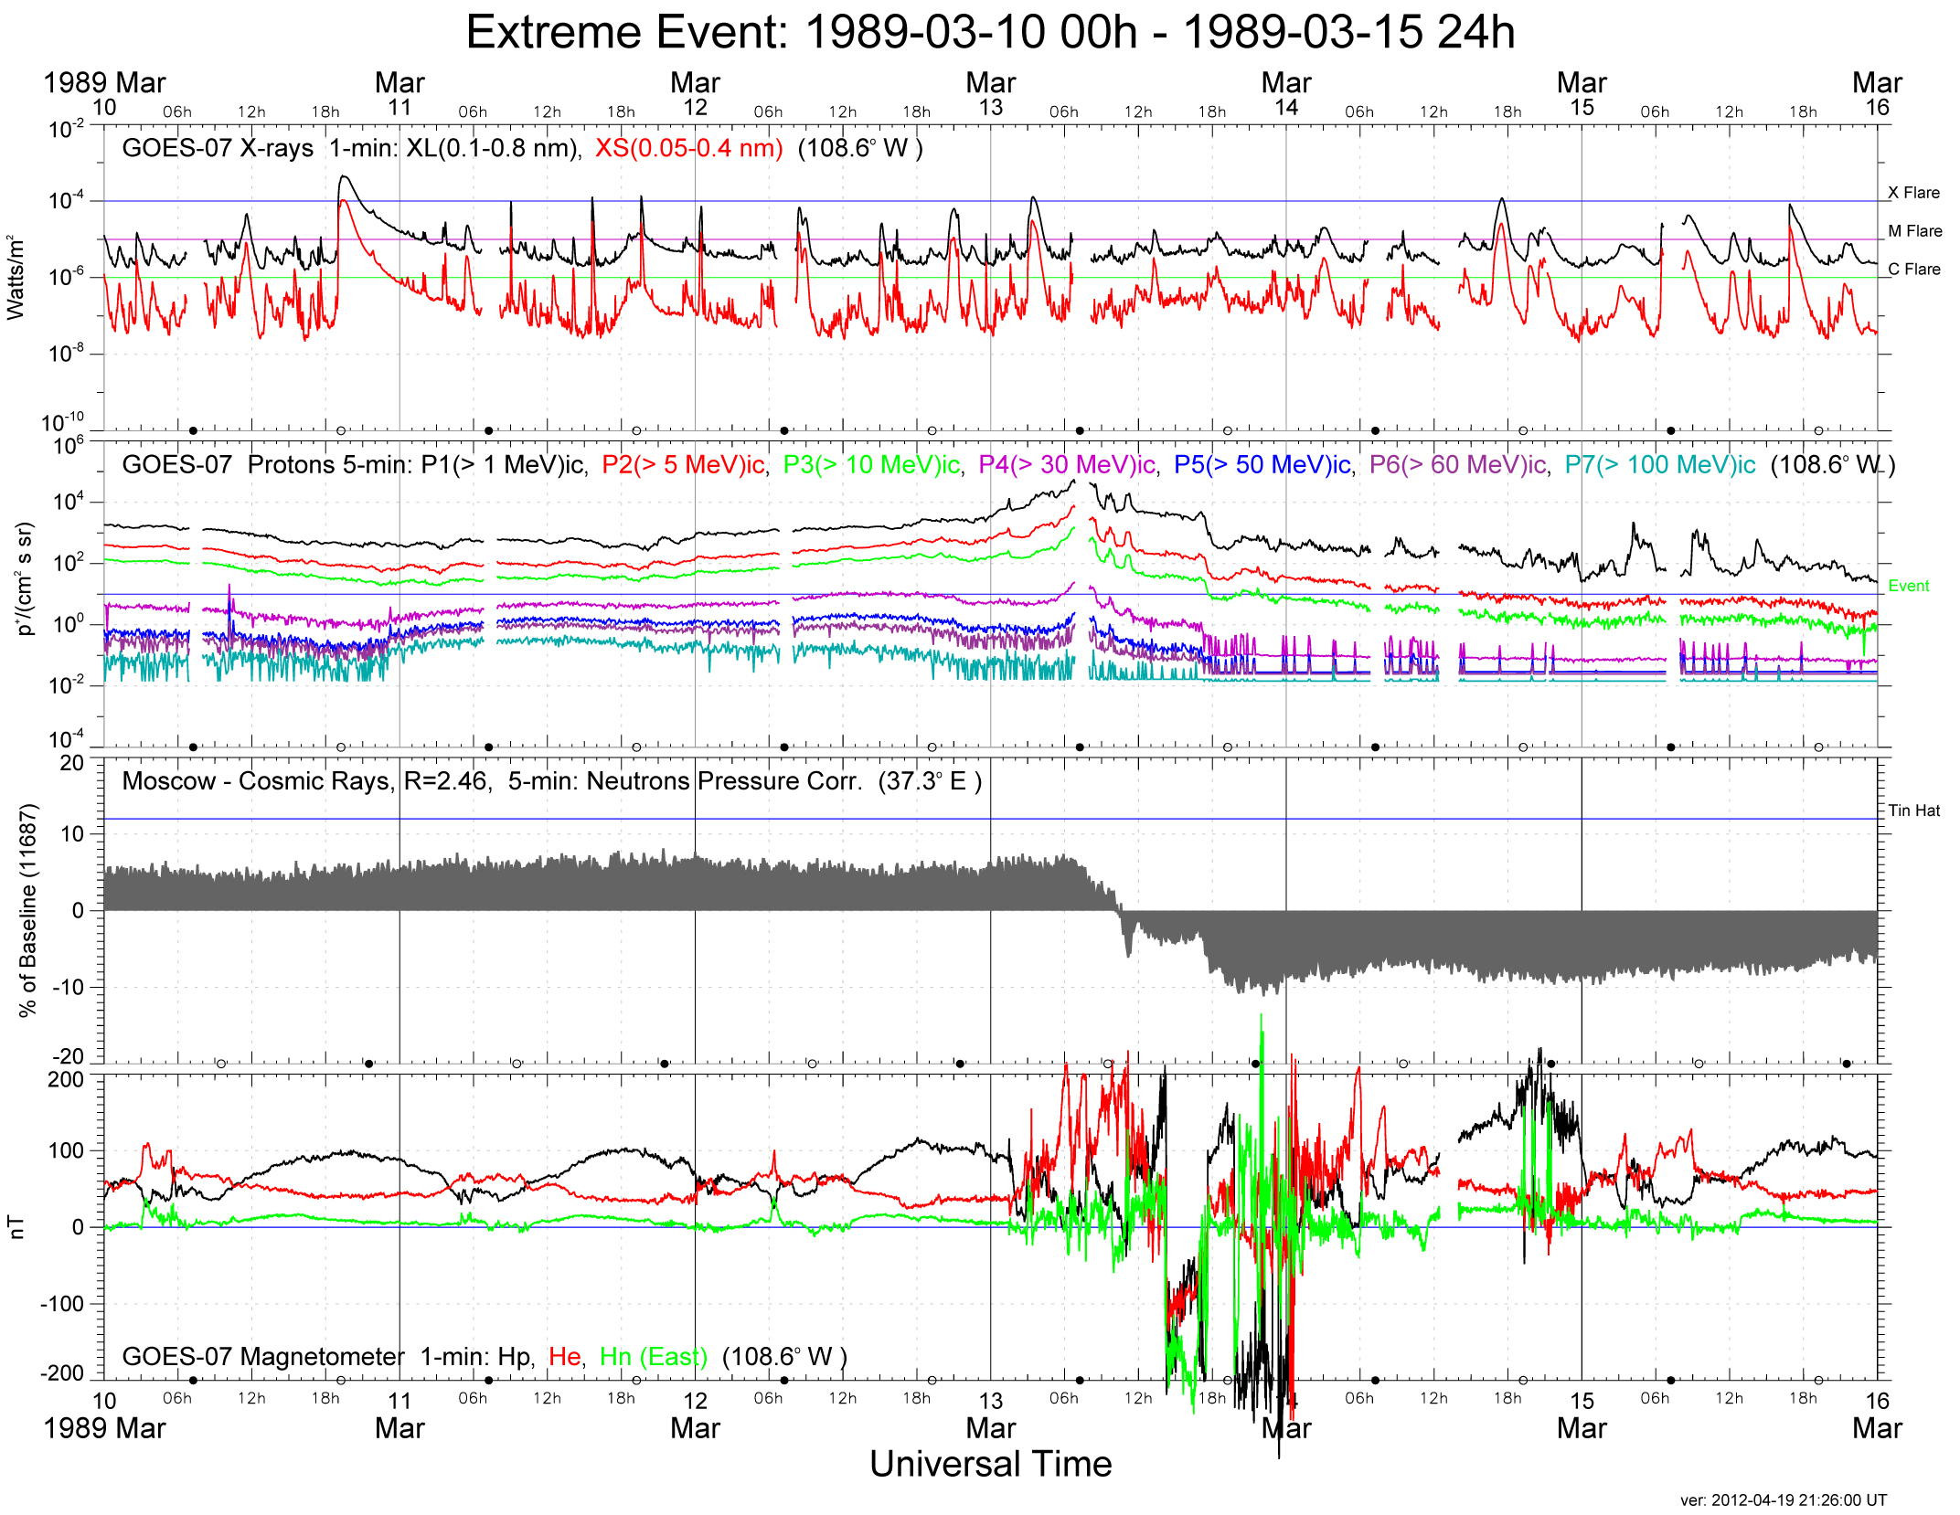
10-15 Mar 1989
R5

Slide 7
10-15 Mar 1989
R5
S3

Slide 8
10-15 Mar 1989
R5
S3
G5

Slide 9
10-15 Mar 1989
R5
S3
G5
Forbush
Decrease
DMSP

Slide 10
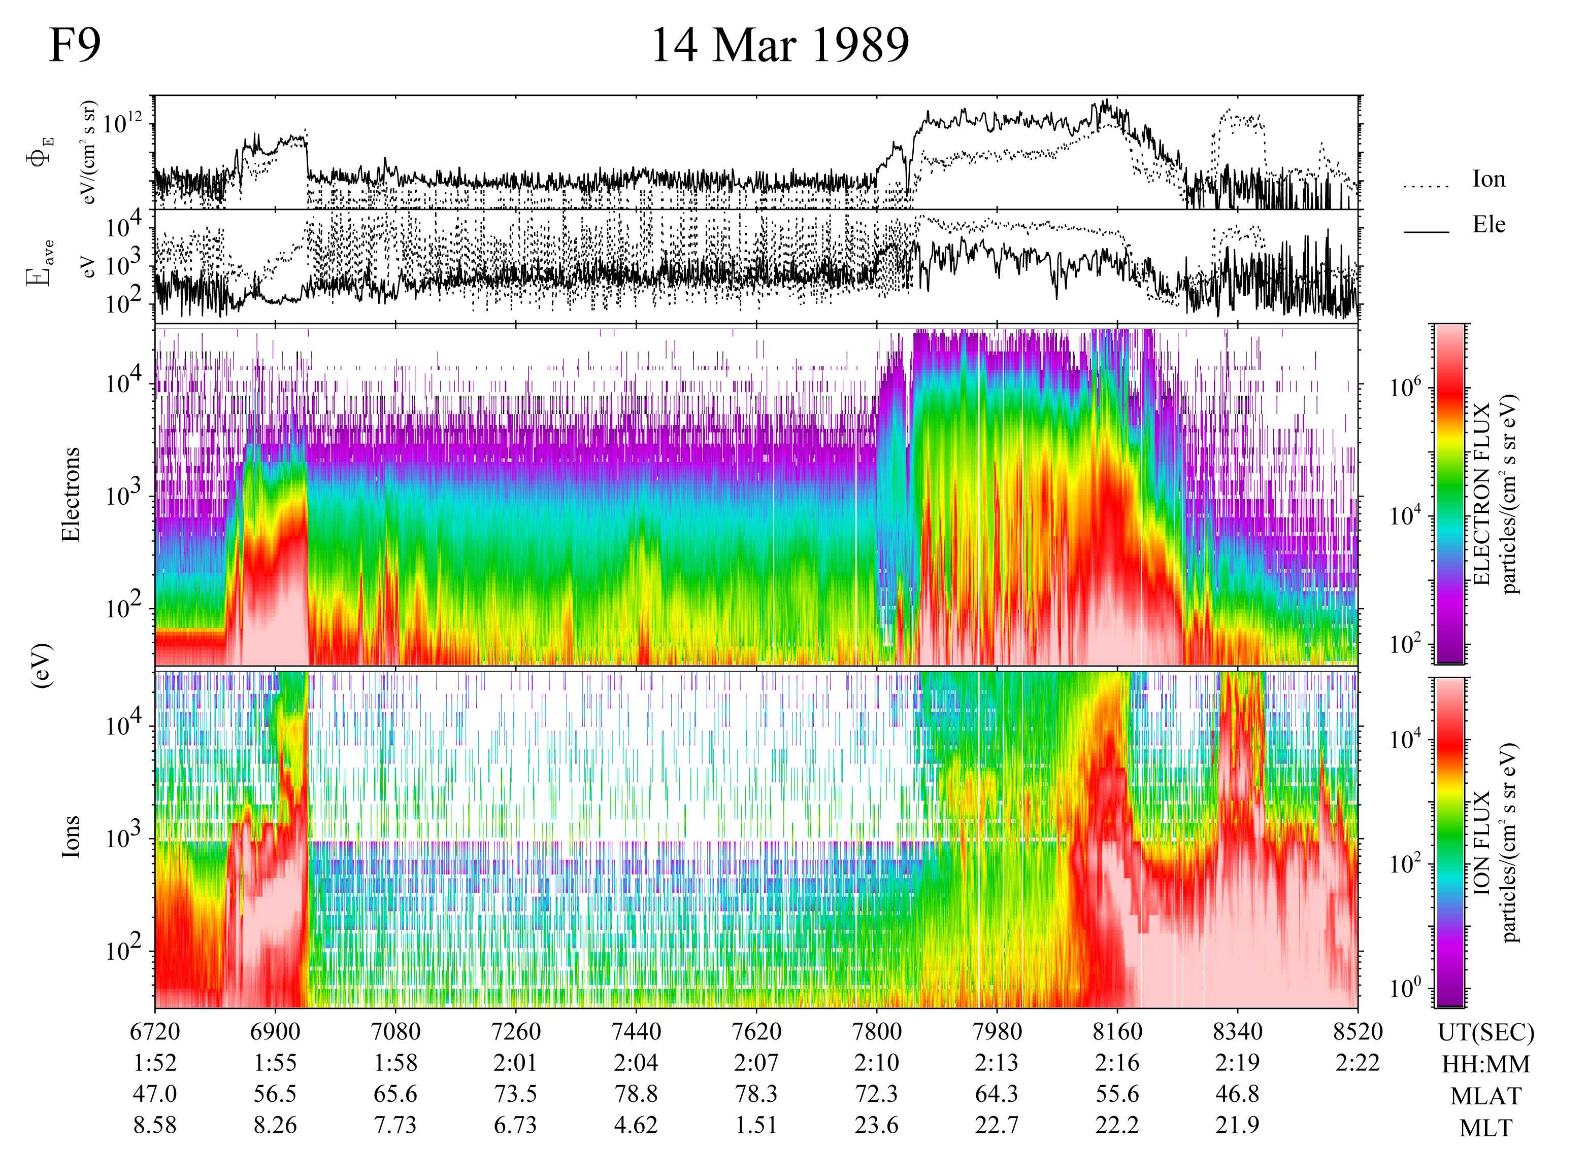
10-15 Mar 1989
AB = 51.8º MLAT
AB = 51.6º MLAT
Take Aways:
Flare Class: X15
SPE: Slow rise
Forbush decrease
Expanded auroral zone
Kezhma, Russia (λ = 58.7º)
(Krasnsyarsk Krai)
Washington D.C. (λ = 38.9º)
Boston (λ = 42.4º)
Montreal (λ = 45.5º)

Slide 11
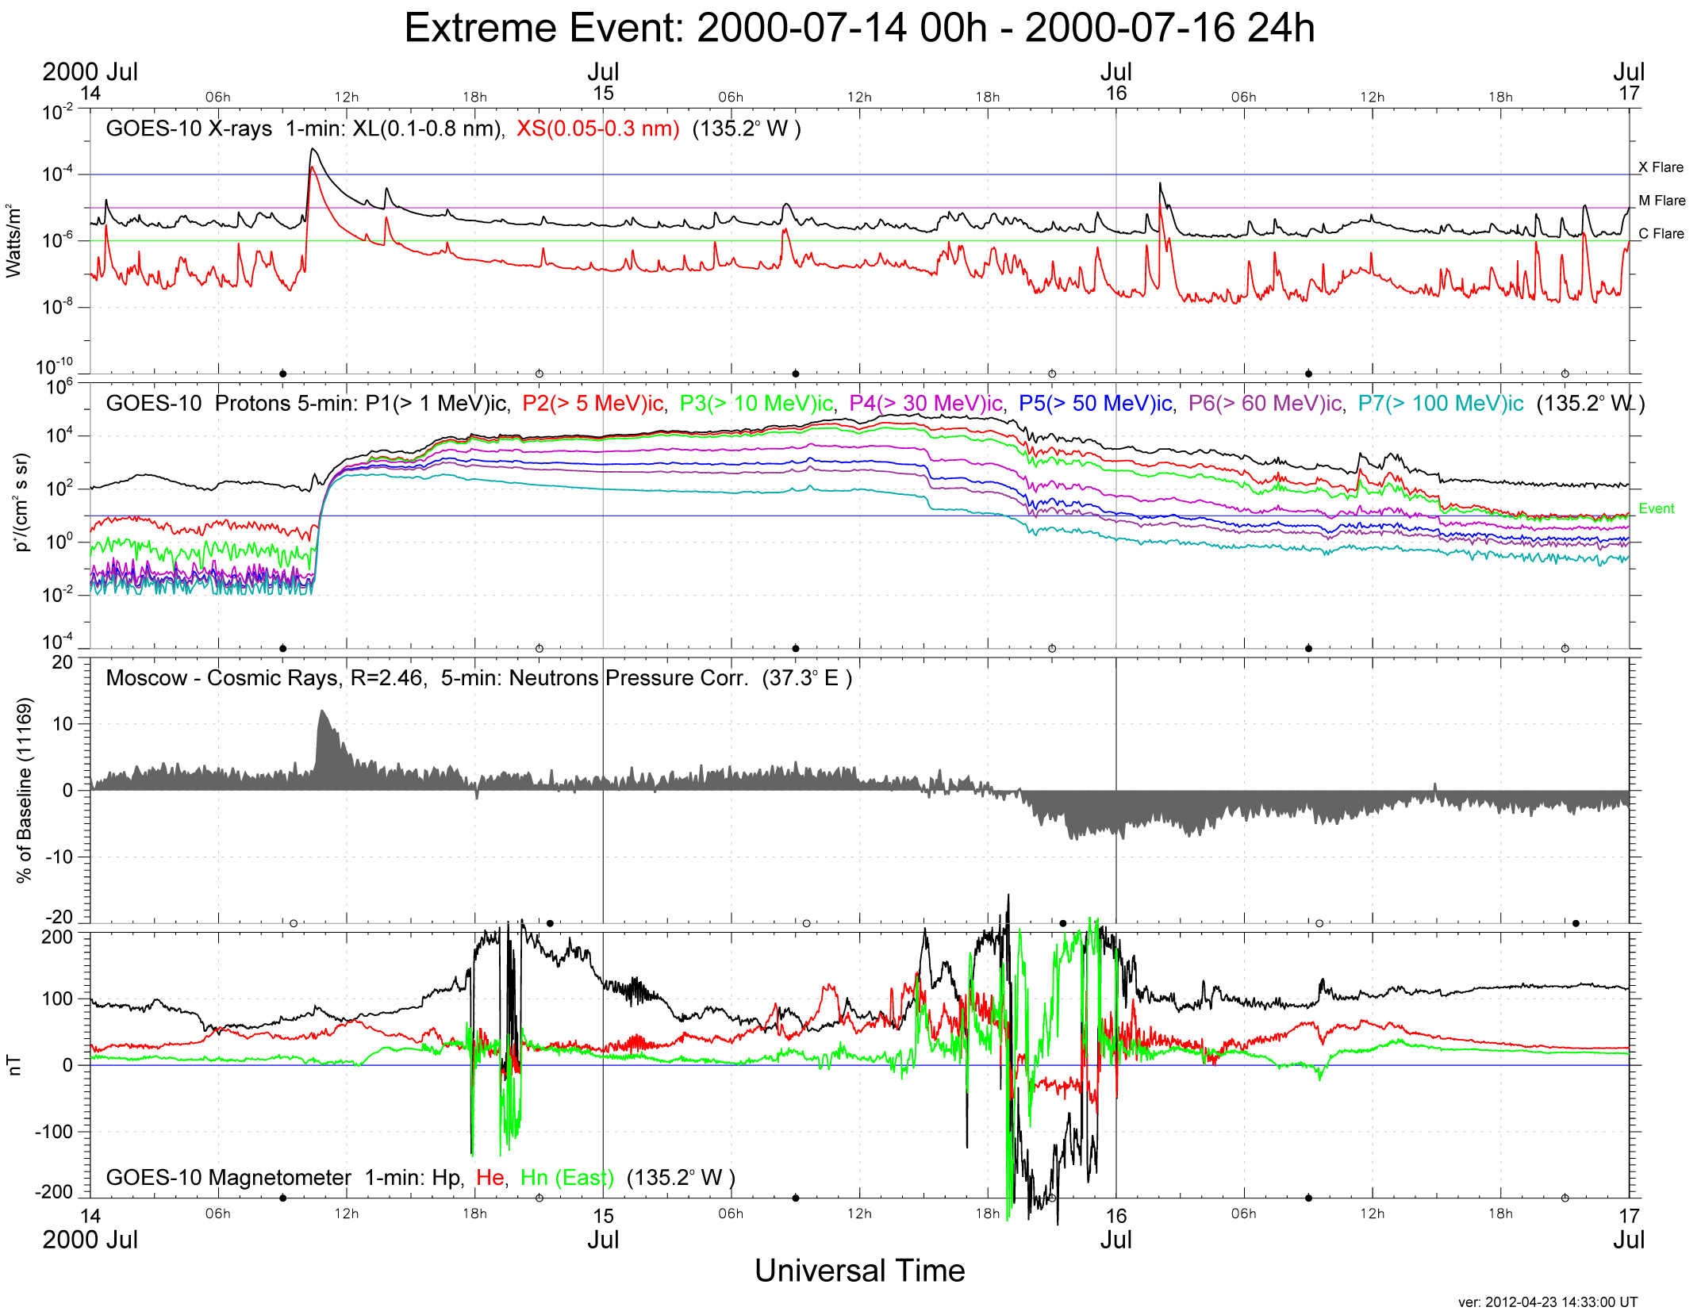
14-16 Jul 2000
R3
S4
G5
Prompt
GLE
DMSP

Slide 12
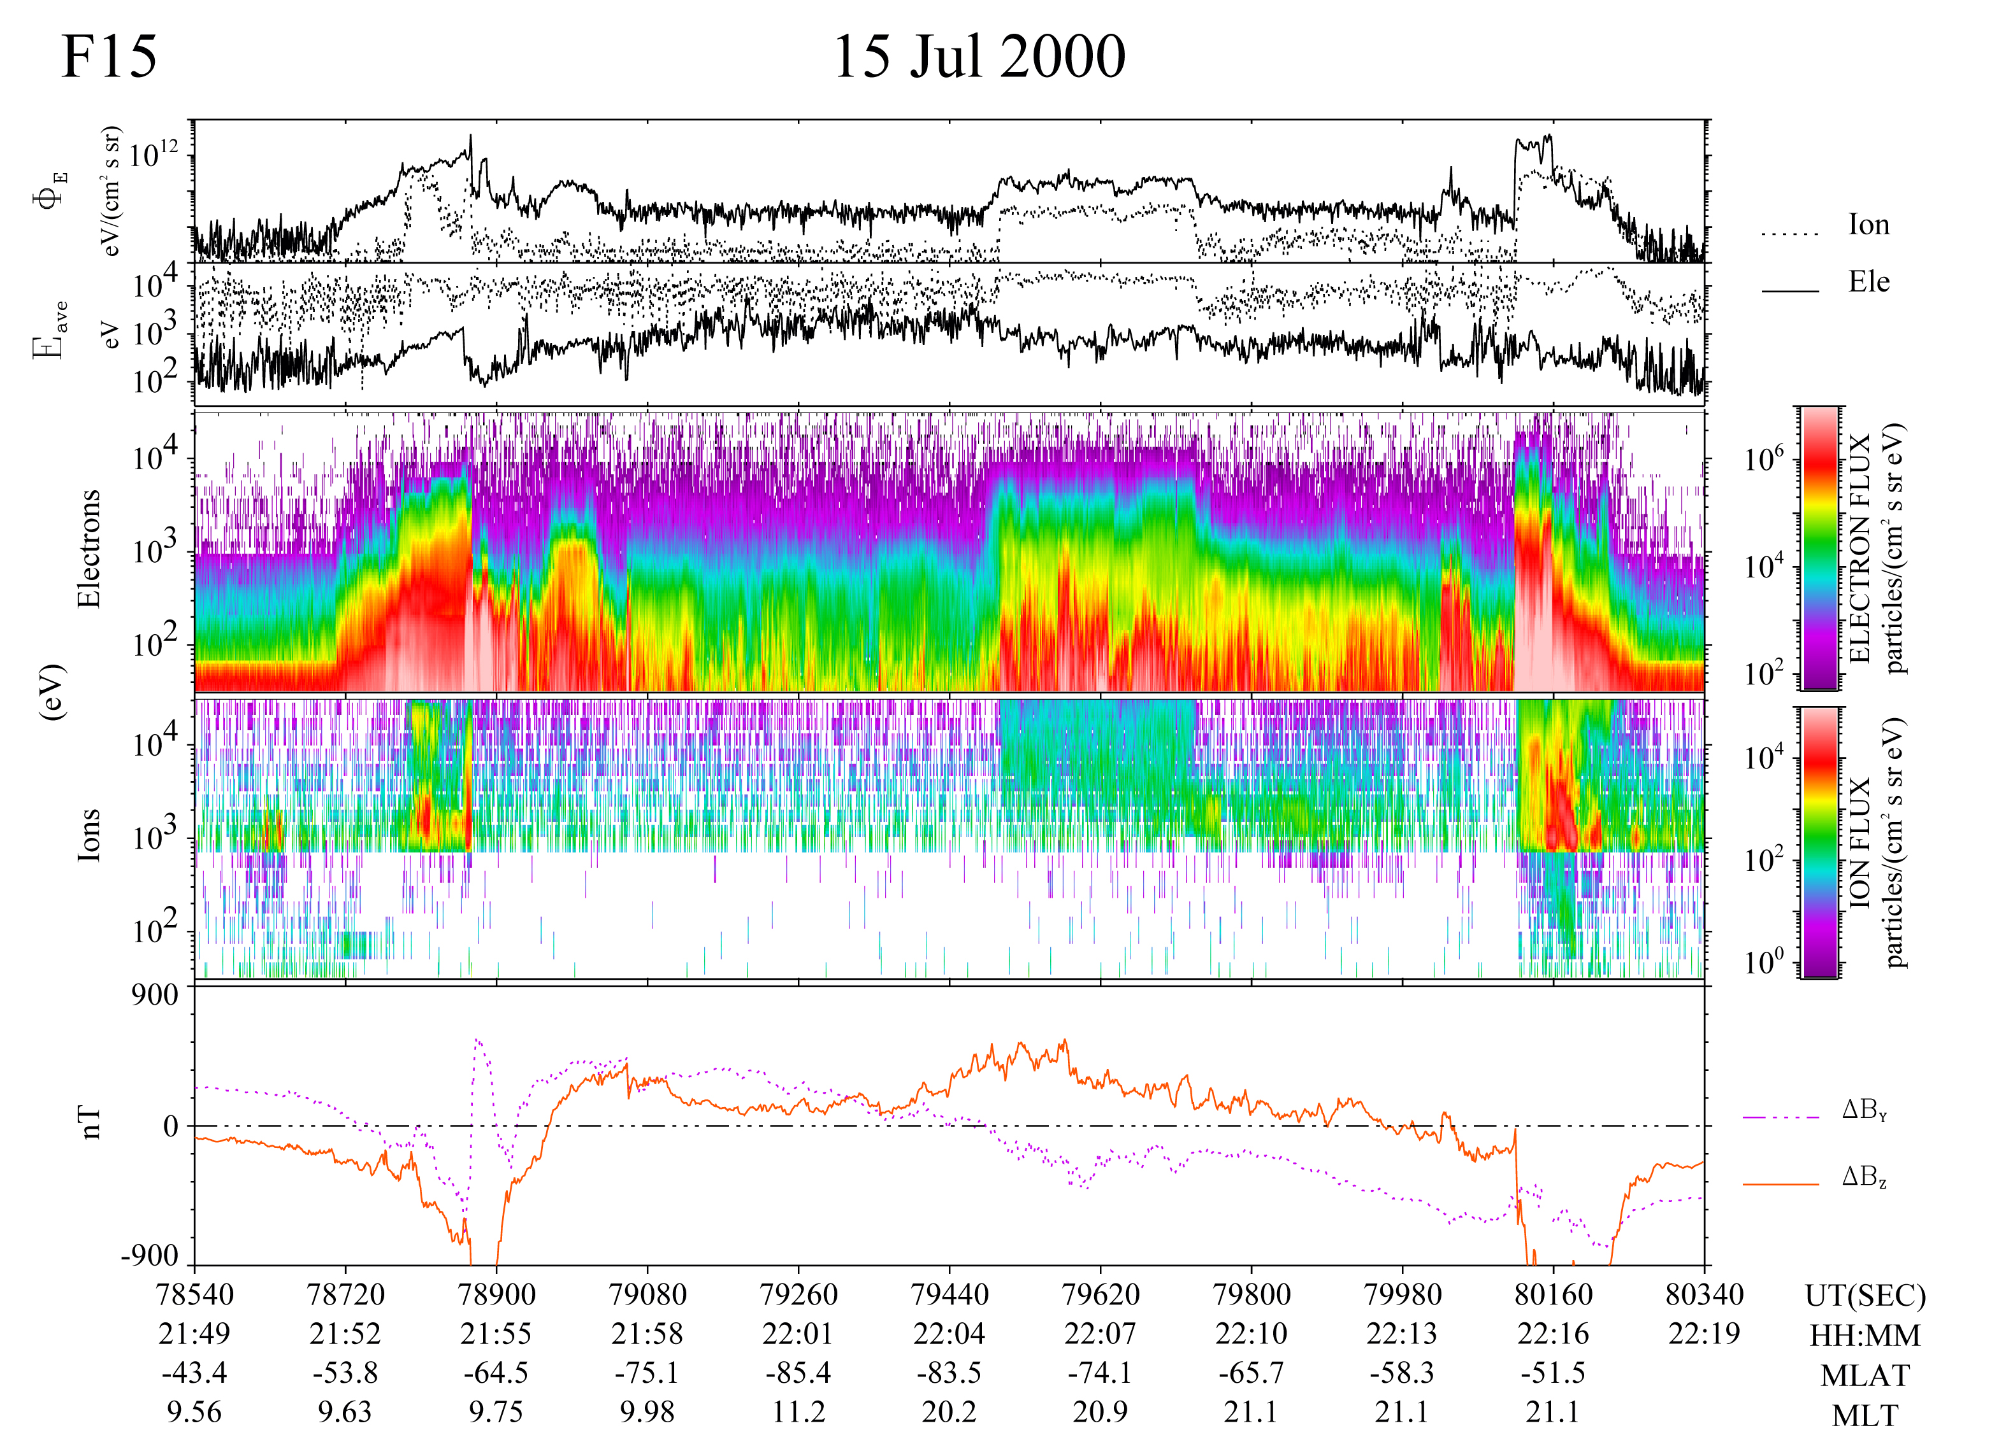
14-16 Jul 2000
53.1
48.0
Take Aways:
SPE: 24,000 pfus
Prompt rise
Ground Level Event
Ionospheric response
Field-Aligned
Currents (FACs)
R2
R1
R1
R2
Region 1/2 FACs
>> 1 μA/m²
Convective
Drifts
Morningside drifts
> 3 km/s (~150 mV/m)

Slide 13
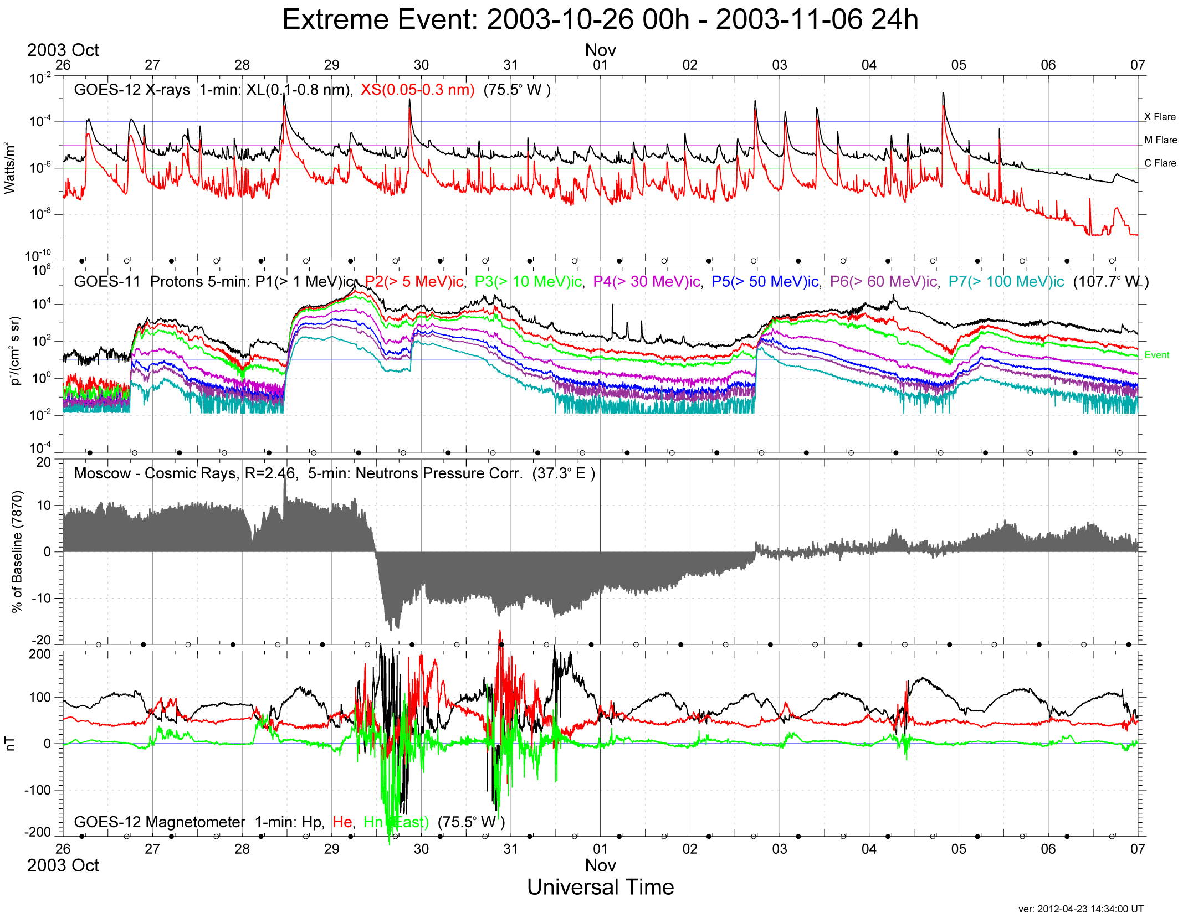
10-Oct – 06 Nov 2003
R4/5
S4
G5
?
DMSP

Slide 14
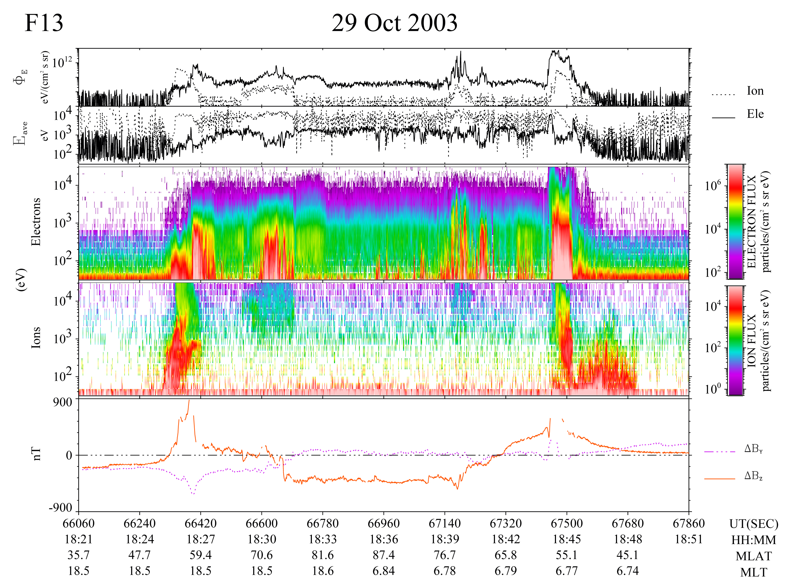
10-Oct – 06 Nov 2003
52.4º
51.6º
Take Aways::
Expanded Auroral Zone
Typical -IMF Bz
R2
R1
R1
R2
Sunward
Sunward
SAID
Antisunward Drifts

Slide 15
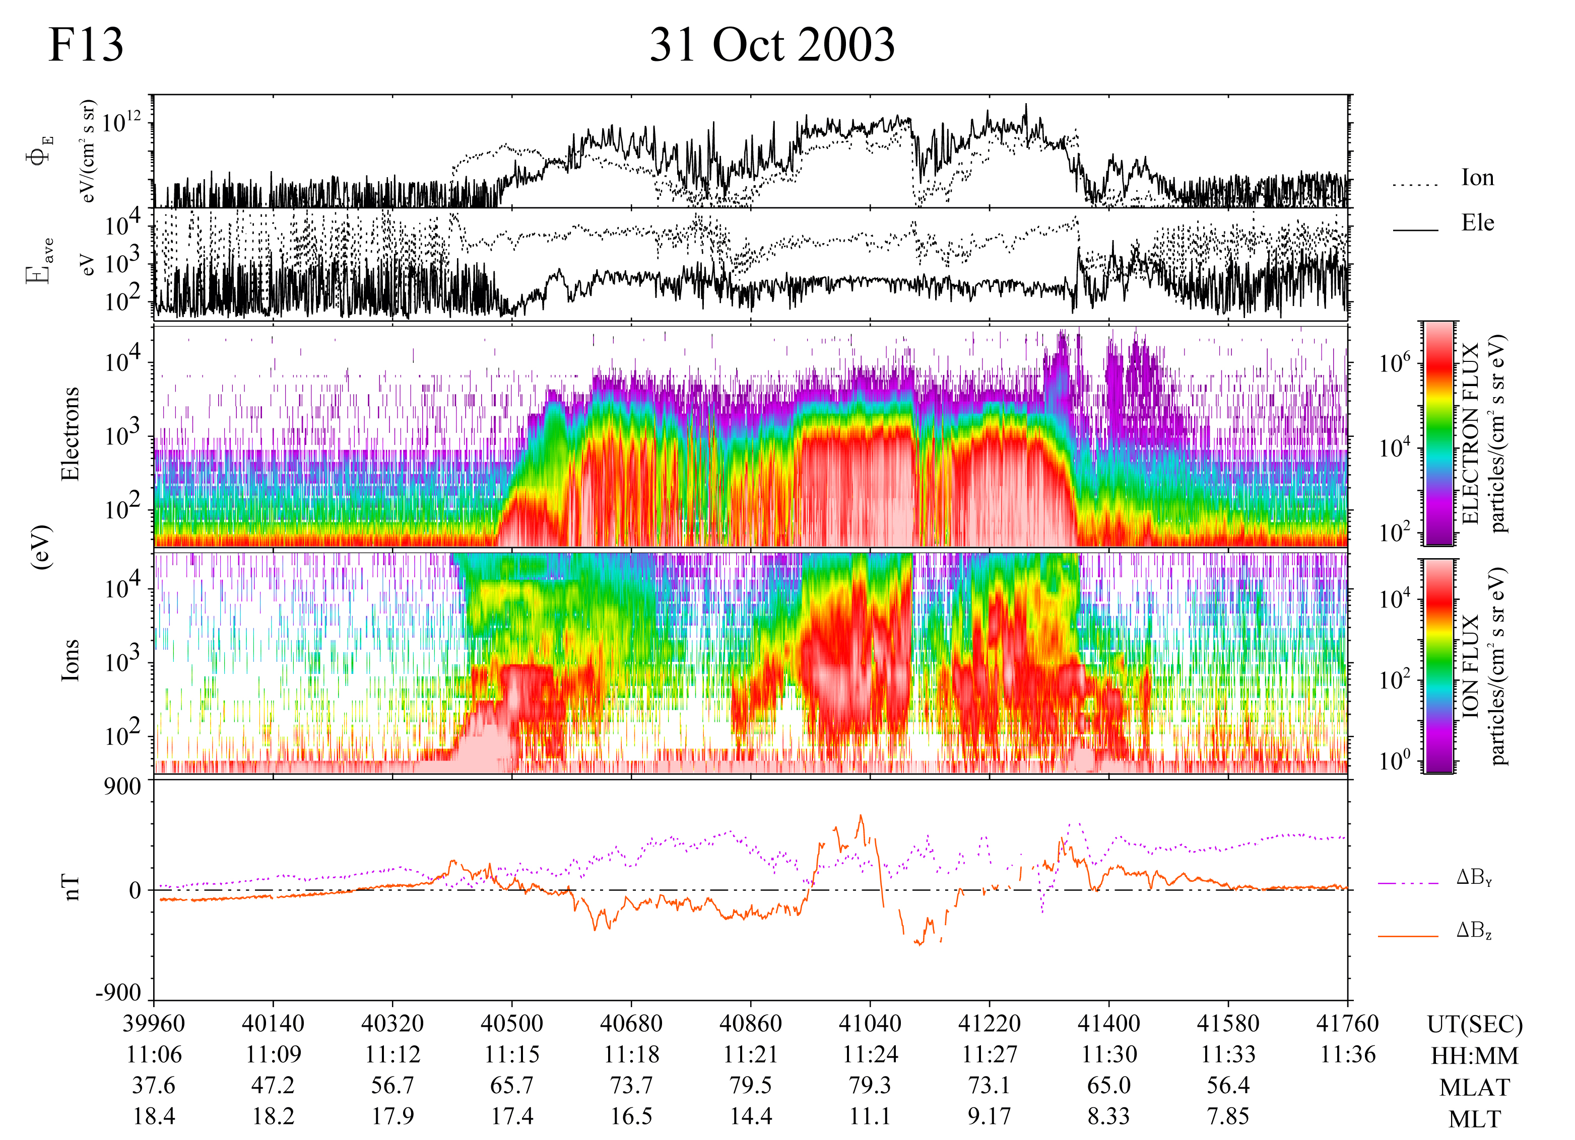
10-Oct – 06 Nov 2003
65.3
67.1
Take Aways::
Compressed polar cap
Very strong sunward convection in polar cap
+IMF Bz
J_{in}
J_{out}
Reversed
Convection
(E_{Dusk-to-Dawn})

Slide 16
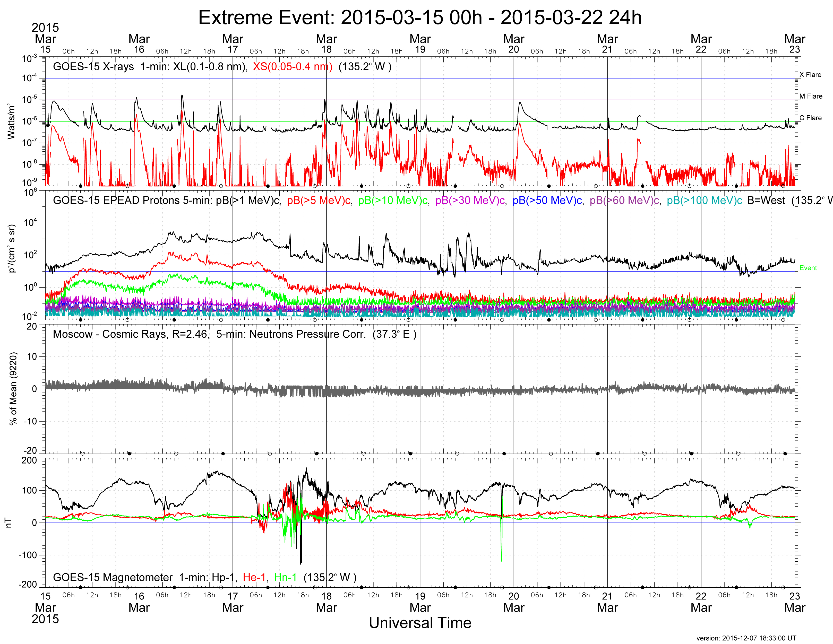
March 15-22, 2015
Not so
R1
S0
G4
See
Rob Redmon
SM41C-2499

Slide 17
Summary
Long-term measurements of the space environment provide opportunities to compare / contrast extreme SWx events
Since the mid 1970s the NOAA GOES satellites have monitored the GEO environment in much the same way
The NOAA Space Weather Scales provide an easy way to characterize the impact of extreme events
When combined with data from polar-orbiting satellites these data can provide a synoptic view of the space environment
GOES satellites will provide continuity of measurements through 2036 (at least)
Well characterized auroral measurements will sunset when DMSP reaches its End-Of-Life (EOL) – possibly sooner

