Slide 1
NOAA Satellites – Current & Future
W. Denig¹, R. Redmon¹ & P. Mulligan²
¹National Geophysical Data Center
²Office of Systems Development

Slide 2
ABSTRACT
EGU – 27 Apr-02May 2014
NOAA Operational Space Environmental Monitoring - Current Capabilities and Future Directions
W.F. Denig^{1,} Rob Redmon and P. Mulligan²
¹NOAA National Geophysical Data Center, Boulder, CO
²NOAA Office of Systems Development, Silver Spring, MD
During the next few years the U.S. National Oceanic and Atmospheric Administration (NOAA) will field new operational capabilities for monitoring the near-earth space environment in addition to maintaining continued measurements in geostationary orbit. The most exciting new capability will be transitioning routine solar wind and magnetic field measurements at L1 (240 Re) from the NASA Advanced Composition Explorer (ACE) satellite to the Deep Space Climate Observatory (DSCOVR) which will be launched in early 2015 with a projected on-orbit readiness in mid-2015. Also under consideration is a solar-sail demonstration mission, called SUNJAMMER, for acquiring plasma and field measurements at twice the L1 location [TBD]. Both DSCOVR and possibly SUNJAMMER will provide a near-term advanced warning of impending space weather events that can adversely affect communications, satellite operations, GPS positioning and commercial air transportation. NESDIS has also supported the development of a Compact Coronagraph (CCOR) which could provide a several days warning of space weather when coupled with an interplanetary disturbance propagation model like ENLIL. Routine monitoring of the ionosphere will be provided by the Constellation Observing System for Meteorology, Ionosphere and Climate (COSMIC) II as a system which is a partnership among the Taiwan's National Space Organization, the U.S. Air Force and NOAA. The new operational capabilities provided by DSCOVR, SUNJAMMER, CCOR and COSMIC II are provided against the backdrop of continued space environmental measurements from the Geostationary Operational Environmental Satellites (GOES) which, in the near future, will transition to the GOES-R series of advanced space weather sensors. Continued space environmental measurements in polar low earth orbit (LEO) will continue to be provided by the remaining Polar Operational Environmental Satellites (POES) and the European MetOp satellites. Instrument specialists at the National Geophysical Data Center and Space Weather Prediction Center are using a combination of operational measurements and models to develop advanced now-cast and forecast space weather applications. Present and future capabilities include but are not limited to the Oval Variation Assessment Tracking Intensity and Online Now-casting (OVATION) Prime based auroral forecast and magnetopause location and geosynchronous crossing detection applications.
REFERENCE ONLY
NOT PRESENTED
Notes:
Nothing to mention here. Just the abstract for completeness.

Slide 3
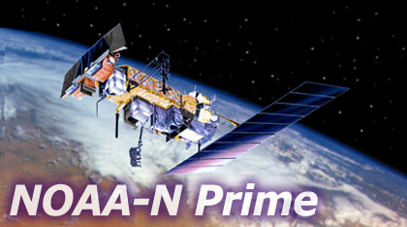
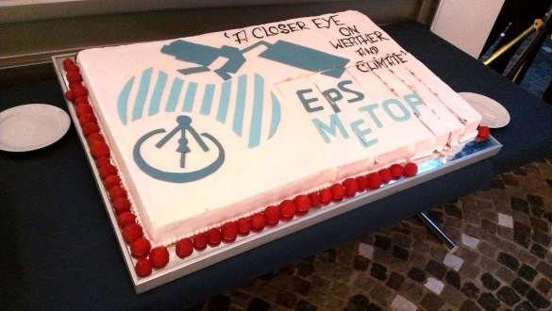
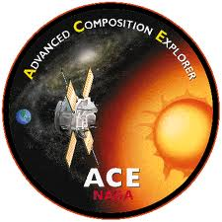
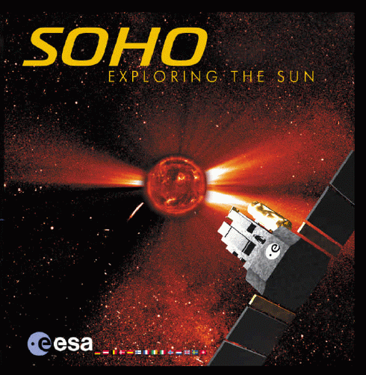
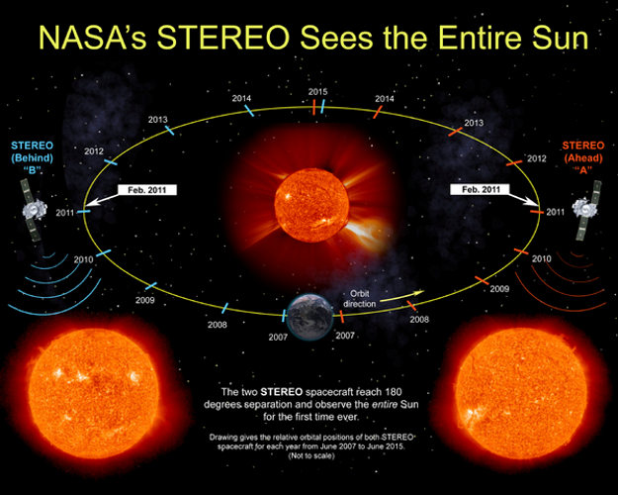
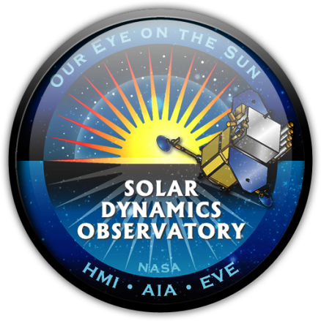
NOAA Operational Space Weather
Data Used in SWx Operations
The NOAA Space Weather program relies on a variety of NOAA (top) and non-NOAA (bottom) satellite assets to conduct its operational mission

Slide 4
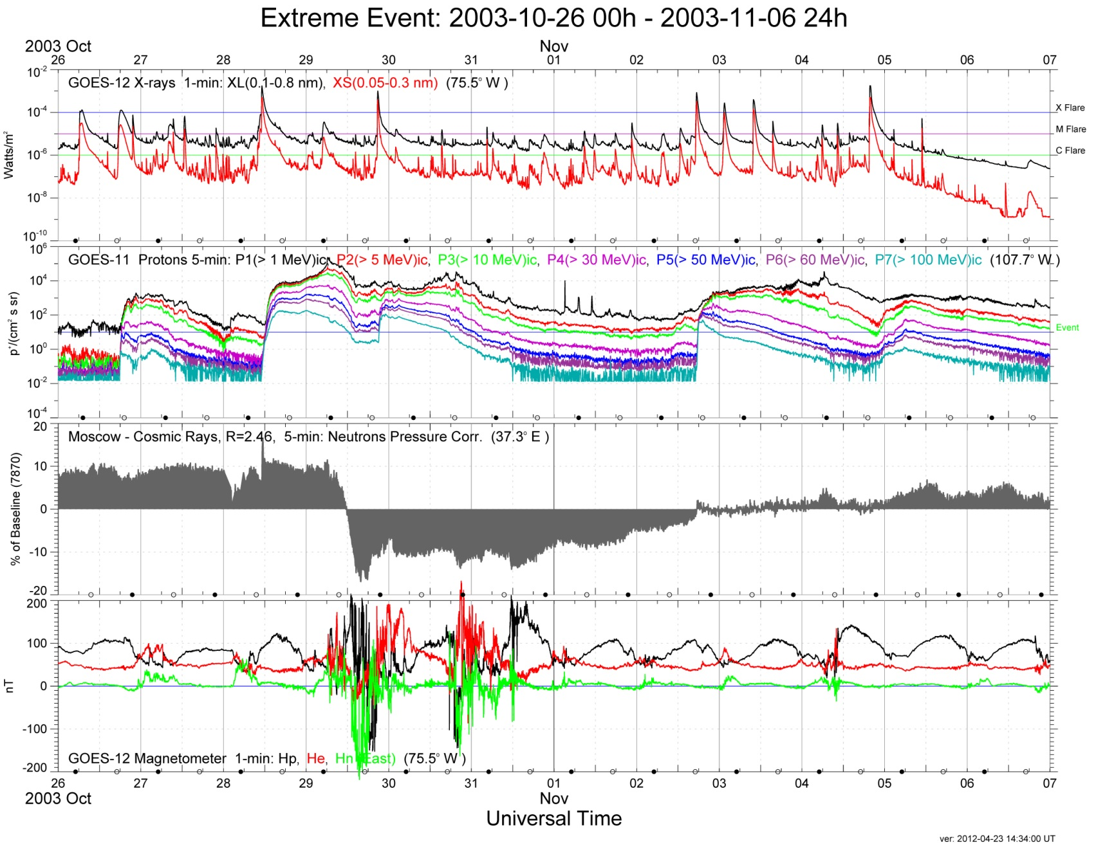
GOES Environmental Data
40 Years of Geostationary Measurements
Solar
X-Rays
X class
S4
Proton
Events
Cosmic
Rays
(non-GOES)
Forbush Decrease
Magnetic
Field
http://www.ngdc.noaa.gov/stp/satellite/goes/index.html

Slide 5
Continuity of GEO Measurements
Transitioning to GOES-R/S/T/U

Slide 6
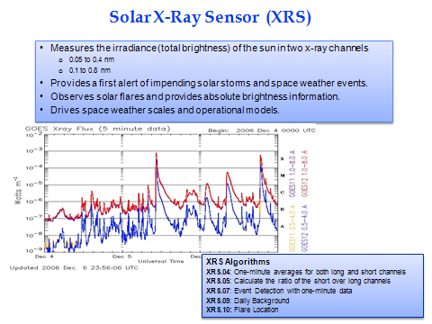
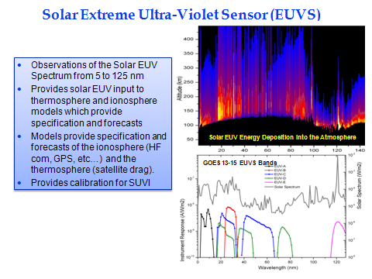
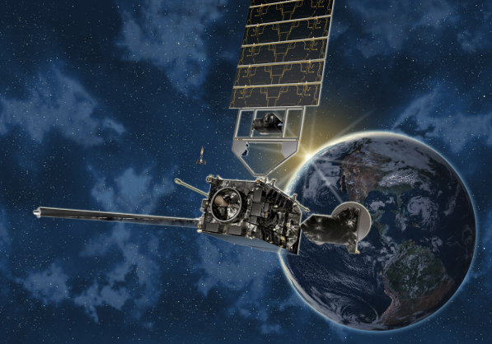
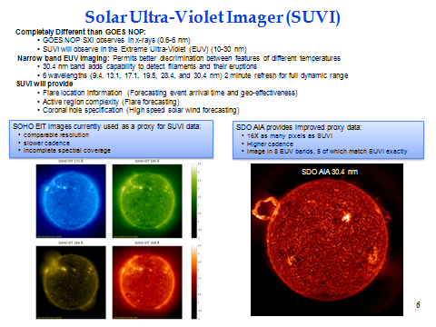
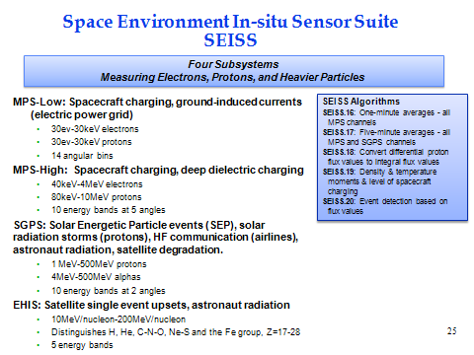
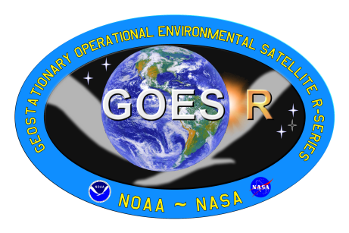
GOES-R (R/S/T/U) Series
Improved SWx Capabilities
The GOES-R series space/solar sensors provide incremental improvements to current NOAA GEO space weather monitoring. The first launch date of the GOES-R series is late 2015.
Increased # of wavelength bands
Credit: Lockheed-Martin
Solar UV imagery versus soft x-rays
Improved particle energy coverage
Not shown: GOES-R Magnetometer

Slide 7
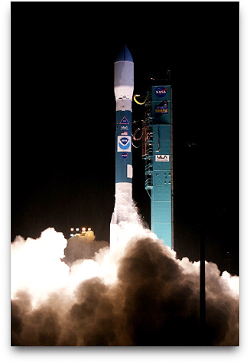
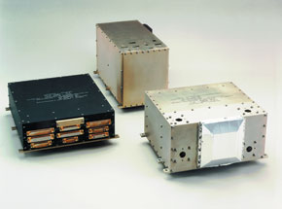
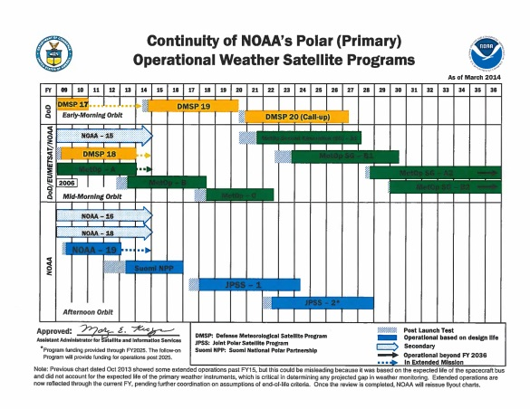
Continuity of LEO Measurements
An End of an Era (since 1978)
NOAA-19 (POES)
Launched: 08 Feb 2009
NOAA-19 is the last NOAA satellite in polar LEO to provide operational SWx data
European MetOp satellites carry NOAA Space Environmental Monitor (SEM) packages
MetOp A – CY2006 – 2012 (SEM)
MetOp B – CY2012 – 2017 (SEM)
MetOp C – CY2016 – 2020 (SEM)
Data from POES/MetOp will continue to be available through the end of these programs
http://www.ngdc.noaa.gov/stp/satellite/poes/index.html

Slide 8
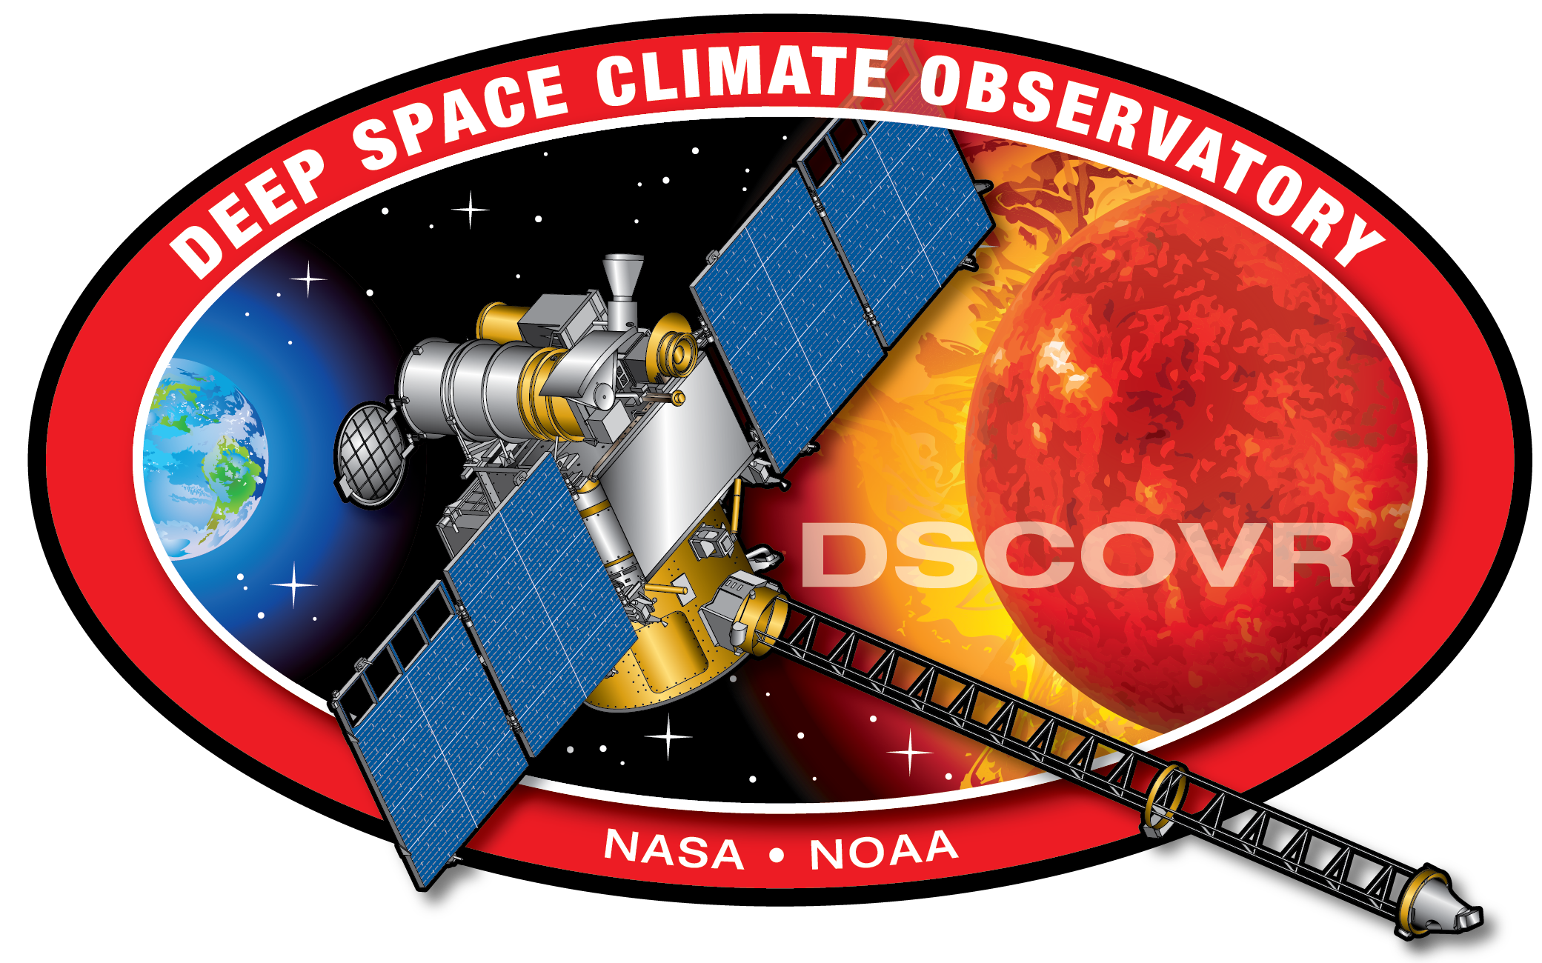
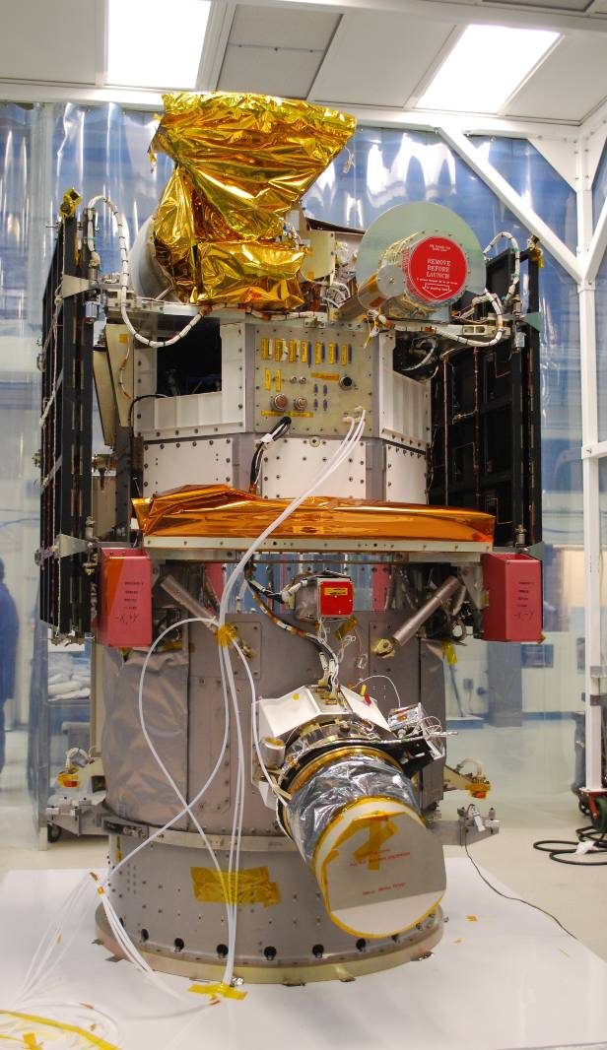
New Capability
Operational SWx Data from L1
NOAA currently relies on the NASA ACE spacecraft to provide advanced warning of hazardous space weather conditions
The DSCOVR spacecraft will measure the solar wind (n_{p}, v_{p}, t_{p}) and the interplanetary magnetic field at 240 R_{e} forward of the earth
The DSCOVR spacecraft refurbishment is nearing completion for a launch in Jan 2015
Recalibration of Plas/Mag – complete
Magnetic cleanliness testing – complete
Mag is being relocated to end of boom
Integration phase of the project is beginning
USAF plans on a Space-X Falcon 9 launch
DSCOVR solar wind/IMF data downlinked via the Real-Time Solar Wind Network (RTSWnet)
Mission transfers to NOAA at L+90 days
Secondary mission – Earth Observations
Deep Space Climate Observatory (DSCOVR)

Slide 9
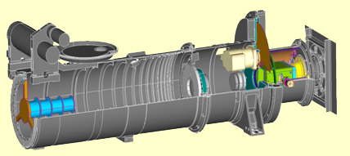
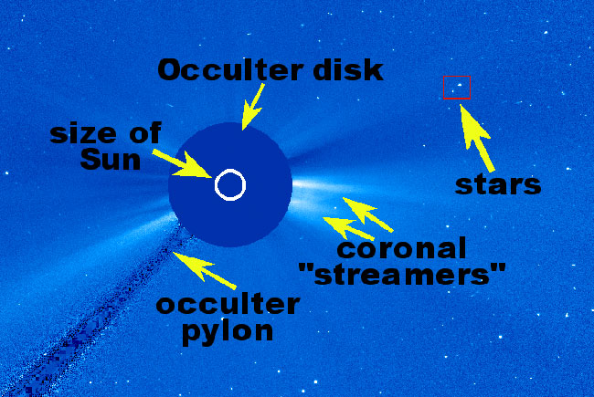
Under Development
Compact Coronagraph (CCOR)
NOAA currently uses SOHO coronagraph to detect and characterize coronal mass ejections (CMEs)
CCOR design offers reduced sensor mass and volume at lower cost
6 kg telescope, 17 kg for sensor
Optical train is 1/3 length of traditional coronagraphs & uses multiple occulters
NRL completed Phase A study & successfully bench tested the optical design
NOAA will continue to fund risk reduction studies at NRL
CCOR ranked in DoD Space Experiments Review Board for STP launch
CCOR under consideration for DSCOVR follow-on mission options

Slide 10
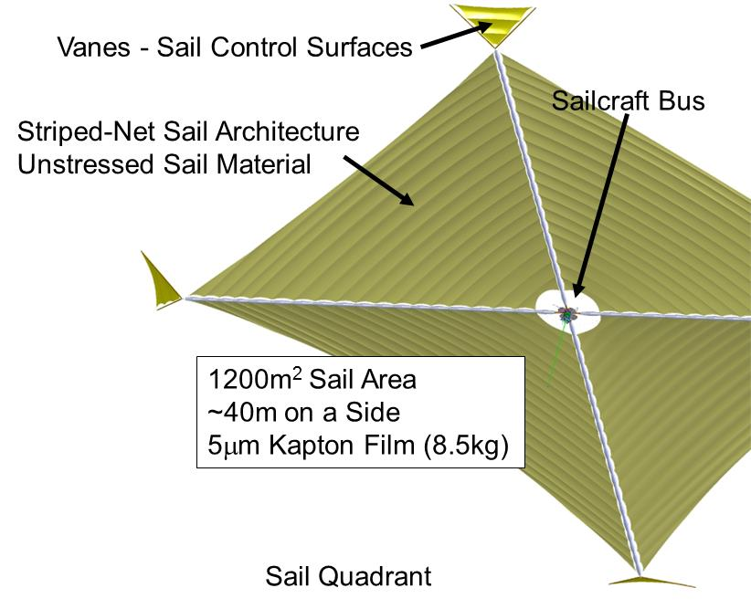
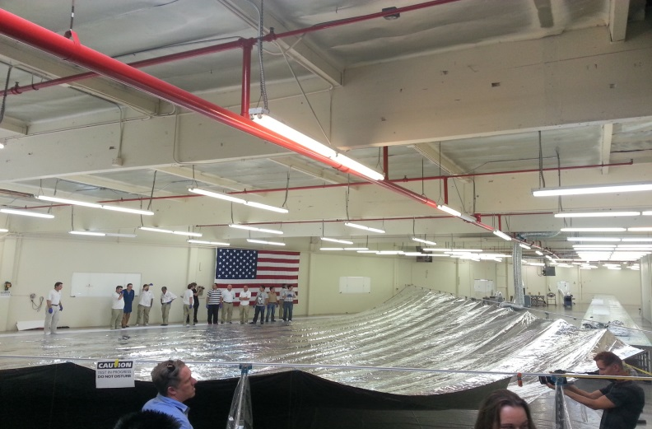
Technology Demonstration
Sunjammer – Solar Sail Demonstration
Sunjammer is a NASA technology demonstration mission (TDM) to examine the propellantless propulsion potential of solar sails
Mission will demonstrate sail maneuvers in its first 30 days – then continue to provide space weather data (possibly at 2x L1 [TBD])
NOAA plans to partner with L’Garde, Inc to provide data reception, analysis and archive
Mission is an important indicator for the viability of commercial space missions
Space weather instruments:
Particle spectrometer – MSSL
Magnetometer – Imperial College London
NOAA will assist in evaluating the data
Sunjammer Quadrant Deployment Test 9.30.2013

Slide 11
DSCOVR Follow-on
Operational Solar Wind / CME Imagery Missions
NOAA is committed to continued solar wind/CME monitoring
Solar Wind – Commercial and other options:
Evaluate Sunjammer mission performance data for improved space weather forecasts
Evaluate business case for Sunjammer commercial data buy option
Examine sensor concepts for improved sensor performance; i.e. extending DSCOVR Plas/Mag measurement range
Refresh cost estimates for other options such as government satellites
CME Imagery
Continue CCOR risk reduction studies at NRL
Pursuing STP launch option
Include CME imagery option in DSCOVR follow-on studies
NOAA L1 Requirements Workshop – 7 April 2014 (SWPC/Boulder, CO)
>60 participants – held in conjunction with Space Weather Workshop
Meeting report to be released [TBD]

Slide 12
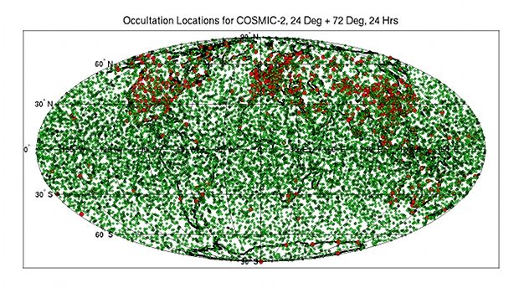
New Capability
GNSS Radio Occultation – COSMIC 2
Constellation Observing System for Meteorology, Ionosphere & Climate (COSMIC 2)
Taiwan-USAF-NOAA Partnership
12 satellite constellation – 6 @ 24º inclination (low) / 6 @ 72º inclination (high)
Phase 1 launch planned for May 2016 – low inclination; Phase 2 launch - 2018
NOAA coordinating with international partners to host/operate ground receptors
Full up constellation will acquire more than 8000 ionospheric soundings per day

Slide 13
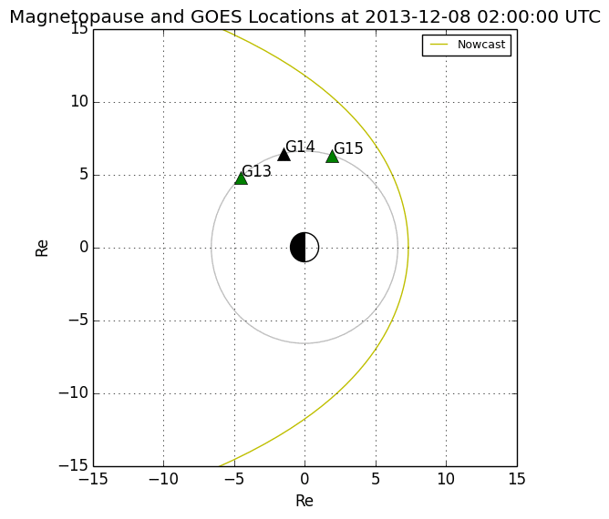
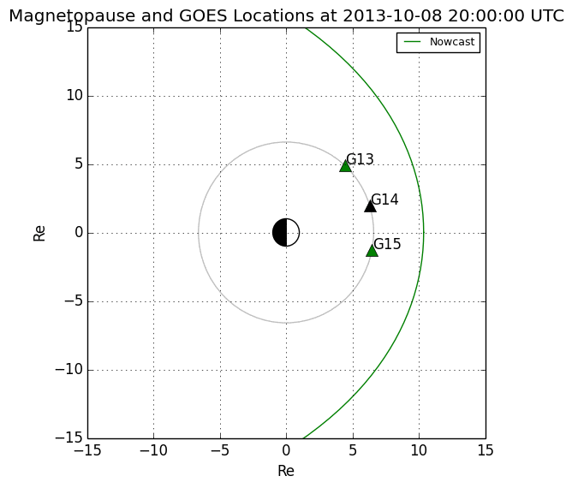
Expanded Products & Services
Geosynchronous Magnetopause Crossings
December 8, 2013, model predicts magnetopause crosses GEO. No GOES near noon to confirm
October 8, 2013, GEO orbit inside magnetosheath. Negative polar field (red triangle) and e-flux dropout observed near noon
Predicted Crossing
Observed Crossing
R_{E}
R_{E}
R_{E}
250
GOES-15
Hp
Note: GOES-14 is currently not operational and thus is not providing magnetometer measurements (black triangle)
0
-150
18:00
21:00
UT
Notes:
The red coloring of the GOES-15 triangle is based only on the magnetometer. See here for SEISS e-flux depression:
http://satdat.ngdc.noaa.gov/sem/goes/data/new_plots/2013/goes13/summary/g13_summary_20131001-00h_20131031-24h.pdf
Other links:
October 8:
G15: http://satdat.ngdc.noaa.gov/sem/goes/data/new_plots/2013/goes15/summary/g15_summary_20131201-00h_20131231-24h.pdf
December 8:
G13: http://satdat.ngdc.noaa.gov/sem/goes/data/new_plots/2013/goes13/summary/g13_summary_20131201-00h_20131231-24h.pdf
G15: http://satdat.ngdc.noaa.gov/sem/goes/data/new_plots/2013/goes15/summary/g15_summary_20131201-00h_20131231-24h.pdf

Slide 14
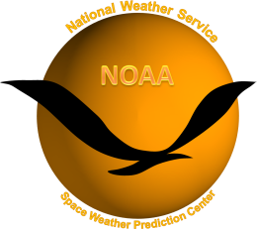
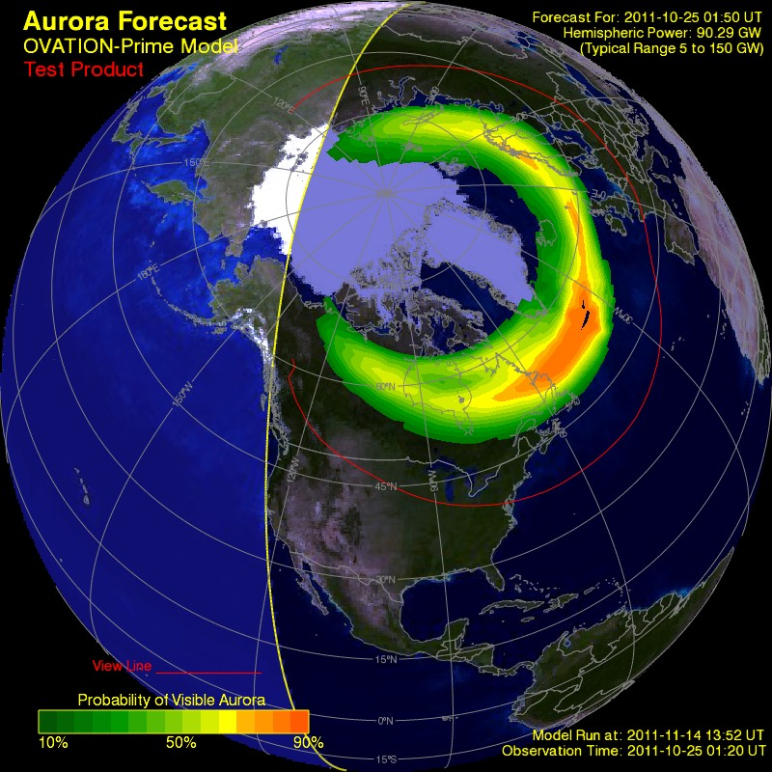
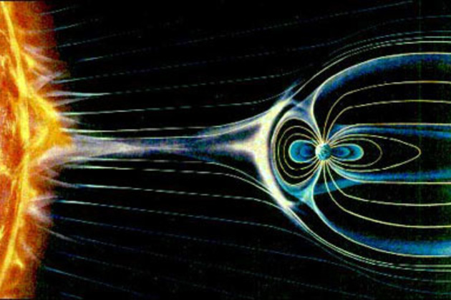
Expanded Products & Services
Ovation Auroral Forecast Model
Methodology developed at JHU/APL
30-40 min forecast driven by ACE solar wind and interplanetary magnetic field data
Developed as a joint project between NGDC and SWPC
Customer products now available from SWPC – link

Slide 15
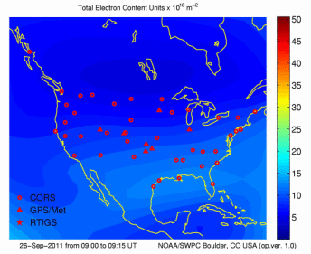
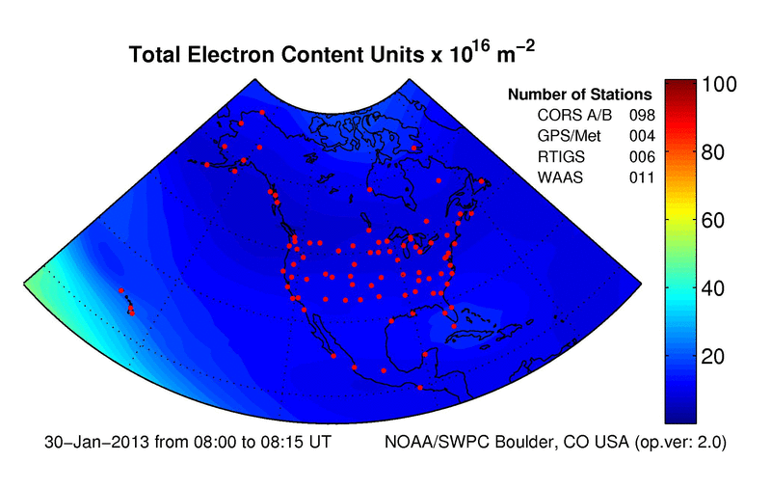
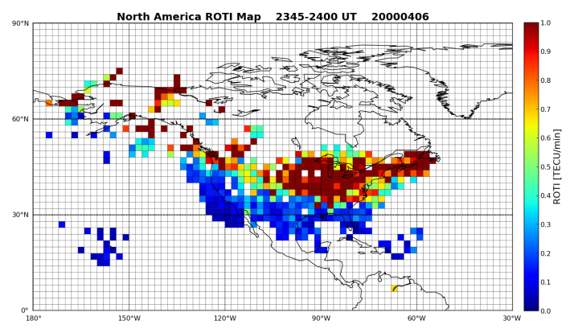
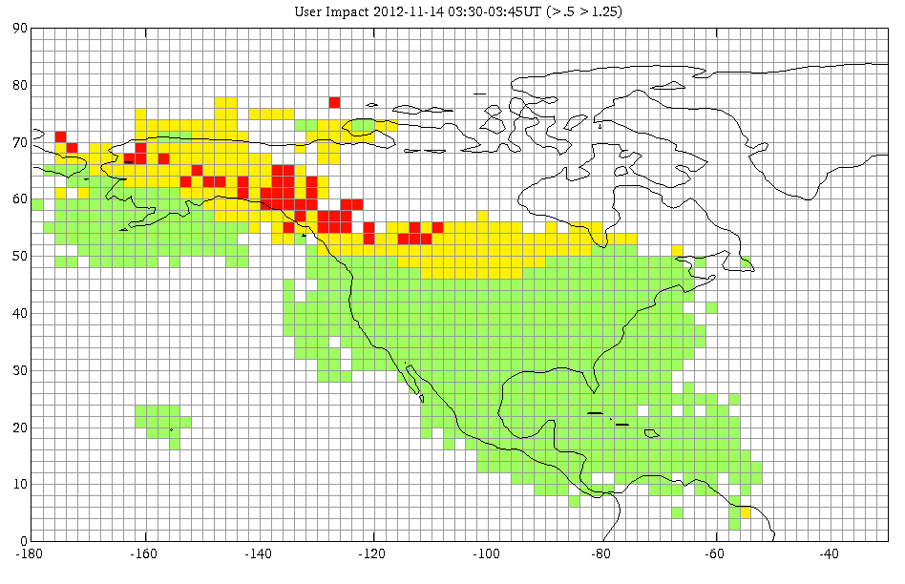
Expanded Products & Services
North America TEC
Extending current US-TEC product to NA-TEC
Research
to
Operations
Related products
Rate of TEC Index Product
GPS Scintillation Specification
Research
and
Development

Slide 16
Thank You!

