Slide 1
NOAA Space Environmental Data
Paper 2.3 - AMS
W.F. Denig
National Geophysical Data Center
Boulder, CO
william.denig@noaa.gov
Monday, 03 Feb 14 / 2:00 PM / Rm C110

Slide 2
ABSTRACT
AMS – 02/2014
Stewardship of NOAA Space Environmental Data (Paper 2.3)
W.F. Denig¹
¹NOAA National Geophysical Data Center, Boulder, CO
The National Geophysical Data Center (NGDC) is the steward of NOAA's space environmental data. Currently NGDC has prime responsible for stewarding space weather data from the GOES and POES satellite systems. These data are available directly from NGDC and via various data portals such as the NASA Space Physics Data Facility (SPDF) and the Virtual Radiation Belt Observatory (VIRBO). NGDC also stewards operational space weather products from the USAF's Solar Electro-Optical Network (SEON) along with numerous other solar and space environmental datasets tied to NGDC's heritage as the World Data Center for Solar-Terrestrial Physics. In this talk I will review the range of space environmental datasets available from NGDC and describe how to acquire and use the data. I will also discuss my perceived value for the historical datasets and solicit input on how to prioritize them in light of declining budgets and available manpower. Finally, I will discuss new space weather datasets coming online including data from the next-generation GOES satellites and NOAA's operational DSCOVR mission at L1.
REFERENCE ONLY
NOT PRESENTED
Notes:
Nothing to mention here. Just the abstract for completeness.

Slide 3
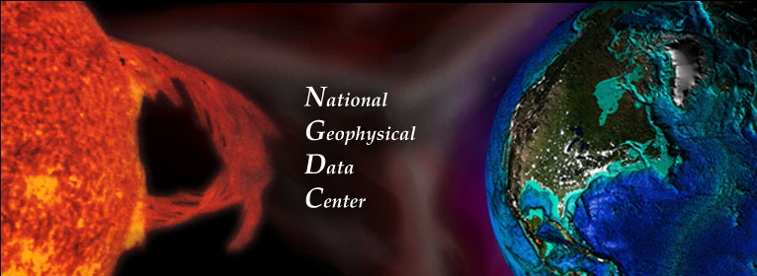
Data Stewardship
NOAA National Geophysical Data Center
NGDC provides stewardship, products and services for geophysical data from our Sun to Earth and Earth's sea floor and solid earth environment, including Earth observations from space.
The STP Division is responsible for the archive and access of solar and space environmental data and derived products collected by NOAA observing systems and acquired through the former World Data Center for Solar and Terrestrial Physics (Boulder).
NOAA Observing Systems: GOES & POES-MetOp (Current)

Slide 4
NRC Whitepaper - 2011
Benefits of Operational SWx Monitors
Over 30 years of operational space environmental data is available for heliophysics research. For the most part the measurement parameters have remained the same except for some improvements in sensor design and performance – sometimes, much to the angst of the operational agencies:
NOAA GOES – particles, fields, solar observation
Date range: 1974 – present
# of satellites: 15 (not counting 1 failure)
Availability: on-line
NOAA POES – energetic charged particles
Date range: 1978 – present
# of satellites: 12 (not counting 1 failure)
Availability: on-line
USAF DMSP – particles & fields, UV imagery
Date range: 1976 – present
# of satellites: 17 (not counting 1 failure)
Availability: on-line (F6 and beyond only)
DOE LANL – particles (GEO and GPS)
Data range: 1976 – present
# of satellites: Unknown
Availability: restricted
It keeps going and going and going

Slide 5
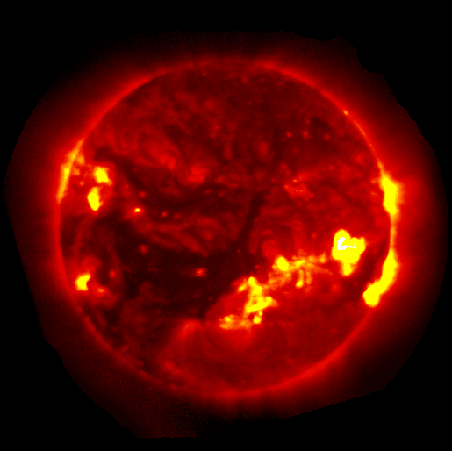
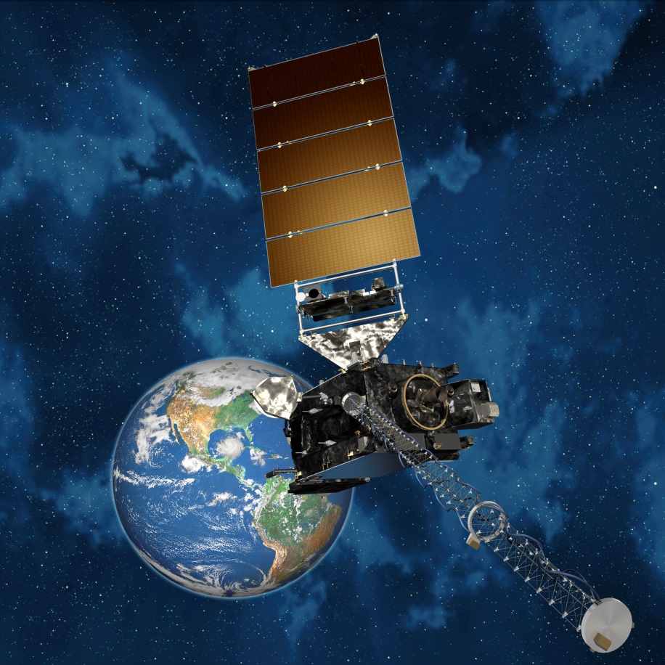
Current NOAA Observing Systems
GOES Satellites - Geostationary
Space Environment Monitor
Geosynchronous Orbit, Since 1974
Parameters: In Situ Magnetic Fields Whole Sun X-ray Flux Energetic Particles
Solar X-ray Imager
Data available since 2003
Full sun solar image (~1 per minute)

Slide 6
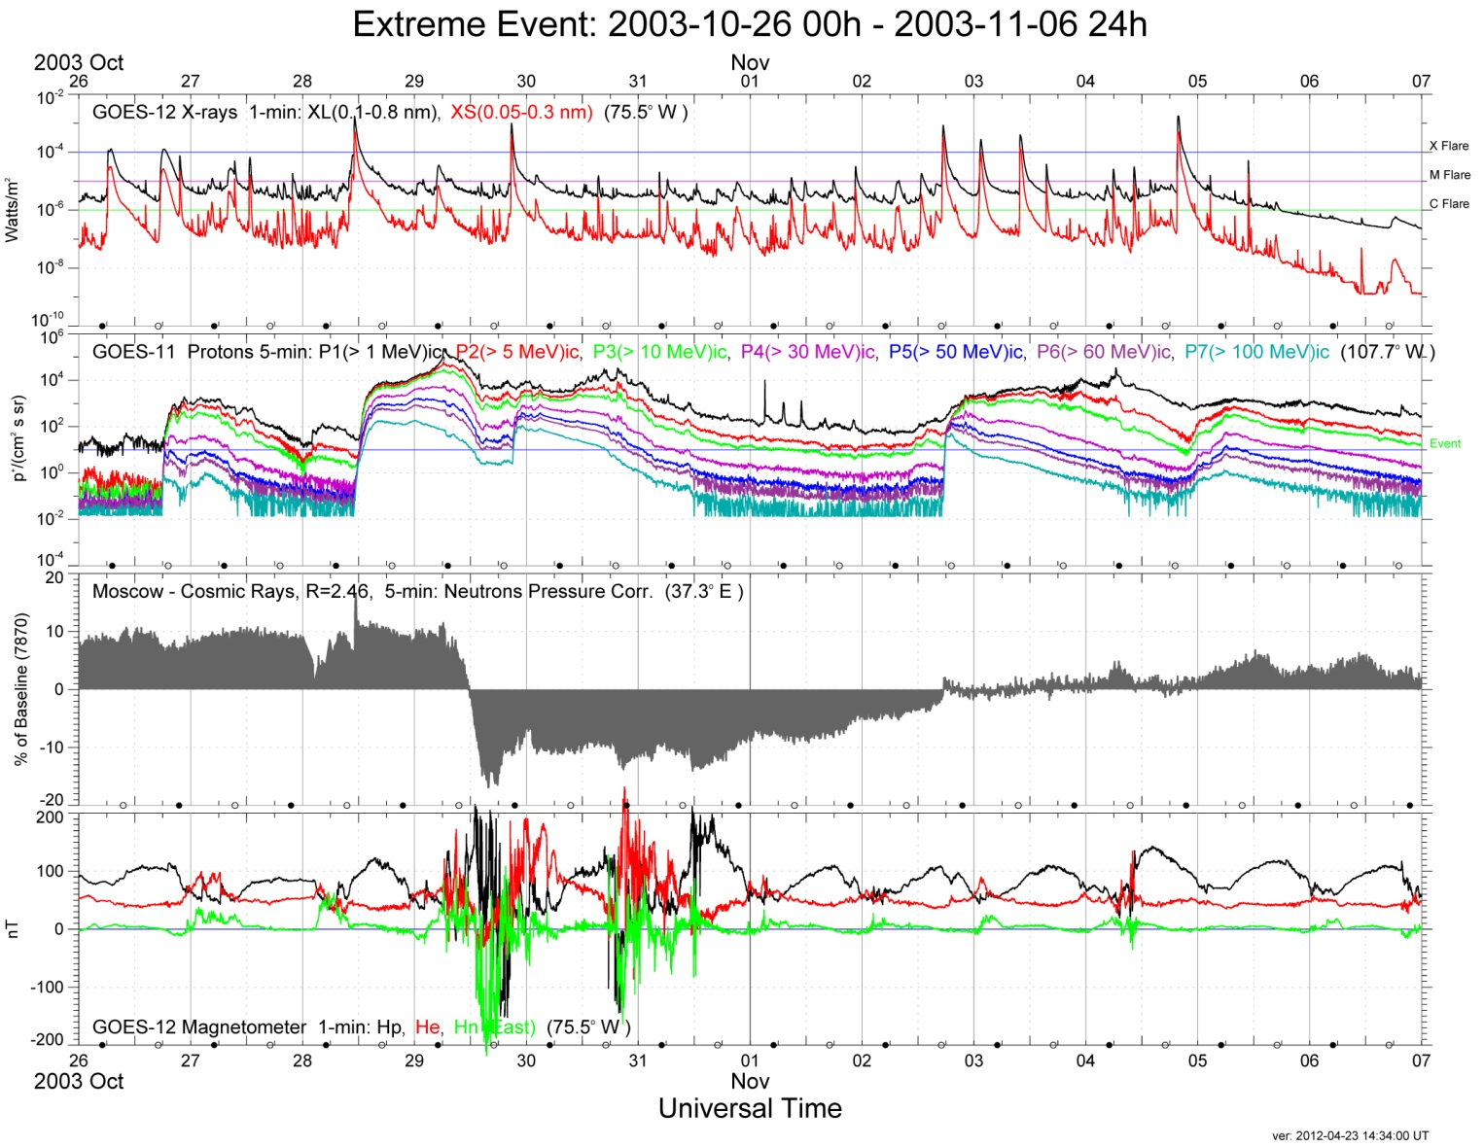
Current NOAA Observing Systems
GOES – Extreme Events (Survey Plots)
Halloween Storm – Oct/Nov 2003
Numerous X-class flares starting on
28 Oct 2003
Solar proton event – S4 on NOAA Space Weather Scale
Neutron Monitor Forbush Decrease (Moscow)
In-situ GEO magnetic field structure
See AMS Poster 313 “Extreme Space Weather Events Measured by GOES – 1974-2013”

Slide 7
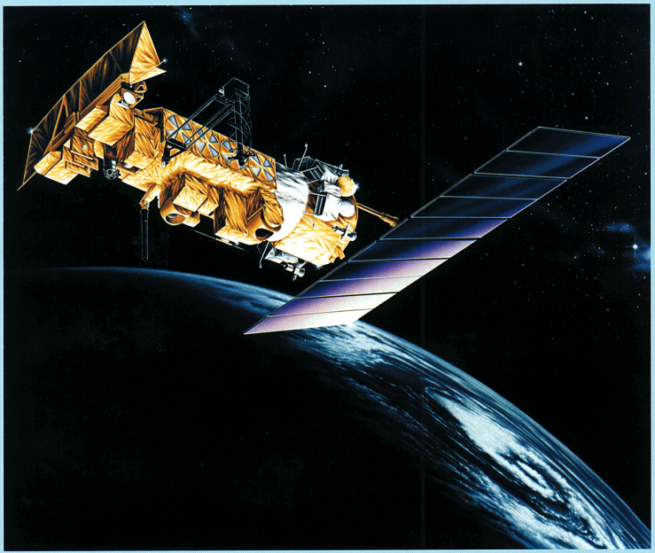
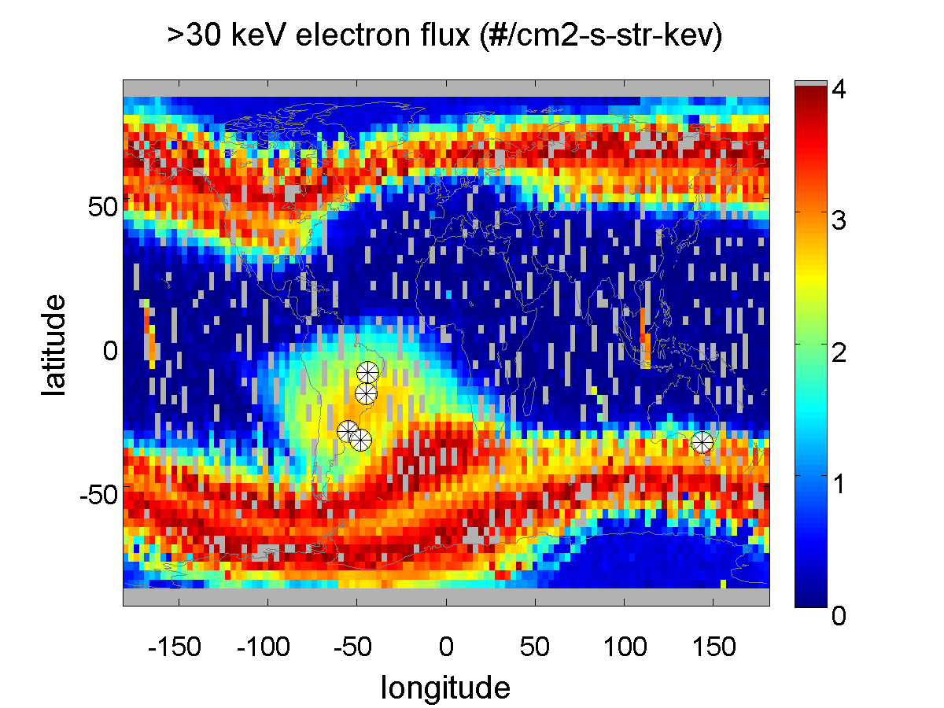
Current NOAA Observing Systems
POES/Metop Satellite System
Measurement Description & Data Availability
POES/SEM-1 – TIROS-N/NOAA 6-14 - 1978 to 2004
POES/SEM-2 – NOAA 15-19/MetOp – 1998 – present
TED ions 50 eV to 20 keV 16 channels / 2 FOV
e- 50 eV to 20 keV 16 channels / 2 FOV
MEPED p+ 30 keV to 200 MeV 10 channels / 2 FOV
e- 30 keV to 1 MeV 3 channels / 2 FOV
METOP – Will carry on after POES – Same SEM-2
POES on Orbit
Data from POES/MetOp SEM can be used to assess the LEO radiation environment. After MetOp the availability of energetic particle measurements in LEO will be very limited.
VIIRS Anomalies

Slide 8
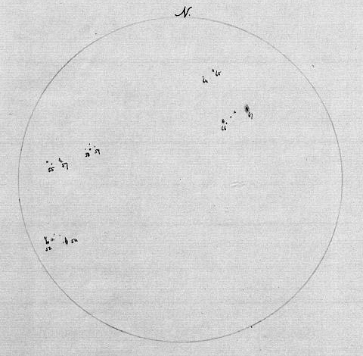
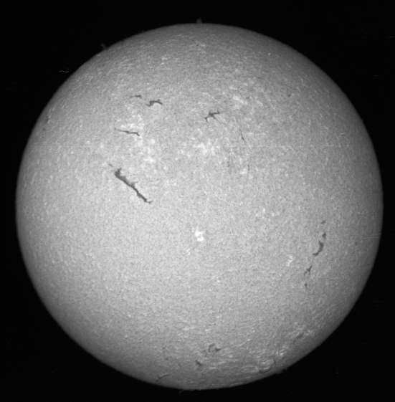
Improved SWx Monitoring
NOAA Historical Solar Observations
Observations of sunspots in white light made by Charles Anthony Schott of the Coast Survey, 1859-1860 plus data from other providers. The daily sunspot number (SSN) from multiple sources has been a consistent solar index from the early 1800’s to present.
From 1967 to 1994 the NOAA Space Environment Center observed the sun in H-alpha (656.3 nm). Chromospheric observations of prominences, filaments, plague and the chromospheric network. Daily observations of the sun for SWx operations transitioned to the USAF starting in 1979.
NOAA historical space weather data available through NGDC

Slide 9
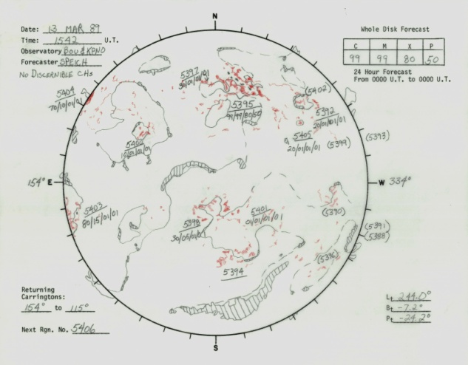
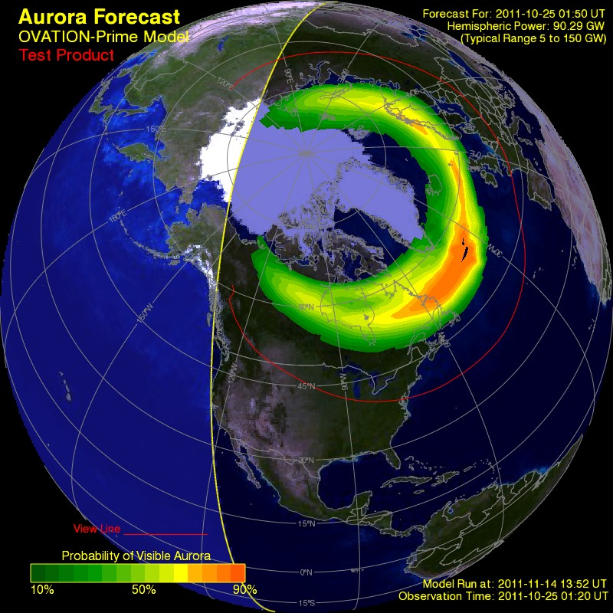
Current NOAA Archived Products
Provider: Space Weather Prediction Center
Boulder Composite Drawings
Trained operator assembles data from multiple sources to describe features on the sun (1972-present).
. . . Plus daily space weather reports
SWx models:
US-TEC, DRAP, Ovation, ENLIL¹
¹Archived ENLIL runs available by request.

Slide 10
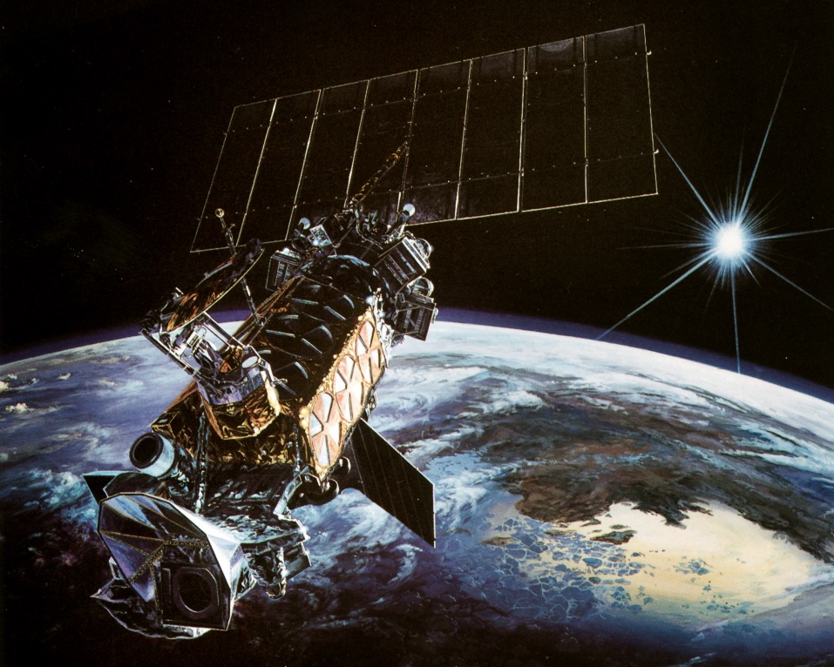
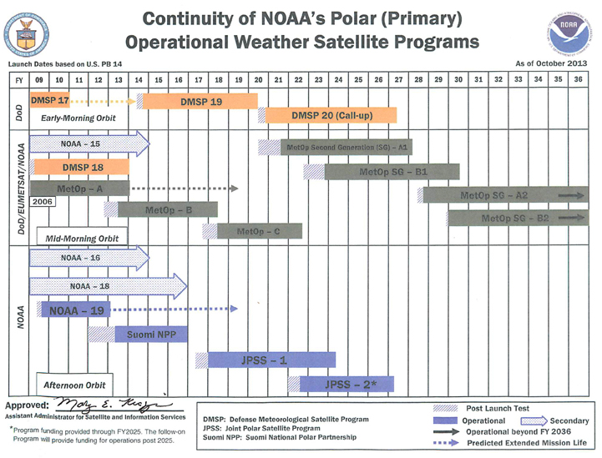
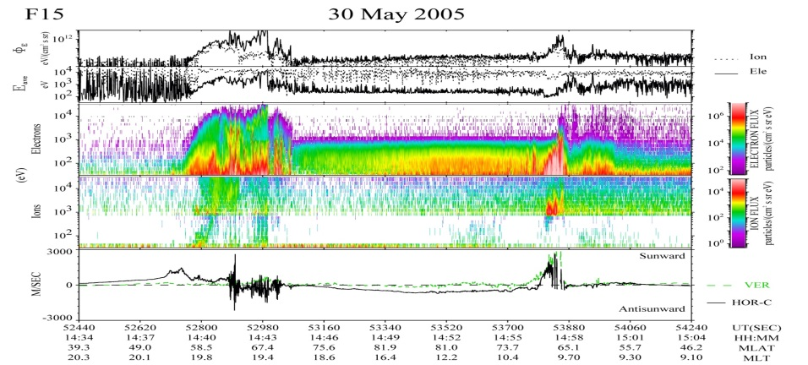
USAF SWx Observing Systems
Defense Meteorological Satellite Program
DMSP Space Weather Sensors (AFRL)
Sensors:
SSJ – Electron/Ion Spectrometer
SSIES – Cold Plasma Sensor (Driftmeter)
SSM – Magnetometer
Satellites: F06-F18 (1982 – Present)
Comment: Data provider: AFRL
Image courtesy LMMS

Slide 11
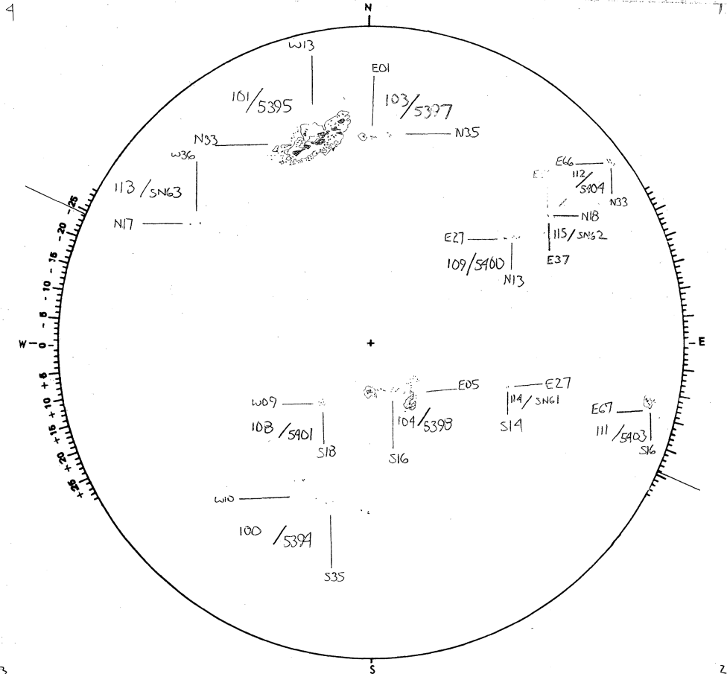
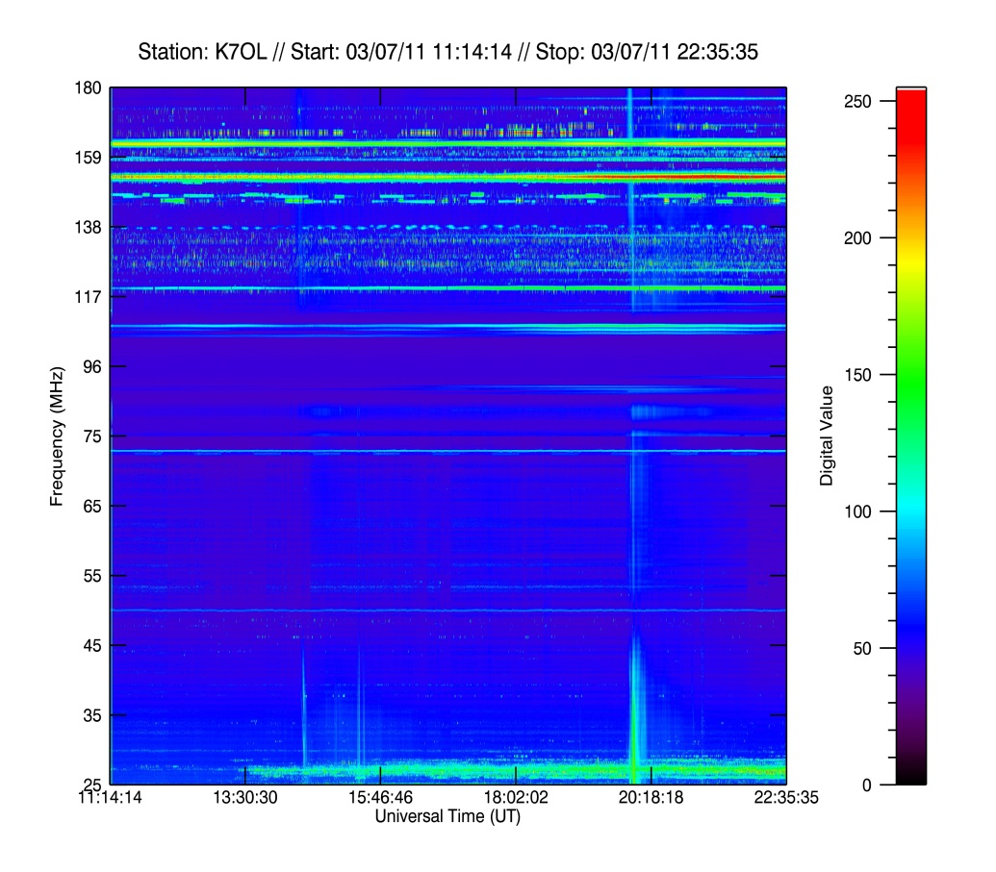
USAF SWx Observing Systems
Solar Electro-Optical Network (SEON)
13 March 1989
Holloman AFB
Solar Observing Optical Network
Daily solar sunspot drawings from 5 SOON sites from 1979 to present. Additional data on H-alpha flare reports.
Radio Solar Telescope Network (RSTN)
Daily solar radio fixed frequency and spectral measurements from 5 RSTN sites from 2000 to present.

Slide 12
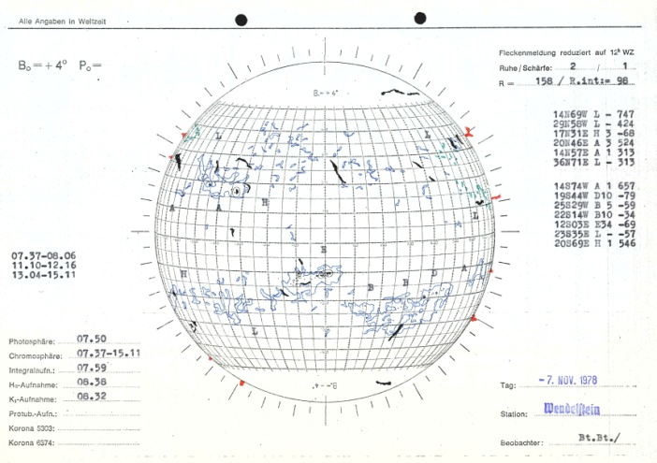
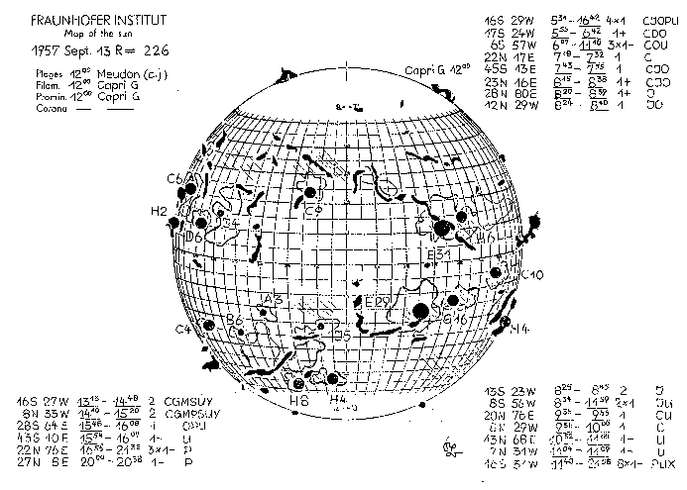
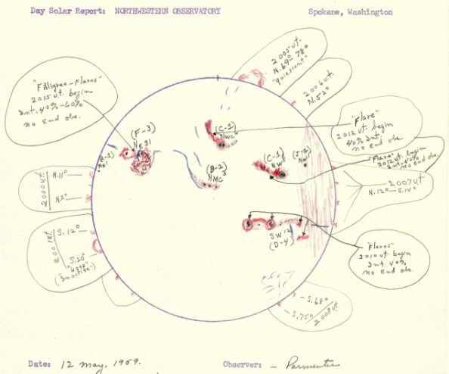
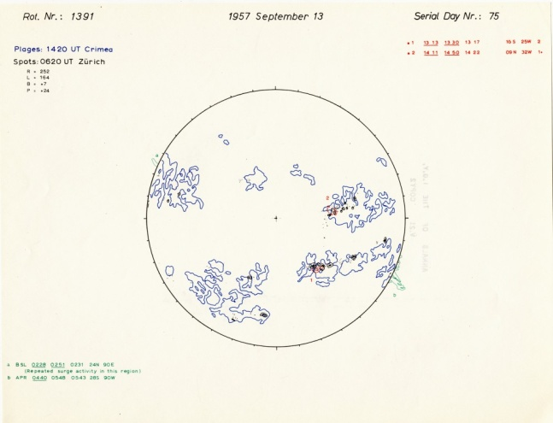
WDC for Solar-Terrestrial Physics
A Legacy from the 1957-59 IGY
Under the auspices of the former World Data Center for Solar-Terrestrial Physics (now the World Data Service for Geophysics) NGDC assumed responsibility for numerous datasets related to solar phenomena, the ionosphere, cosmic rays, geomagnetic field, aurora and airglow. Included here is a sample of available solar composite drawings.
Wendelstein Observatory
(1947-1987)
Boulder Daily Composites
(1972-present)
Fraunhoffer Institute
(1956 - 1973)
Northwestern Observatory
(1958 -1970)
Drawings from the IGY
(1957 - 1958)

Slide 13
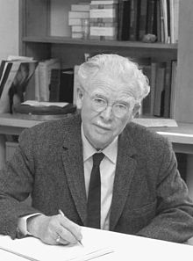
WDC for Solar-Terrestrial Physics
Interesting Historical Record – Scott Forbush
Original dataset “rescued” from destruction were the original records of Scott Forbush, an early cosmic ray physicist.
114 station-years of data from Cheltenham, Christchurch, Godhavn, Climax, Huancayo and Mexico City (1936-1968)
Discoveries attributed to Forbush include;
Decrease in cosmic rays during solar storms (Forbush Effect)
Anti-correlation between the 11-yr solar cycle and the cosmic ray flux
Association of increased cosmic radiation (solar energetic particles) correlated with solar flares
Ionization Chamber – Huancayo (Peru) – 03 Jan1938

Slide 14
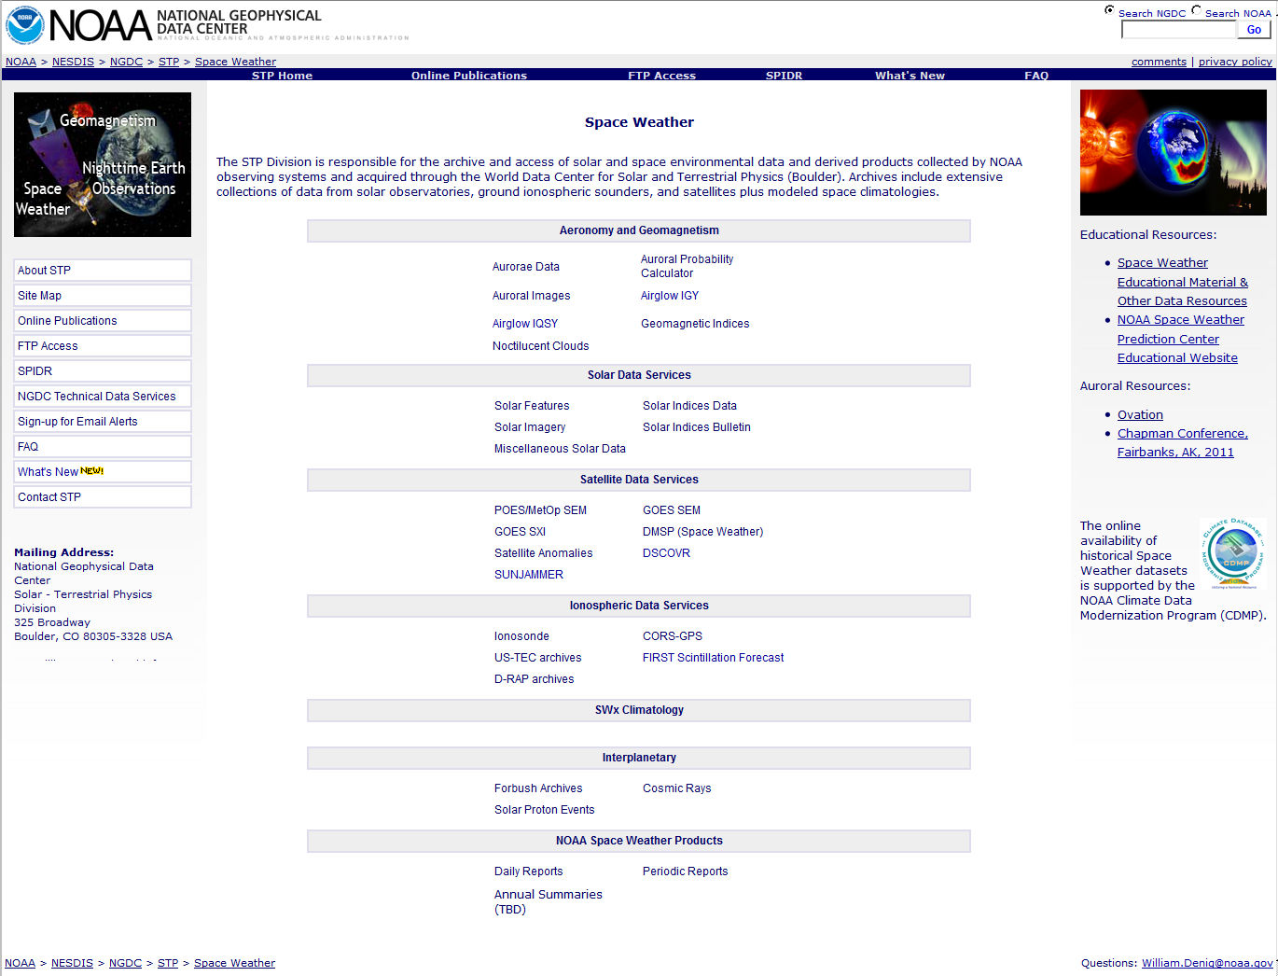
Main Access Portal – SWx
http://www.ngdc.noaa.gov/stp/spaceweather.html

Slide 15
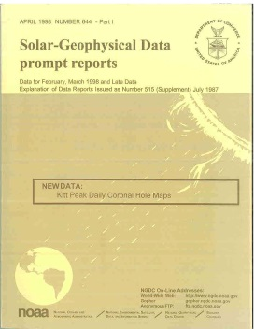
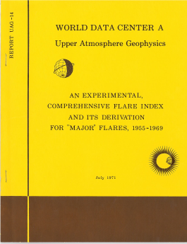
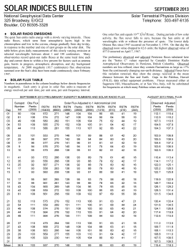
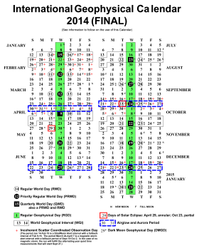
Concluding Thoughts
NOAA SWx Data Stewardship
1. The NGDC Solar & Terrestrial Physics (STP) division within NGDC is responsible for stewarding NOAA’s SWx datasets and related information
Current focus is the archive, access and assessment (AAA) of SWx data from NOAA’s fleet of operational environmental satellites
STP also stewards operational SWx data provided from USAF satellites and ground systems.
Division continues to manage a variety of historical SWx data collected through the World Data Service for Geophysics, formerly the WDC-STP (Boulder).
2. Challenges
While the first priority is NOAA’s satellite data, retaining the personnel (number and skillsets) needed to steward the breadth of technical data available is difficult.
There are limited opportunities to digitize historical paper, microfiche and film records
3. Some historical publications (available online) not discussed here:
Solar Geophysical Data
(1957-2009)
Upper Atmosphere Geophysics
(1968-1996)
Greenwich Photo-heliographic Results
(1874-1982)
Solar/Geomagnetic Indices Bulletins
(1985-Present)
International Geophysical Calendar
(1957-Present)

Slide 16
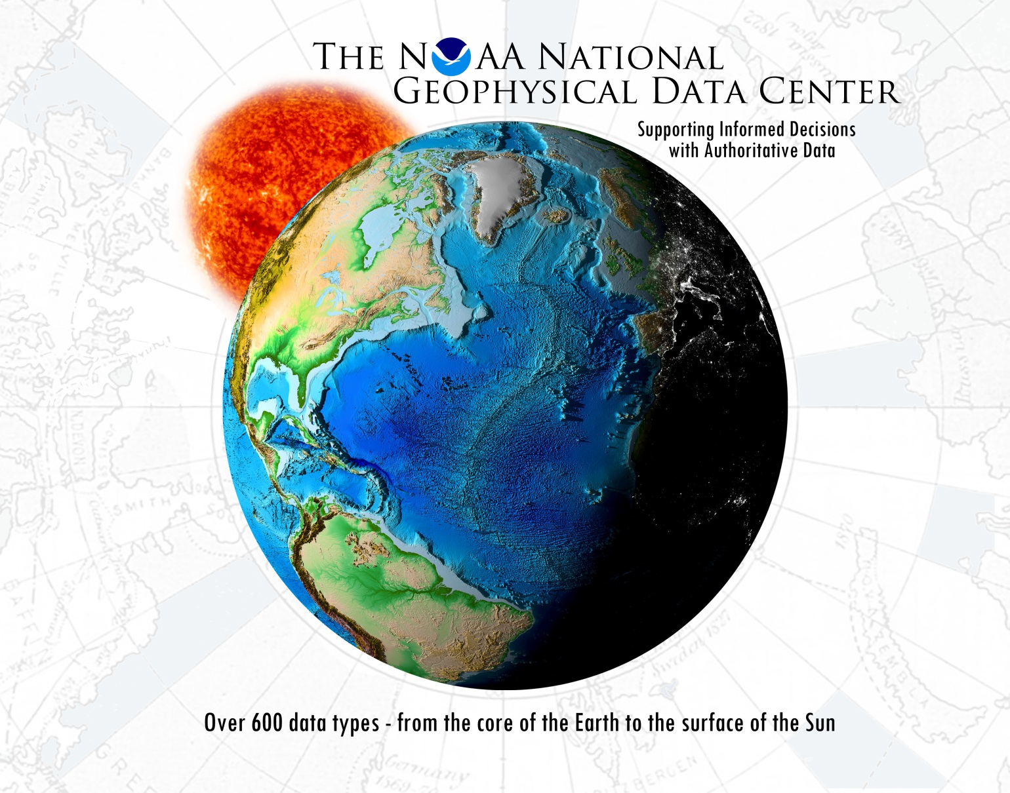
Thank You!

