Slide 1
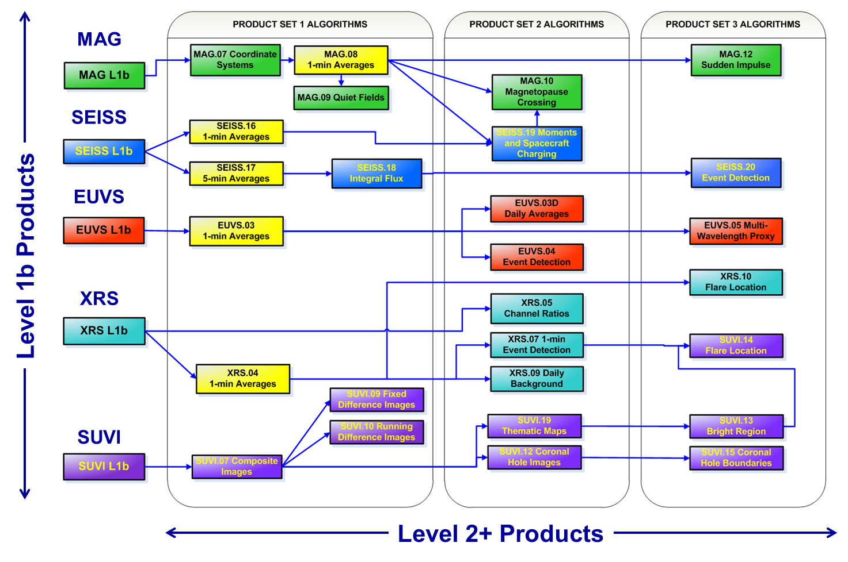
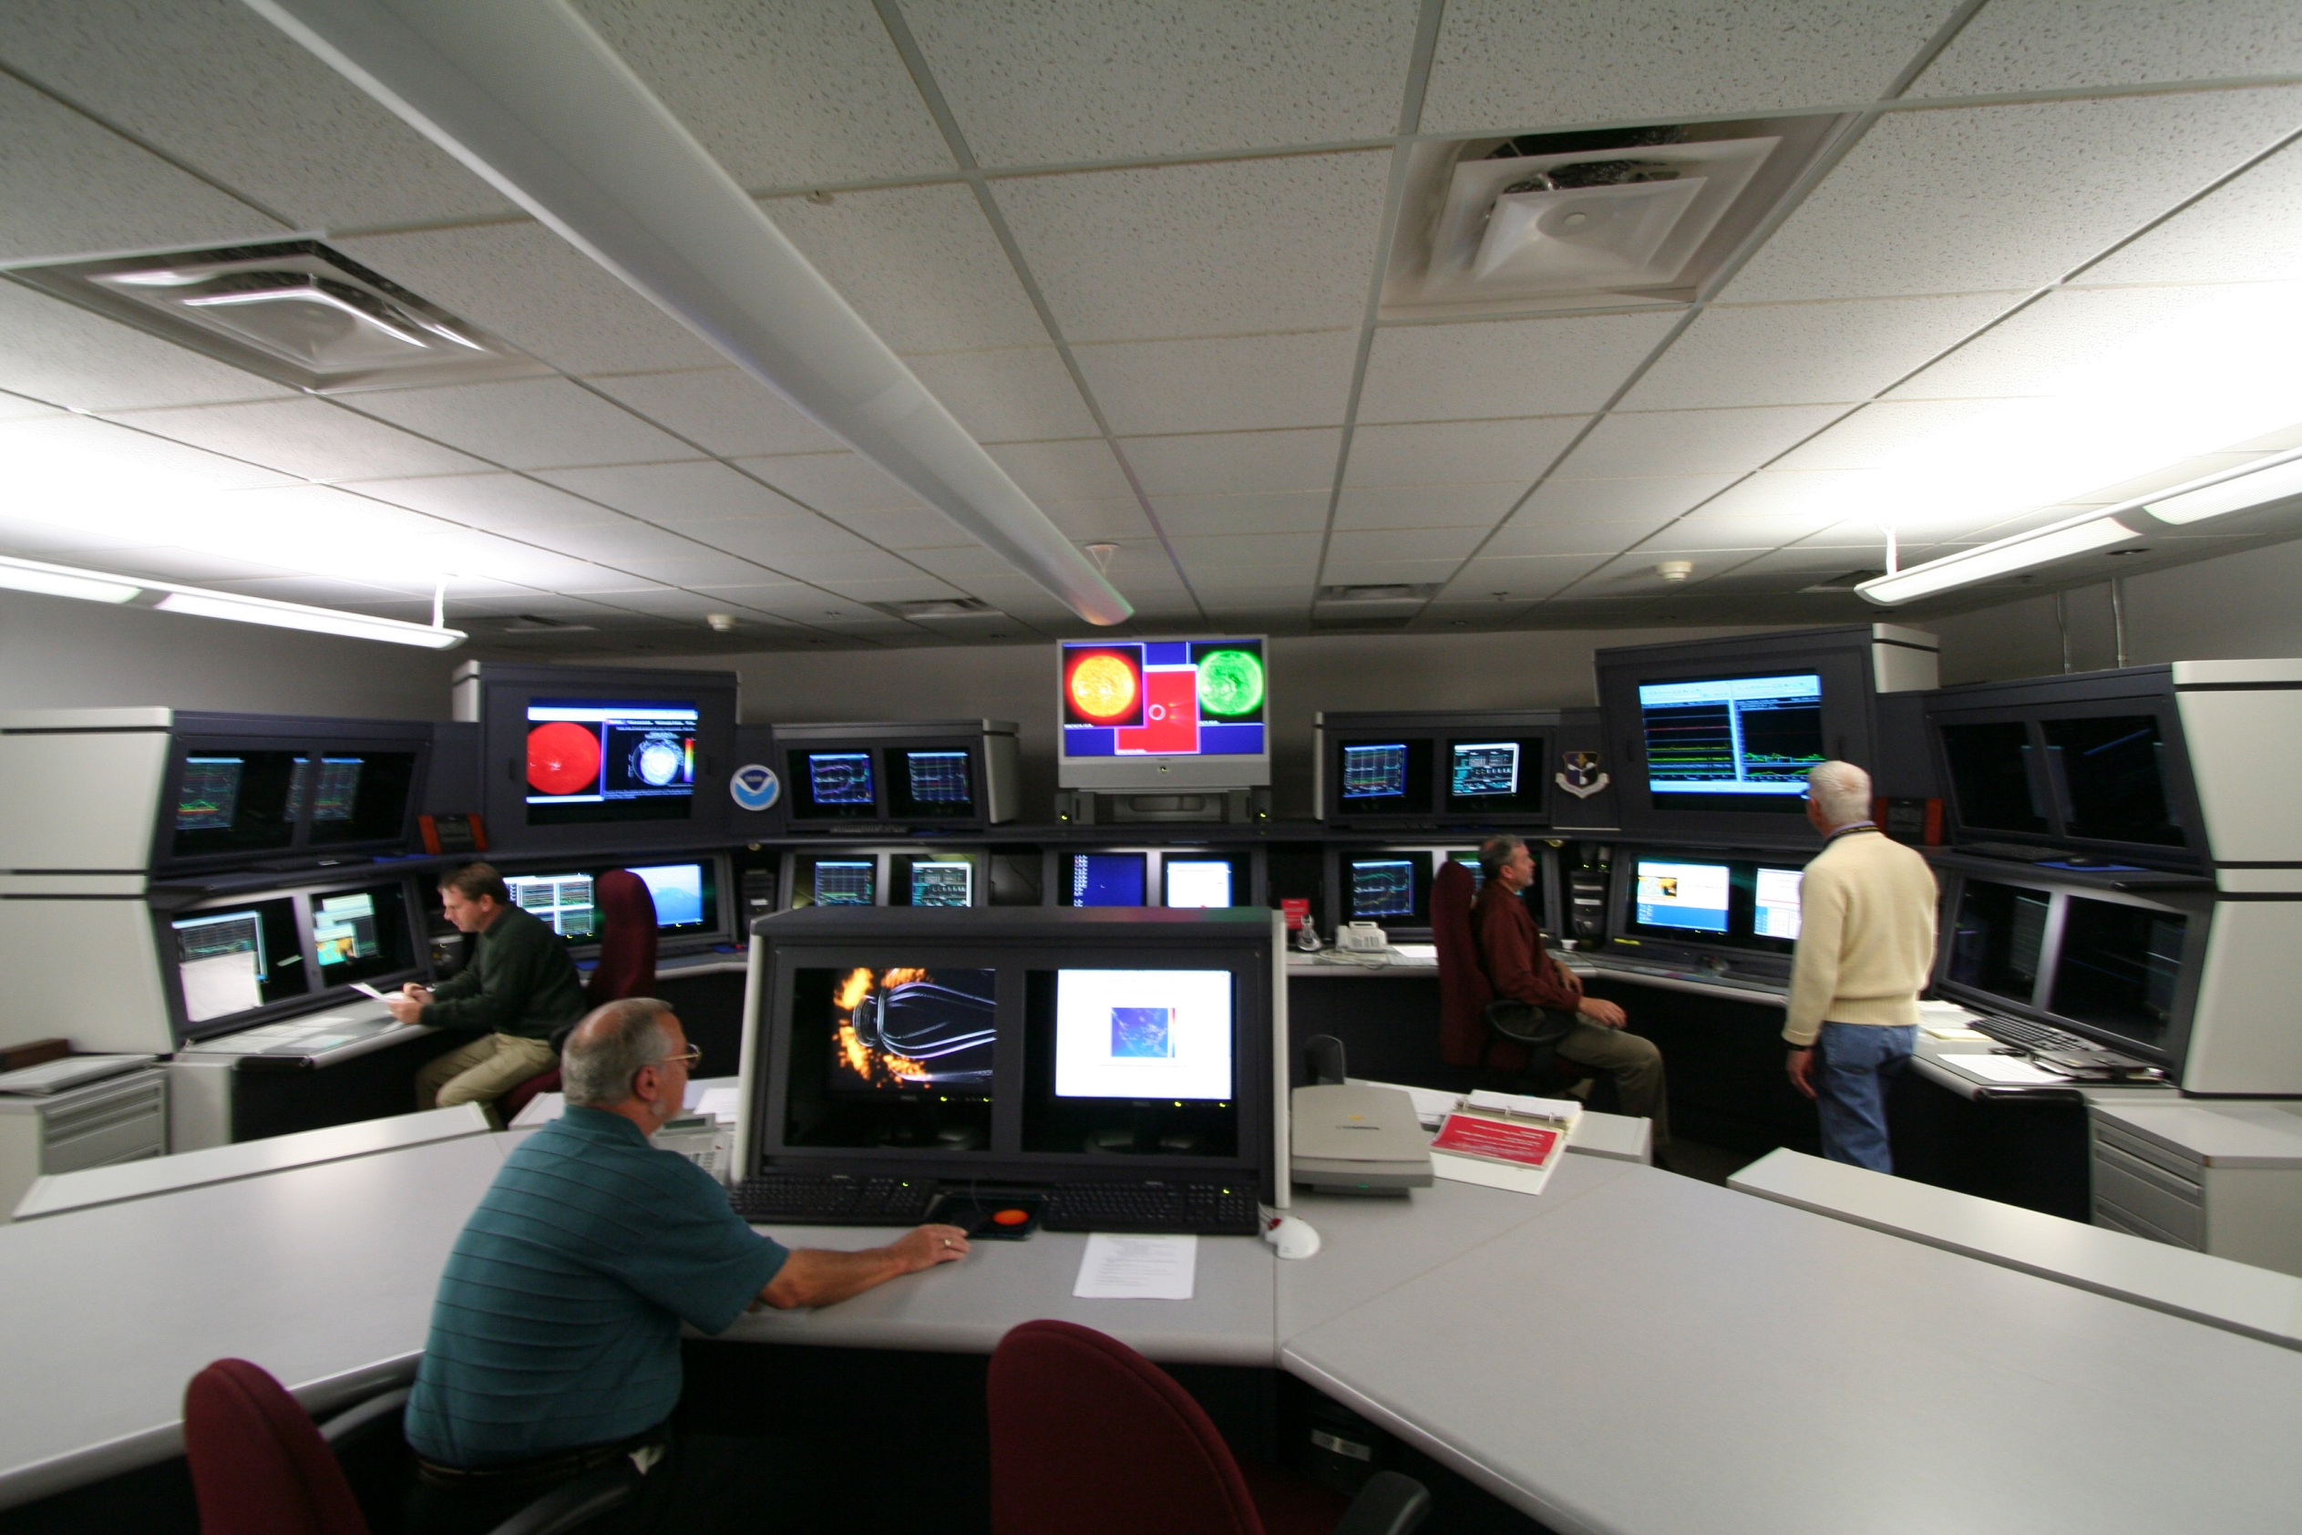
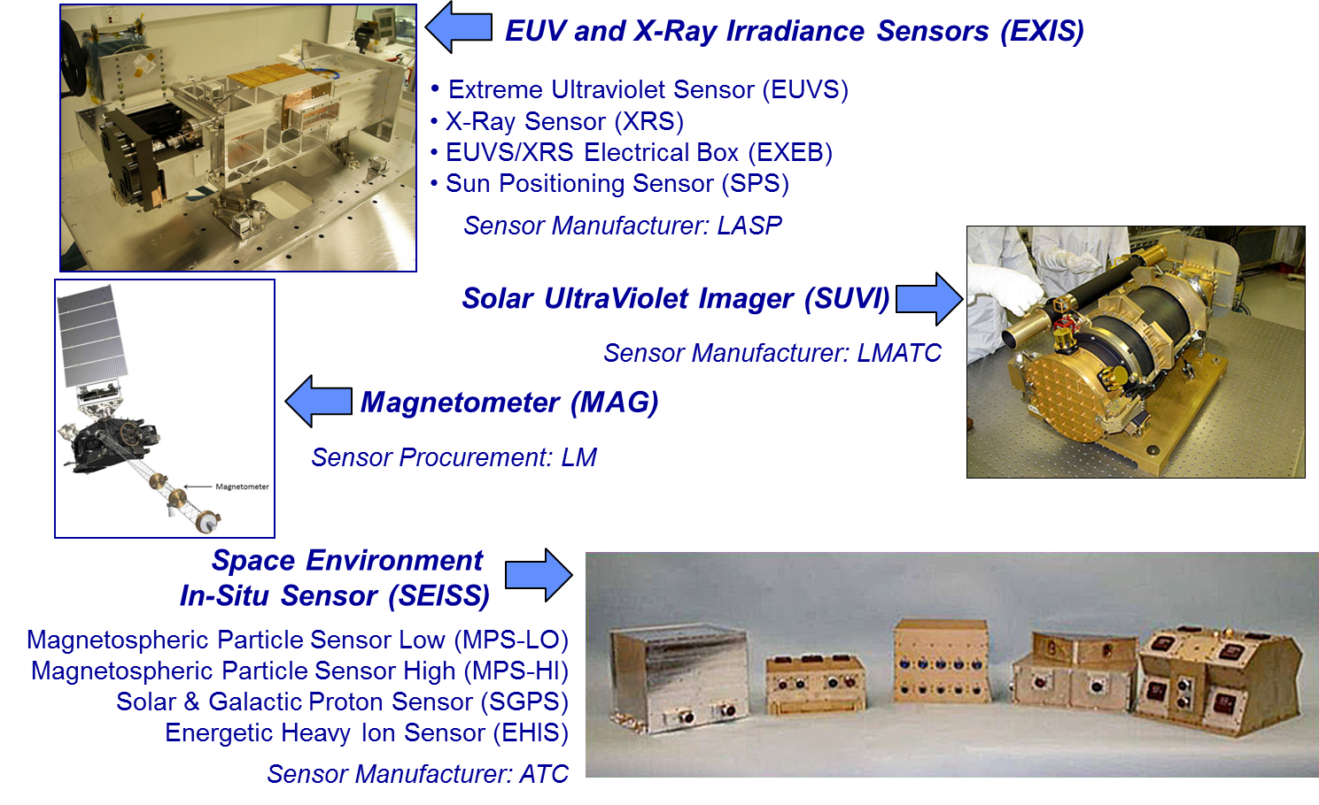
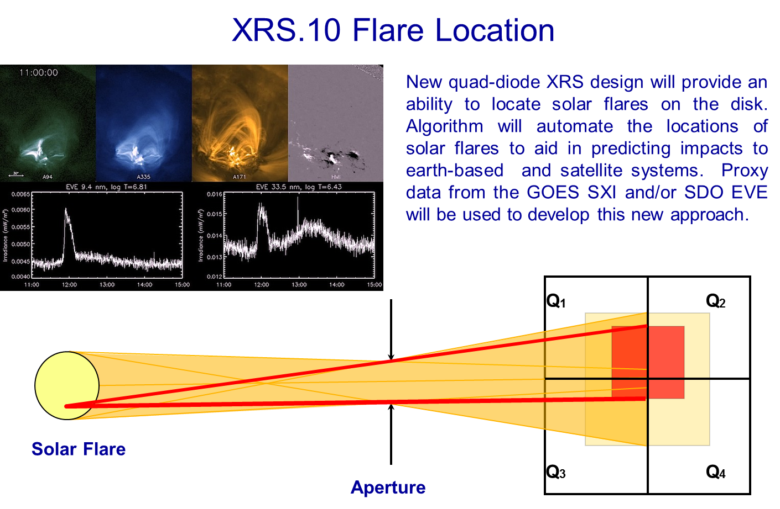
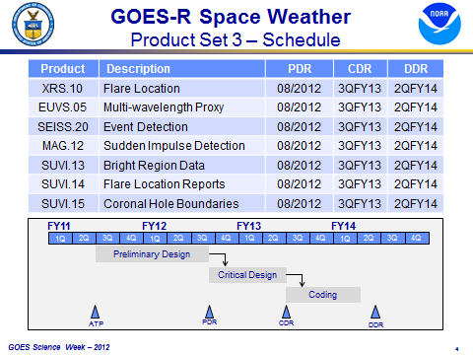
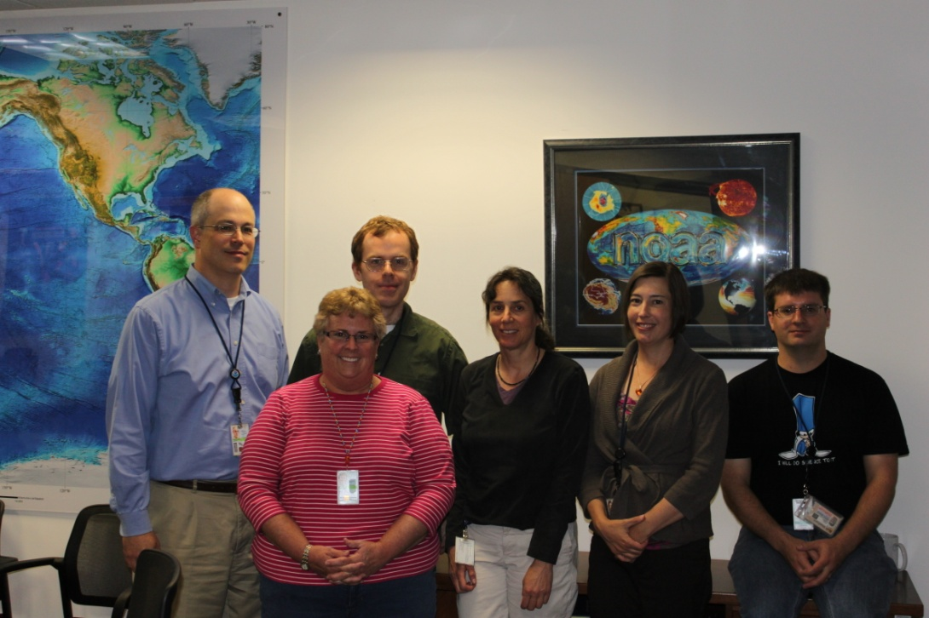
GOES-R Space Weather L2+ Algorithm Development
W. F. Denig
The NESDIS National Geophysical Data Center (NGDC) is currently responsible for the development of the GOES-R Level 2+ space weather science algorithms within the Risk Reduction and Algorithm Readiness programs. Close interaction with the user community represented by the NWS Space Weather Prediction Center (SWPC) ensures that the algorithms have operational relevance and, in some cases, can be immediately tested and deployed in the GOES-R Proving Ground. GOES-NOP data and space environmental measurements available from NASA science missions are used to produce proxy datasets and to allow “real-world” testing. The GOES-R algorithm developments have also been leveraged to provide early product demonstrations in the form of environmental assessments including spacecraft charging anomaly reports provided to NOAA senior leadership. In spite of the availability of space weather L2+ science algorithms it has yet to be determined where the operational processing will occur to support SWPC operations.
¹NOAA/NESDIS/National Geophysical Data Center (NGDC), 325 Broadway, Boulder, CO 80305 [william.denig@noaa.gov]
DEVELOPMENT TEAM
The NOAA National Geophysical Data Center (NGDC) is currently developing the Level 2+ space weather algorithms under the GOES-R Risk Reduction and Algorithm Readiness programs. These algorithms are being developed in cooperation with the NWS Space Weather Prediction Center (SWPC) who represents the operational users for the L2+ products (Figure below).
The L2+ algorithms are being developed by a dedicated affiliate team from the University of Colorado’s Cooperative Institute for Research in Environmental Sciences (CIRES) overseen by a Federal advisory staff. Core team members from CIRES are:
Mary Shouldis (NGDC) Systems Engineering
Juan Rodriguez (NGDC) SEISS
Alysha Reinard (SWPC) EXIS
Janet Machol (NGDC) EXIS
Jonathan Darnel (NGDC) SUVI
William Rowland (NGDC) MAG
Leslie Mayer (SWPC) MAG/SEISS
Jim Vickroy (SWPC) SUVI
GOES-R SPACE WEATHER SENSORS
The space weather sensors for GOES-R represent a significant advancement in operational capability from GOES-NOP. The sensor complement will provide in-situ measurements of the space environment in terms of energetic charged particles (electrons, protons and heavier ions) and the local magnetic field. Also included are solar-viewing sensors to image the sun in the ultraviolet and to measure radiant emissions in both x-rays and ultraviolet. Threshold capabilities for the GOES-R space weather sensors were derived from a series of user workshops held during the GOES-R concept exploration phase.
Level 2+ space weather algorithms initially recommended for development by SWPC and subsequently approved by the GORWG are listed below for Product Sets 1 to 3. The Product Sets represent both improvements to legacy GOES-NOP algorithms and new products all of which take full advantage of the GOES-R advanced sensing capabilities. Product Sets 1 and 2 are now complete and ready for operational implementation. Currently under development within NGDC are those science algorithms listed in Product Set 3.
Product Sets 1 to 3 represent an interdependent set of algorithms which increase in complexity from simple averaging and image differencing in Product Set 1 to image composite analyses and geophysical interpretations in Product Set 3.
Product L1b/L2+ Interdependencies
SET 3 SELECTED PRODUCT DESCRIPTIONS
ionospheric sounding data
LEVERAGED USE OF THE GOES-R PRODUCTS (EXAMPLE)
DEVELOPMENTAL SCHEDULE
The developmental schedule for Product Set 3 is shown below. The algorithm team members are currently working with the space weather operators within SWPC on the detailed requirements for the algorithms. The requirements are being captured in a GOES-R SWx L2+ Algorithm Requirements Document coordinated between NGDC and SWPC. Final deliveries of the Product Set 3 algorithms are currently planned for 2QFY14. As noted earlier, the path for research to operations (R2O) is currently unknown.
CONCLUSIONS
Activities in Year 1 were focused on requirements definition in cooperation with the operational user (SWPC)
Current Year 2 activities include Preliminary / Critical Design Review (PDRs/CDRs) for the 7 products currently under development
Year 3 activities involve final algorithm coding (science) and Data Delivery Reviews (DDRs)

