Slide 1
GOES-R Space Weather L2+ Algorithms
GOES Science Week
William F. Denig, Chief
Solar & Terrestrial Physics Division
NOAA/NESDIS/NGDC
+1 303 497-6323
William.Denig@noaa.gov

Slide 2
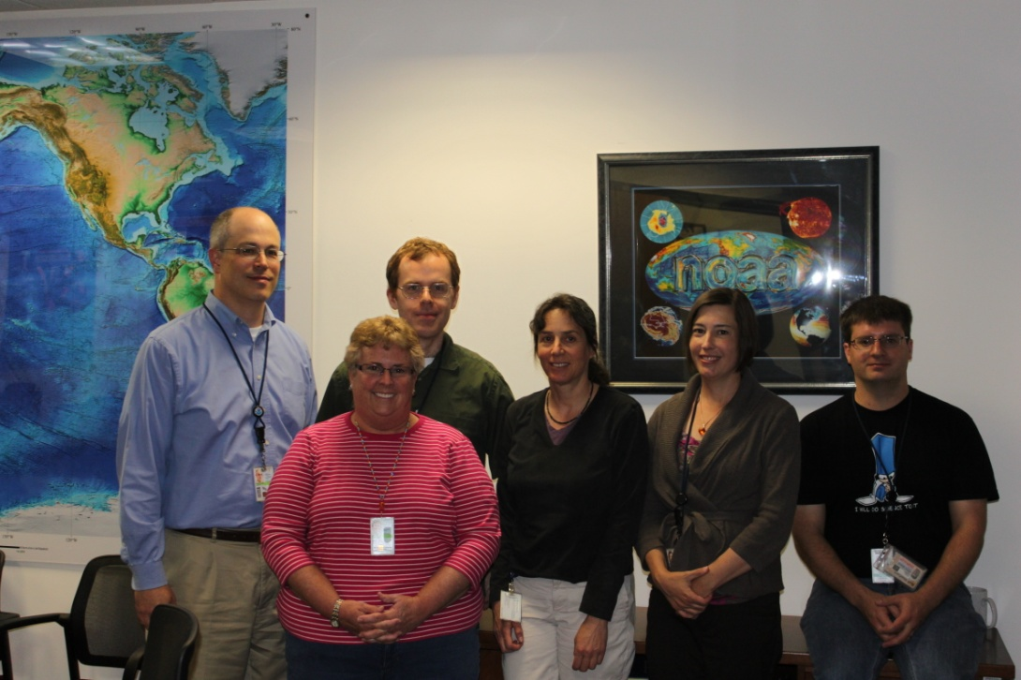
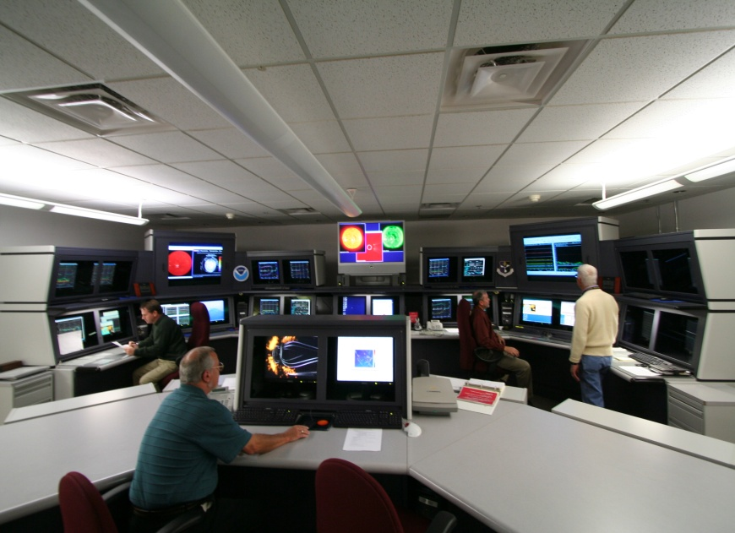
GOES-R Space Weather
GOES-R Space Weather Team
Core Team Members
Mary Shouldis Systems Engineering
Juan Rodriguez SEISS
Alysha Reinard EXIS
Janet Machol EXIS
Jonathan Darnel SUVI
William Rowland MAG
Leslie Mayer MAG/SEISS
Jim Vickroy SUVI
Federal Advisory Staff (NGDC/SWPC)
Bill Denig Federal Oversight
Janet Green SEISS Advisory
Rob Redmon MAG Advisory
Dan Wilkinson Archive
new hire (pending) SUVI Advisory
Steven Hill SUVI Advisory
Terry Onsager SEISS Advisory
Rodney Viereck XRS/EUVS Advisory
Howard Singer MAG Advisory
Christopher Balch Lead Forecaster
Space Weather Forecast Office, Boulder, CO

Slide 3
GOES-R Space Weather
Space Weather L2+ Product Overview
Product Set 1
Complete
Product Set 2
Complete
Product Set 3
In Process
XRS.04: One-minute averages for both long and short channels
EUVS.03: One-minute averages of broad spectral bands
SEISS.16: One-minute averages - all MPS channels
SEISS.17: Five-minute averages - all MPS and SGPS channels
SEISS.18: Convert differential proton flux values to integral flux values
MAG.07: MAG data in alternate geophysical coordinate systems
MAG.08: One-minute averages
MAG.09: Comparison to quiet fields
SUVI.07: Composite (wide dynamic range) images
SUVI.09 and .10: Fixed and running difference images
XRS.05: Calculate the ratio of the short over long channels
XRS.09: Daily Background
XRS.07: Event Detection with one-minute data
EUVS.03D: Daily averages of broad spectral bands
EUVS.04: Event Detection
SEISS.19: Density & temperature moments & level of spacecraft charging
MAG.10: Magnetopause crossing detection
SUVI.12: Coronal Hole Images
SUVI.19: Thematic Map
XRS.10: Flare Location
EUVS.05: Multi-wavelength Proxy
SEISS.20: Event detection based on flux values
MAG.12: Sudden Impulse (SI) detection
SUVI.13: Bright Region Data
SUVI.14: Flare Location (XFL) Reports
SUVI.15: Coronal Hole Boundaries
Algorithms leverage new sensor capabilities and extended environmental ranges.
Legacy Product
New Product
26 Level 2+ Space Weather Products in three product sets
18 are operational legacy, 8 are new or have experimental heritage

Slide 4
GOES-R Space Weather
Product Set 3 – Schedule
Product | Description | PDR | CDR | DDR
XRS.10 | Flare Location | 08/2012 | 3QFY13 | 2QFY14
EUVS.05 | Multi-wavelength Proxy | 08/2012 | 3QFY13 | 2QFY14
SEISS.20 | Event Detection | 08/2012 | 3QFY13 | 2QFY14
MAG.12 | Sudden Impulse Detection | 08/2012 | 3QFY13 | 2QFY14
SUVI.13 | Bright Region Data | 08/2012 | 3QFY13 | 2QFY14
SUVI.14 | Flare Location Reports | 08/2012 | 3QFY13 | 2QFY14
SUVI.15 | Coronal Hole Boundaries | 08/2012 | 3QFY13 | 2QFY14
FY11 FY12 FY13 FY14
1Q
2Q
3Q
4Q
1Q
2Q
3Q
4Q
1Q
2Q
3Q
4Q
1Q
2Q
3Q
4Q
Preliminary Design
Critical Design
Coding
ATP
PDR
CDR
DDR

Slide 5
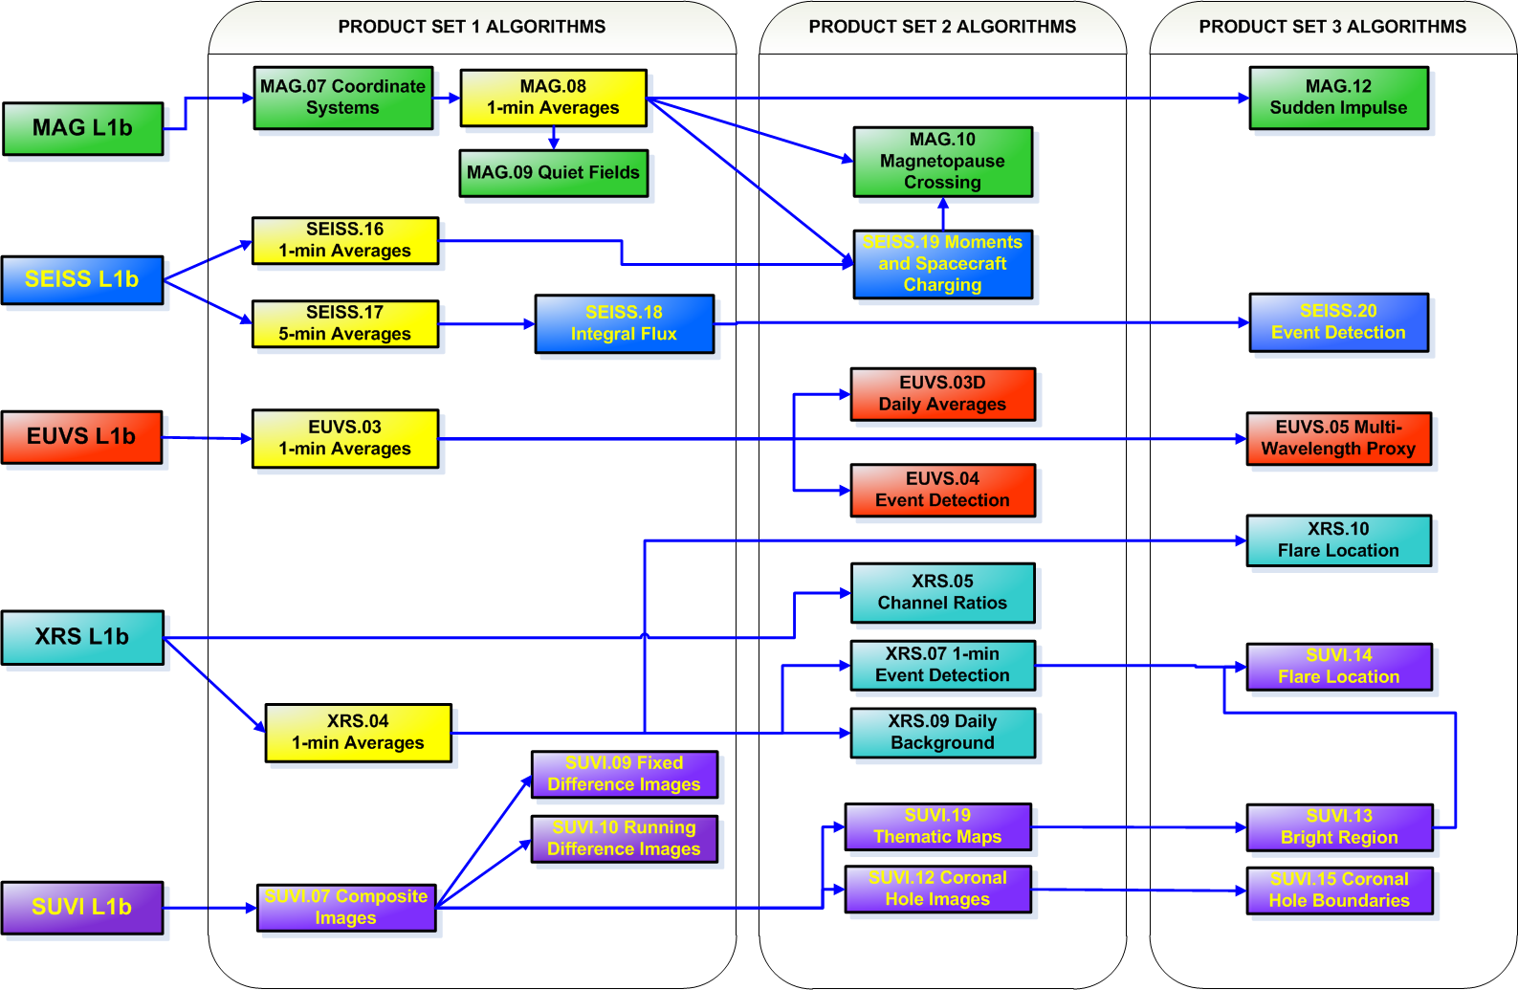
GOES-R Space Weather
Product L1b/L2+ Interdependencies
MAG
SEISS
EUVS
Level 1b Products
XRS
SUVI
GOES-RRR 23 Sep 2011
Level 2+ Products

Slide 6
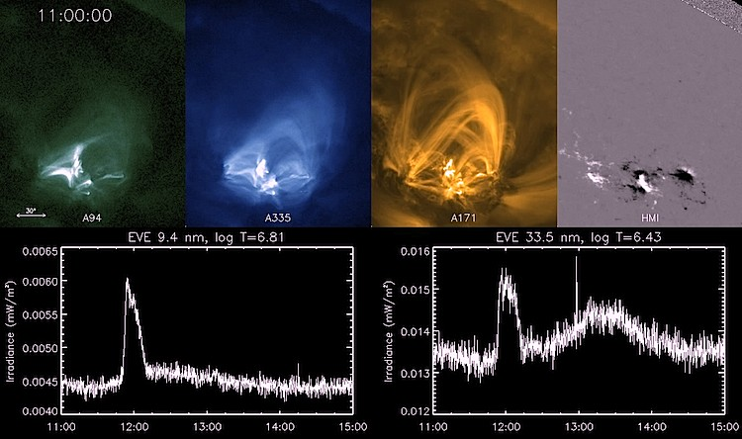
GOES-R Space Weather
XRS.10 Flare Location
New quad-diode XRS design will provide an ability to locate solar flares on the disk. Algorithm will automate the locations of solar flares to aid in predicting impacts to earth-based and satellite systems. Proxy data from the GOES SXI and/or SDO EVE will be used to develop this new approach.
Q1
Q2
Solar Flare
Q3
Q4
Aperture

Slide 7
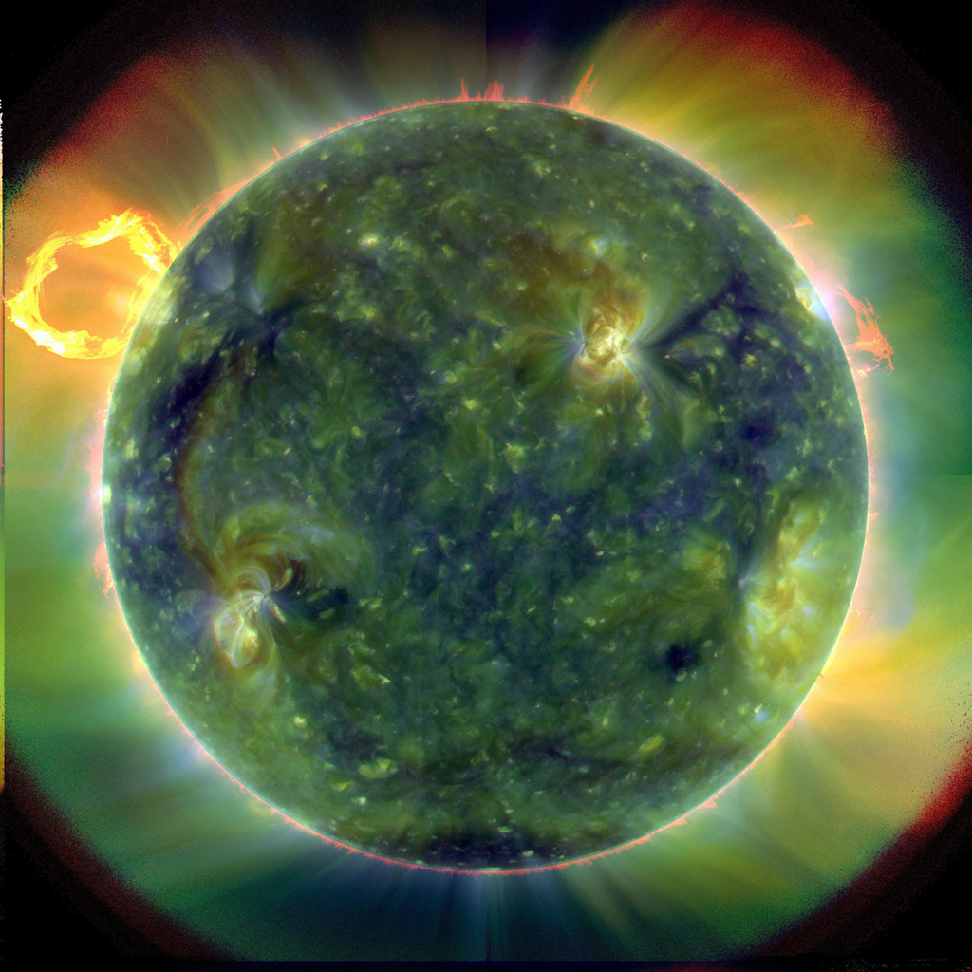
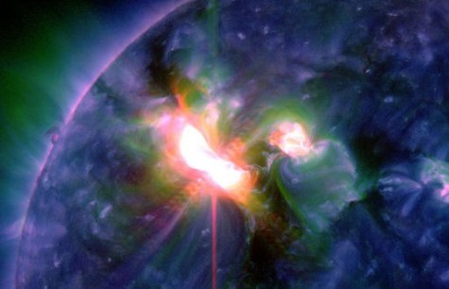
GOES-R Space Weather
EUVS.05 Multi-Wavelength Proxy
EUVS measurements within three spectral regions in the extreme ultra-violet (EUV) to monitor solar emissions from the chromosphere, transition region, and the corona. Algorithm will regenerate the full EUV spectrum via a bootstrap technique. Proxy data provided from the SDO EVE and the SORCE SOLSTICE sensors.
Solar Flare – 07 Mar 12
EUV Composite Solar Image

Slide 8
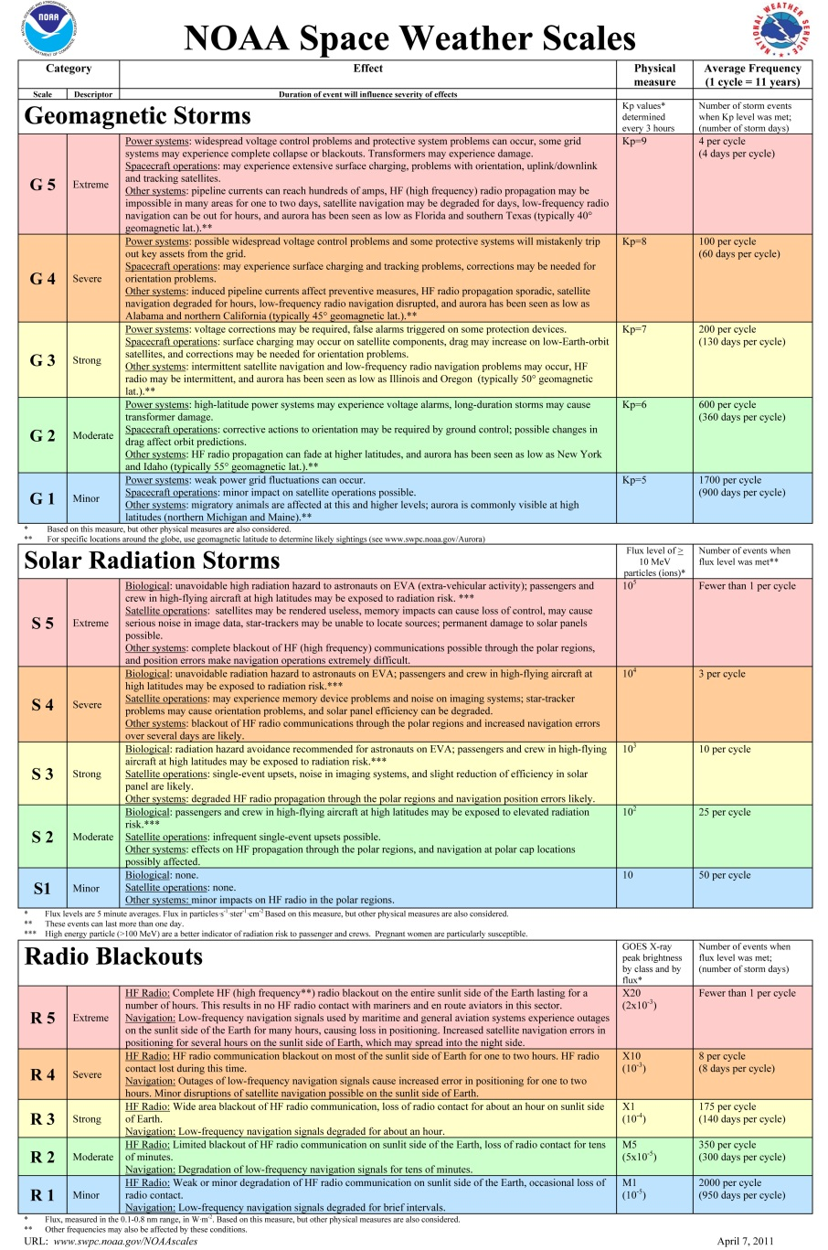
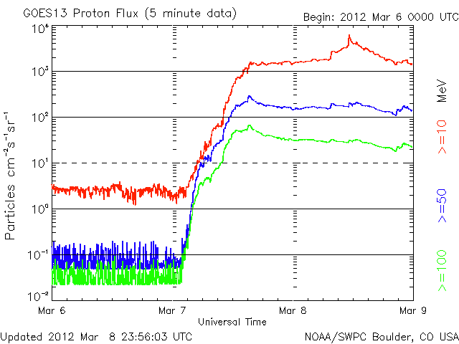
GOES-R Space Weather
SEISS.20 Event Detection
Algorithm will report all event detection parameters, peak fluxes and event fluences based on SEISS SGPS measurements. Adding a rate of rise quantity to the event onset detection will enhance the algorithm’s prediction capabilities.
S3
S2
S1

Slide 9
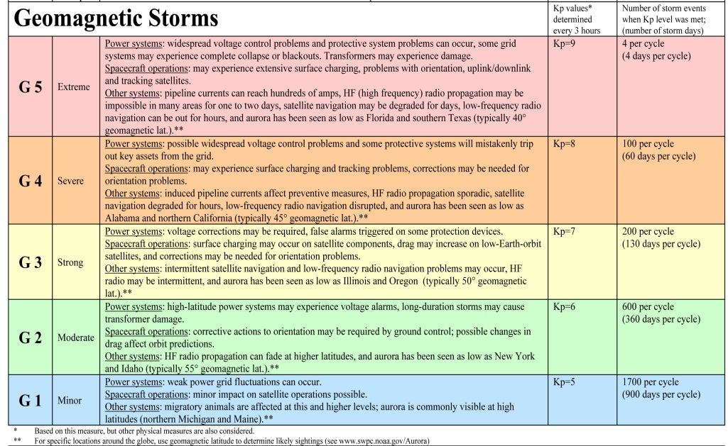
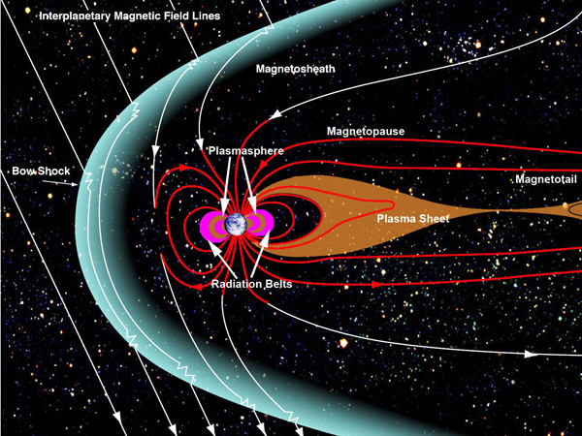
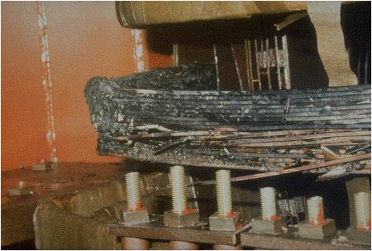
GOES-R Space Weather
MAG.12 Sudden Impulse Detection
Algorithm to detect impulsive magnetospheric events. GOES-R data to be used in conjunction with ground magnetometer observations to detect events. Outputs used for SWPC geomagnetic storm warning.
Destroyed Power Transformer – March 1989

Slide 10
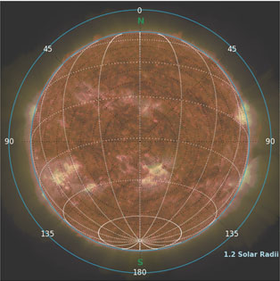
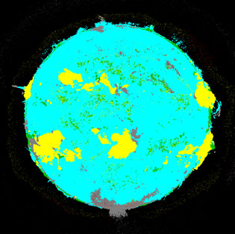
GOES-R Space Weather
SUVI.13 – 15 Solar Features
SUVI.13 – Bright Regions (Faculae)
SUVI.14 – Solar Flare Locations
SUVI.15 – Coronal Hole Boundaries
Thematic maps will be used to automate the identification and location of bright regions, flares and coronal hole boundaries in solar images. For on-disk features, locations specified in helio-graphic coordinates (i.e. the lat/lon grid). For off-disk features, a radius from solar center and angle from solar north is used.
Thematic Map
2012-04-30 12:04 UT
Solar Geometry
Notes:
Key (Thematic Map)
- Outer Space – Black
- Coronal Hole – Grey
- Blue – Quiet Corona
- Yellow – Active Region
- Green – Prominence or Filament
- Red - Flare

Slide 11
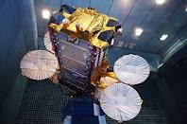
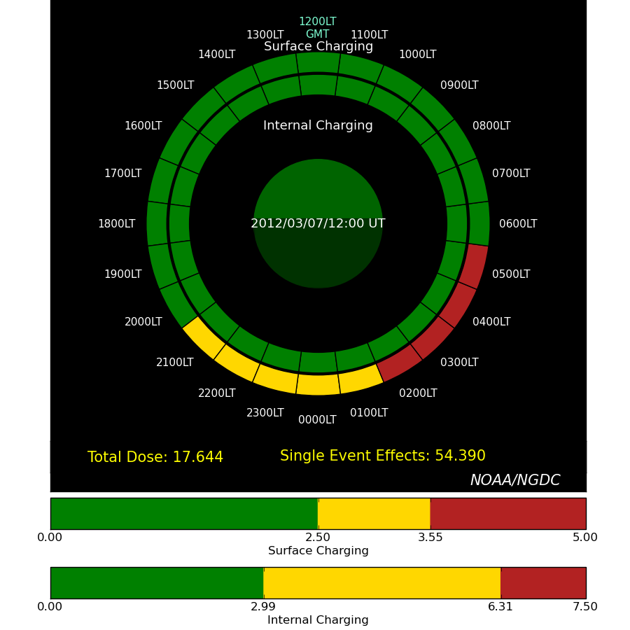
Leveraged Development
Environmental Assessments
On March 7th, 2012 the SkyTerra-1 satellite suffered an anomaly causing a COMM outage that adversely impacted homeland security readiness. Using tools developed under the GOES-RRR/AR program, NGDC conducted an environmental assessment that showed that the SkyTerra-1 was at increased risk of experiencing a Single Event Upset (SEU) .
SkyTerra-1
Outage

Slide 12
GOES-R Space Weather
Overall Status
GOES-R Risk Reduction activities are researching and developing operational algorithms for existing and new space weather products
User requirements for improved GOES-R space weather products have presented challenges requiring new approaches and algorithms for processing and interpreting the sensor data
Product Sets 1 and 2 are complete with completion of 20 of 27 science algorithms completed to date
Product Set 3 algorithm research and development is well underway with PDR expected in late summer
Metadata and archival requirements definition efforts have been supported by the core team
Team has also been heavily involved in calibration and validation activities needed for the space weather sensors

