Slide 1
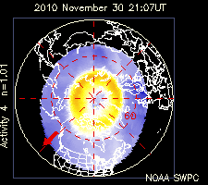
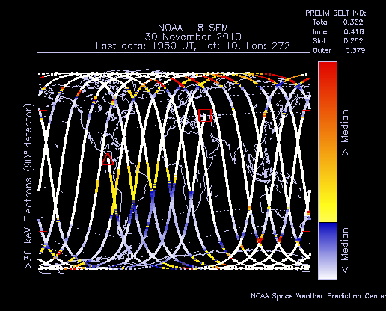
New Operational Algorithms for Charged Particle Data from Low-Altitude Polar-Orbiting Satellites
J. L. Machol^{1,2 *}, J.C. Green¹, J.V. Rodriguez^{3,4}, T.G. Onsager³, W.F. Denig¹, and P.N. Purcell^{1,2}
¹National Oceanic and Atmospheric Administration(NOAA)/National Geophysical Data Center, Boulder, Colorado, USA;²Cooperative Institute for Research in the Atmosphere, Colorado State University, Fort Collins, Colorado USA; ³NOAA/Space Weather Prediction Center, Boulder, Colorado, USA; ⁴Cooperative Institute for Research in Environmental Sciences, University of Colorado, Boulder, Colorado, USA; *janet.machol@noaa.gov
Summary
NOAA is developing operational algorithms for the next generation of low-altitude polar-orbiting weather satellites. Here we focus on two new algorithms for charged particles: Energetic Ions and Auroral Energy Deposition. Both algorithms take advantage of the planned improved performance of the Space Environment Monitor – Next (SEM-N) sensors over the earlier SEM instruments flown on the NOAA Polar Orbiting Environmental Satellites (POES). These new instruments are planned to fly on the Defense Weather Satellite System (DWSS), the successor to the Defense Meteorological Satellite Program (DMSP).
Method
1. Read in 5 channels of raw proton counts. The energy ranges of the channels overlap.
2. Generate initial estimates of the
differential flux spectrum in order to
convert raw counts to non-overlapping
energy channels.
3. Initialize the E_{i} with √E_{u}E_{l} -- the geometric
mean of the E_{i} in adjacent channels.
4. Iteration:
Calculate γ_{i} from E_{i}.
Recalculate E_{i} using the γ_{i}. (Average values.)
If errors/low counts, use single power law fit.*
Repeat iteration until E_{i} change by <1%.
5. Calculate the coefficients j_{0,I} from the final
set of E_{i} and γ_{i}.
6. Extrapolate from the fits to cover the full
energy range.
This technique is based on that used for the SEISS Integral Flux
Algorithm for the GOES-R satellite [Rodriguez, 2009]. The
method differs because the SEM-N detectors have energy-
dependent geometric factors and overlapping detector channels.
Auroral Energy Deposition Algorithm
This algorithm estimates the energy flux deposited into the atmosphere by precipitating low- and medium-energy charged particles. The AED calculations include particle pitch-angle distributions. The algorithm converts differential energy flux [keV / (cm² s sr MeV)] to ionospheric energy deposition [W/m²].
initial fit
Method
2
1
Use SSJ5 low energy particle data.
6 look directions (15˚ x 4˚)
19 electron and proton energy levels (0.03 eV-30 keV)
and EPM medium energy particle data.
5/6 look directions (12˚ x 8˚)
12 electron energy levels (25 keV-1 MeV)
21 proton energy levels (30 keV-10 MeV)
Assume that all particles in loss cone precipitate. The edge of the loss cone is
given by and the B-field values are from the IGRF model.
The detectors do not always fully overlap loss cone.
Extrapolate over missing angles in loss cone; average as needed. Two examples:
Migrate energy flux to ionospheric altitudes ("foot-of-the-field line").
Calculate total precipitated energy flux:
5
4
3
SSJ5
detector
6
Energetic Ions Algorithm
This algorithm derives a differential energy flux spectrum for protons with energies from 10-250 MeV from particle counts by iterating a piecewise power law fit. The algorithm provides the data in energy flux units (MeV cm² s⁻¹ sr⁻¹ MeV⁻¹) instead of just count rates as was done in the past, making the data generally more useful and easier to integrate into higher level products.
p
e⁻
p
RAM
p
e⁻
e⁻
p
e⁻
after iterating
p
e⁻
p
EPM
detector
background
channel
High Energy Omnidirectional Detectors
The algorithm input is count rates from the four SEM-N high energy detectors. The algorithm converts from count rate to a differential energy flux spectrum.
FOV
geometric
factors
j(E) = j₀E^{γ}
*fit with a single
power law
satellite
orbit
detector
j, Differential Flux
descending
B
ascending
downward
loss cone
overlapping
energy channels:
10 -35 MeV
16-35 MeV
35 -250 MeV
70 -250 MeV
140 -250 MeV
10
35
70
140
250 MeV
Simple Validation
"Truth" vs. Fit for 2003 Storm
counts
aging
diff flux
detector
pitch angle
FOV
background
Used functional forms for fluence
spectra for five SEP events for the
2003 Halloween storm generated
by Mewaldt et al.¹ to generate
proxy counts and test algorithm.
More validation will be done
with proxy data generated from
POES data.
error 2.4%
standard dev 4%
loss cone
B
SSJ5
B
loss cone
diff. energy flux
?
?
Basic Concept
The algorithm generates a piecewise power law ( j_{i}(E) = j_{0,i} E^{γi} ) fit to the differential flux over adjacent energy ranges. The algorithm outputs four pairs of coefficients, j_{0,i} , and exponents, γ_{i}.
For geometric factors, G(E), the count rate can be expressed as either:
or for some "center-of-mass" energy, E_{i}
?
-60 -40 -20 0 20 40 60 80
-40 -20 0 20 40 60 80
... true
__ fit
angle relative to zenith
angle relative to zenith
C_{i}
¹Mewaldt, R. A., C. M. S. Cohen, A. W. Labrador, R. A. Leske, G. M. Mason, M. I. Desai, M. D. Looper, J. E. Mazur, R. S. Selesnick, and D. K. Haggerty (2005), Proton, helium, and electron spectra during the large solar particle events of October–November 2003, J. Geophys. Res., 110, A09S18, doi:10.1029/2005JA011038.
differential
flux, j(E)
j_{i}= j_{0i} E^{γ}
Tests with Proxy Data
Current Products
E_{i}
particle energy, E
E_{i+1}
Tested algorithm by generating proxy data from POES data for 1999-2010.
Generated "true" flux spectrum from data, created associated omni counts, added Poisson noise, and then compared algorithm output with "true spectrum".
Average standard deviation of fits from "truth" is 30% (for non-simple fits and POES specifications).
Can use proxy data to optimize thresholds for algorithm.
Future Products
We will reprocess POES data to produce energy flux spectra based on these routines.
We are investigating statistical methods to improve NOAA's real-time maps for auroral and radiation belt particles.
"center of mass"
Auroral
Energy
Flux
Radiation Belt
Particle Flux

