Slide 1
NOAA Non-standard and Test Products for Space Weather
William Denig¹
Rodney Viereck²
¹National Geophysical Data Center (NGDC)
²Space Weather Prediction Center (SWPC)
AGU – 12/2012 Paper: IN31D-03

Slide 2
Non-standard SWx Products
Available from SWPC / NGDC
Non-standard test products include space weather models and applications that are under development as beta-version or test products.
NA-TEC (North America Total Electron Content) – Ionospheric model of vertical TEC within North America and surrounding areas.
FIRST (Forecasting Ionospheric Real-time Scintillation Tool) – Forecast the probability of evening equatorial scintillation by monitoring the height rise of the ionospheric F layer (after Redmon & Anderson [2010]).
SEAESRT (Space Space Environmental Anomalies Expert System Real Time) – Risk assessment tool for geosynchronous satellite operations (after O’Brian et al [2009]).
OPRT (OVATION Prime Real-Time) – Real-time forecast and nowcast model of auroral power using ACE solar-wind data and Kp (after Newell et al [2009]).
PeEPs (People Empowered Products) – Combines Twitter reports of auroral sightings with auroral model projected onto Google Earth.
ART (Auroral Resources Toolkit) – A rich internet application for the visualization and collaboration of auroral phenomenology.

Slide 3
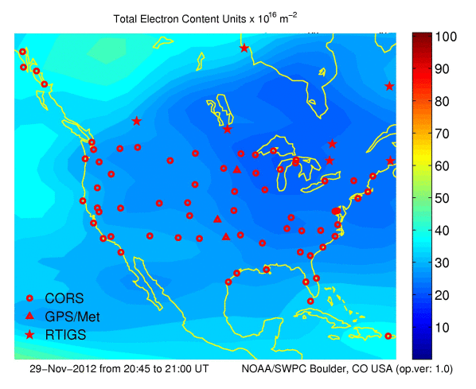
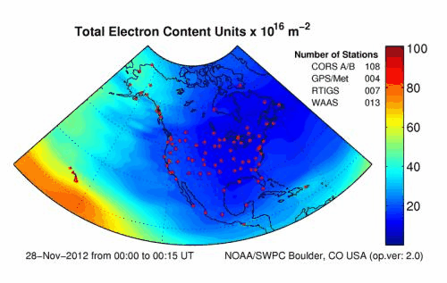
NA–TEC: North America Total Electron Content
A Product for GPS Users
NA-TEC Under Development
Current US-TEC
SWPC/NGDC are expanding the coverage of the operational US TEC model to cover North America
Errors in GPS position information are directly related to the Total Electron Content above the receiver.
Both US-TEC and NA-TEC are Kalman-filter based data assimilation ionospheric models of Total Electron Content. (TEC) which can be an indicator of GPS error.
The solution is well constrained over the CONUS due to the availability of GPS receivers but not so at the high and low latitudes.
More real-time data is needed. Efforts are underway to add new receivers in Alaska and Canada. Many data sets are not “real time” (Latency <15 minutes)
Customers: Airlines, Agriculture, Surveying, Snow Removal, Oil Exploration
Status: Validation prior to release as a test product
US–TEC: http://www.swpc.noaa.gov/ustec/index.html

Slide 4
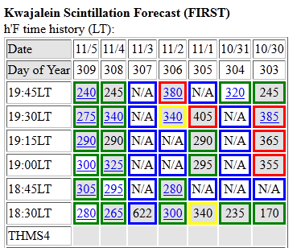
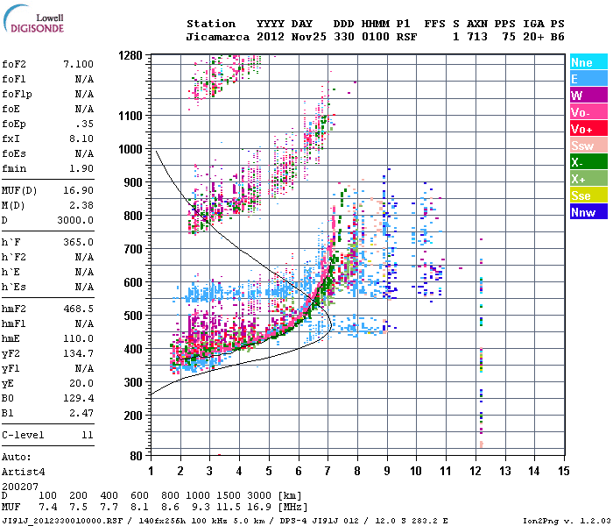
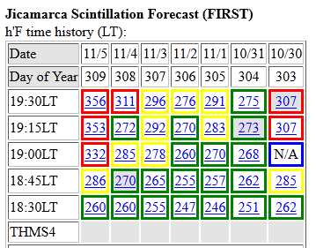
FIRST: Forecasting Ionospheric Rt Scintillation Tool
A Product for Dual Frequency GPS Users Near the Equator
Predict the occurrence of local ionospheric scintillation:
Evening-side phenomena at low magnetic latitudes.
Uses ionosonde measurements of the ionosphere height h’F, (values in boxes) as a proxy for ExB drift and to assess likelihood of scintillation.
Red – Likely / Yellow – Possible / Green – Unlikely
Customers: Aviation, Oil Exploration, DOD
Web access: http://www.ngdc.noaa.gov/stp/iono/FIRST.html

Slide 5
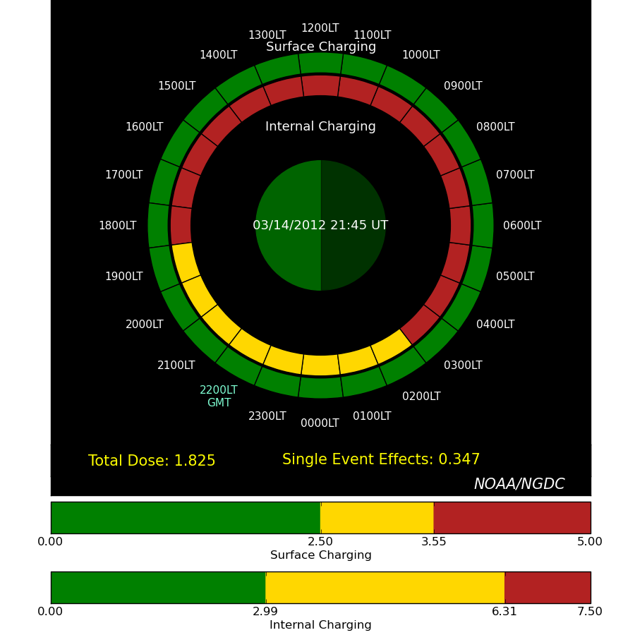
SEAESRT: Space Env. Anomalies Expert System RT
Supporting Satellite Operators in Geostationary Orbit
Near real-time utility to calculate spacecraft charging hazard quotients for geostationary satellites.
Inputs: GOES particle data and the K_{p} geomagnetic index.
Satellite charging hazards:
Surface charging – Surface discharging – induced currents; low energy particles.
Internal charging – Electro-static discharge within sensitive electronics; medium energy particles.
Single Event Upsets – Particle energy deposition in microelectronics; very energetic particles.
Customers: Geosynchronous Satellite Operators
Status: Being Transitioned to Operations

Slide 6
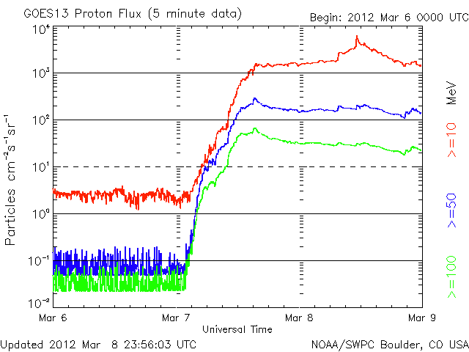
Skyterra Failure: Single Event Upsets SEAESRT Confirms Probable Cause
The SkyTerra outage was likely caused by a solar proton induced Single Event Upset (based on SEAESRT hazard estimates).
GOES 13 data: SkyTerra-1 outage began on March 07 14:43 UT just after the flux of energetic protons increased dramatically.
SEAESRT: Hazard estimate due to energetic protons indicates that a single event upset was 106 times more likely at the time of the outage.
The SEAESRT hazard quotient is based on the flux of >30 MeV protons measured by GOES at the time of the anomaly
Hazard Quotient
Z=(495 protons/cm2-s-str)/4.67
SkyTerra-1
Outage

Slide 7
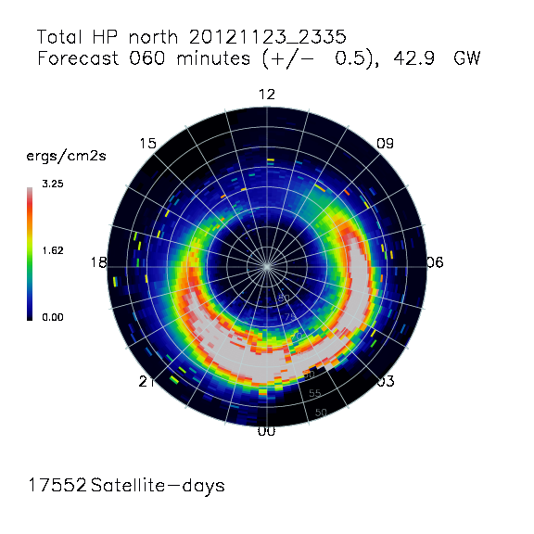
Ovation Prime:
Short Term Forecasts of Aurora
Provides 30-50 min forecast auroral energy deposition in geomagnetic coordinates and hemispheric power (gigawatts).
Runs on a 5 minute cadence.
Empirical model based on DMSP particle data and driven by real-time ACE measurements at L1
Improvements underway
Robustness
Expand to larger storms
Multi-day forecast
Customers: Space Weather Models/products, GPS users, HF Com , DoD
Web access: http://www.ngdc.noaa.gov/stp/ovation_prime/

Slide 8
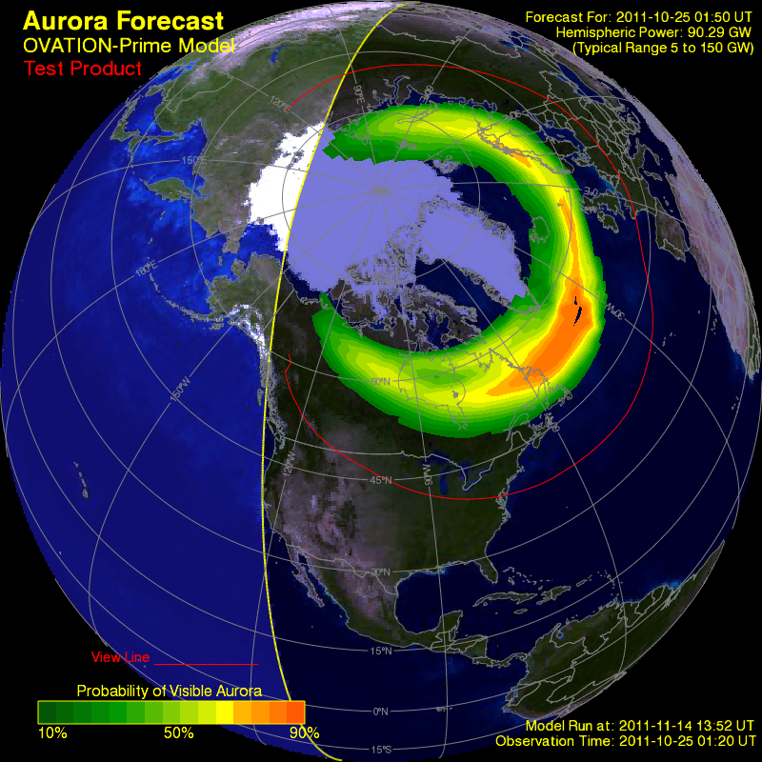
Ovation: Aurora Probability
An additional OVATION product is a map of the aurora in geographic coordinates
Designed as a forecast product for the public
Probability of aurora
Location of aurora
Intensity of aurora
Customers: Aviation, Oil Exploration, Tourism industry, general public interested in viewing the aurora
Status: In transition to operations
Helios.swpc.noaa.gov/ovation

Slide 9
PeEPs
People Empowered Products
Goal: To create a generic framework that incorporates user reports into NOAA real time and retrospective weather products
Status: Under development

Slide 10
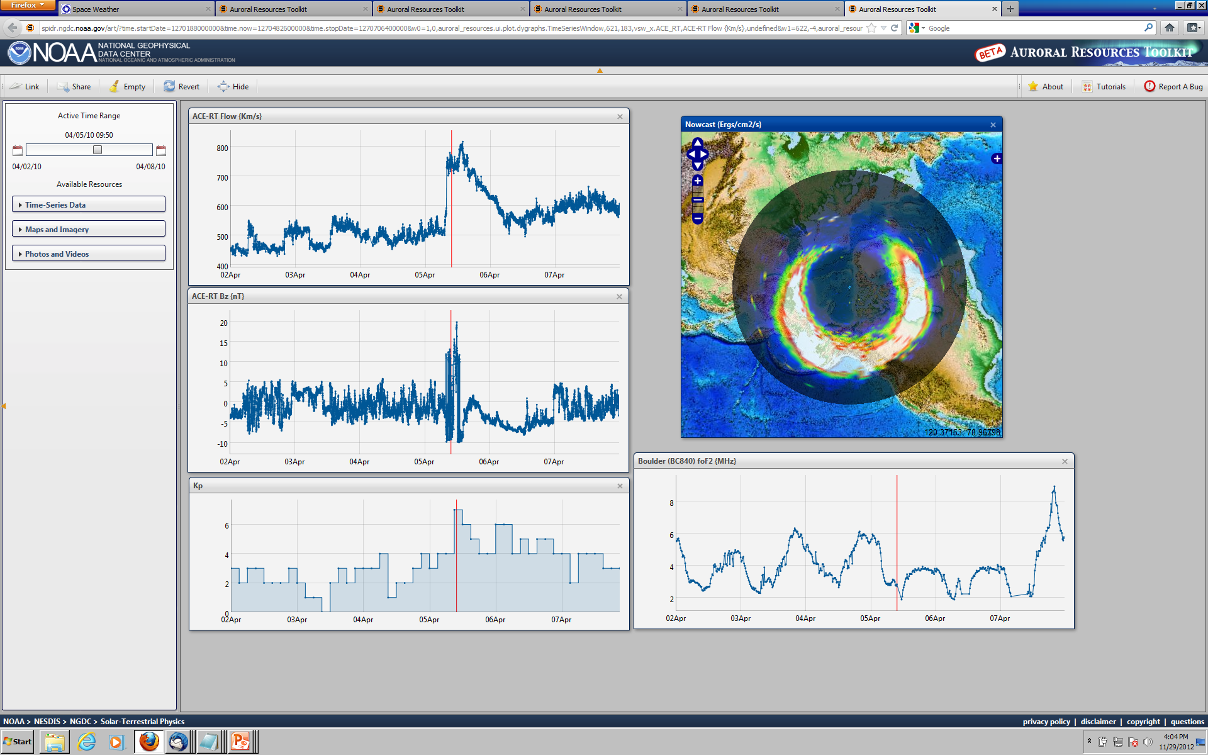
ART
Auroral Resources Toolkit
A rich internet, open source application for visualization and collaboration of auroral phenomenology utilizing VxO best practices.
Web access: http://1.usa.gov/Ie0Q2V

Slide 11
Summary
Concluding Remarks
SWPC and NGDC have a number of “non-standard” products that are available or under development for the space weather community.
These products are driven by user and customer requirements.
Each product will go through a test and evaluation period where customer feedback will be solicited
NA-TEC Rodney.Viereck@noaa.gov 303 497-7348
FIRST Rob.Redmon@noaa.gov 303 497-4331
SEAESRT Jonathan.Darnel@noaa.gov 303 497-4280
OPRT Janet.Machol@noaa.gov 303 497-6686
PeEPs Janet.Green@noaa.gov 303 497-4845
ART Rob.Redmon@noaa.gov 303 497-4331

Slide 12
Thank You
Questions?

Slide 13
References
Additional Reading
NA TEC
Fuller-Rowell, T., E. Araujo-Pradere, C. Minter, M. Codrescu, P. Spencer, D. Robertson, and A. R. Jacobson (2006), US-TEC: A new data assimilation product from the Space Environment Center characterizing the ionospheric total electron content using real-time GPS data, Radio Sci., 41, RS6003, doi:10.1029/2005RS003393.
FIRST
Redmon, R., Anderson, D., Caton, R., Bullett, T. (2010), A Forecasting Ionospheric Real-time Scintillation Tool (FIRST), Space Weather, 8, S12003, doi:10.1029/2010SW000582, 2010
McNamara, L. F. (2006), Quality figures and error bars for autoscaled Digisonde vertical incidence ionograms, Radio Sci., 41, RS4011, doi:10.1029/2005RS003440.
SEAESRT
O’Brien, T. P. (2009), SEAES-GEO: A spacecraft environmental anomalies expert system for geosynchronous orbit, Space Weather, 7, S09003, doi:10.1029/2009SW000473.
OPRT
Machol, J. L., J. C. Green, R. J. Redmon, R. A. Viereck, and P. T. Newell (2012), Evaluation of OVATION Prime as a forecast model for visible aurorae, Space Weather, 10, S03005, doi:10.1029/2011SW000746.
Newell, P.T., T. Sotirelis, and S. Wing (2010), Seasonal variations in diffuse, monoenergetic, and broadband aurora, J. Geophys. Res., 115, A03216, doi:10.1029/2009JA014805.
PeEPs
S. Codrescu, J.C. Green, R.J. Redmon, W.F. Denig and E.A. Kihn (2012), NOAA People Empowered Products (PeEP): Combining social media with scientific models to provide eye-witness confirmed products (IN23F-02), AGU Fall Mtg, 03-07 Dec 2012, San Francisco, CA.
ART
Elespuru, P., R.J. Redmon., E.A. Kihn., M. Zhizhin and D. Medvedev, (2010), Auroral Resources: Dataset Access and Interactive, Visualization (IN43A-1395), AGU Fall Mtg., 13-17 Dec 2010, San Francisco, CA.

