Slide 1
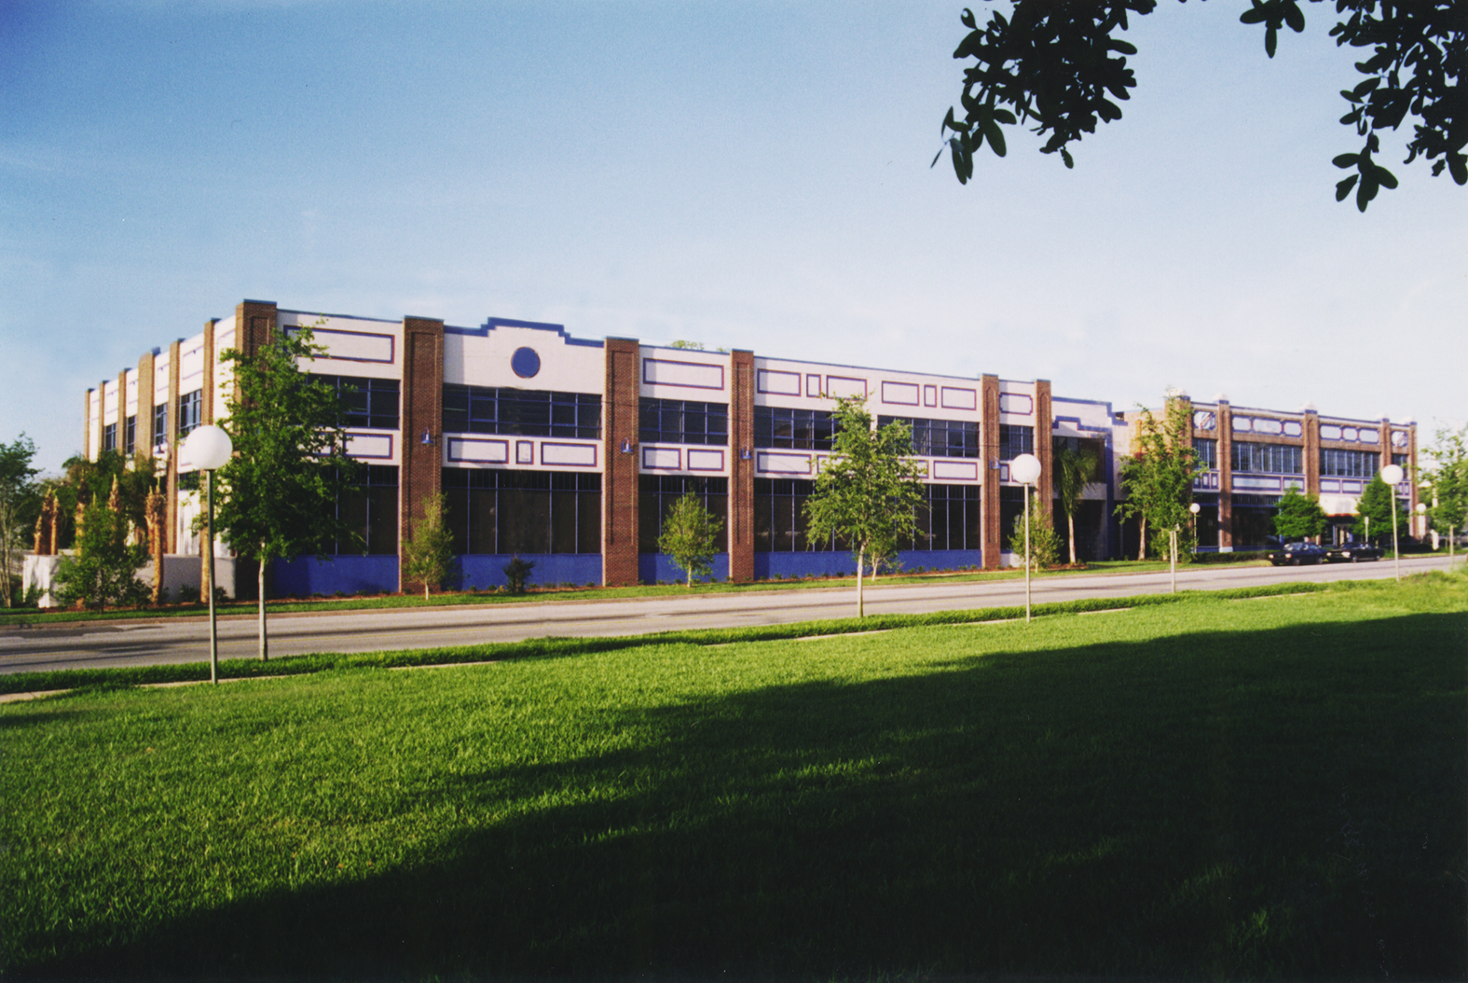
USGS St. Petersburg Coastal and Marine Science Center Core repository
Notes:
By comparison to what we have seen the past couple days we are a very small operation and this presentation will be very short, but we have been growing and are working to get our core and samples datasets organized and available. This is our office in St. Petersburg, Florida. It is on the University of South Florida campus. We have been in existence since the late ‘80s, originally just the one building on the right. The building was an old Studebaker dealership in the 1920s, thus is named the Studebaker building. In 1996 we completed the larger building on the left known as the Getting building, and in 2008 we finished construction of 11,000 square feet of laboratory space in a third building in the back.

Slide 2
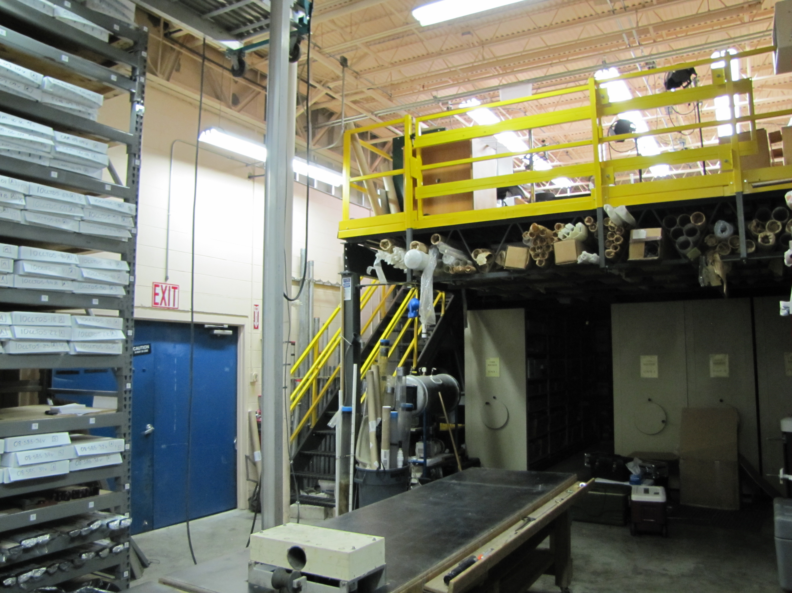
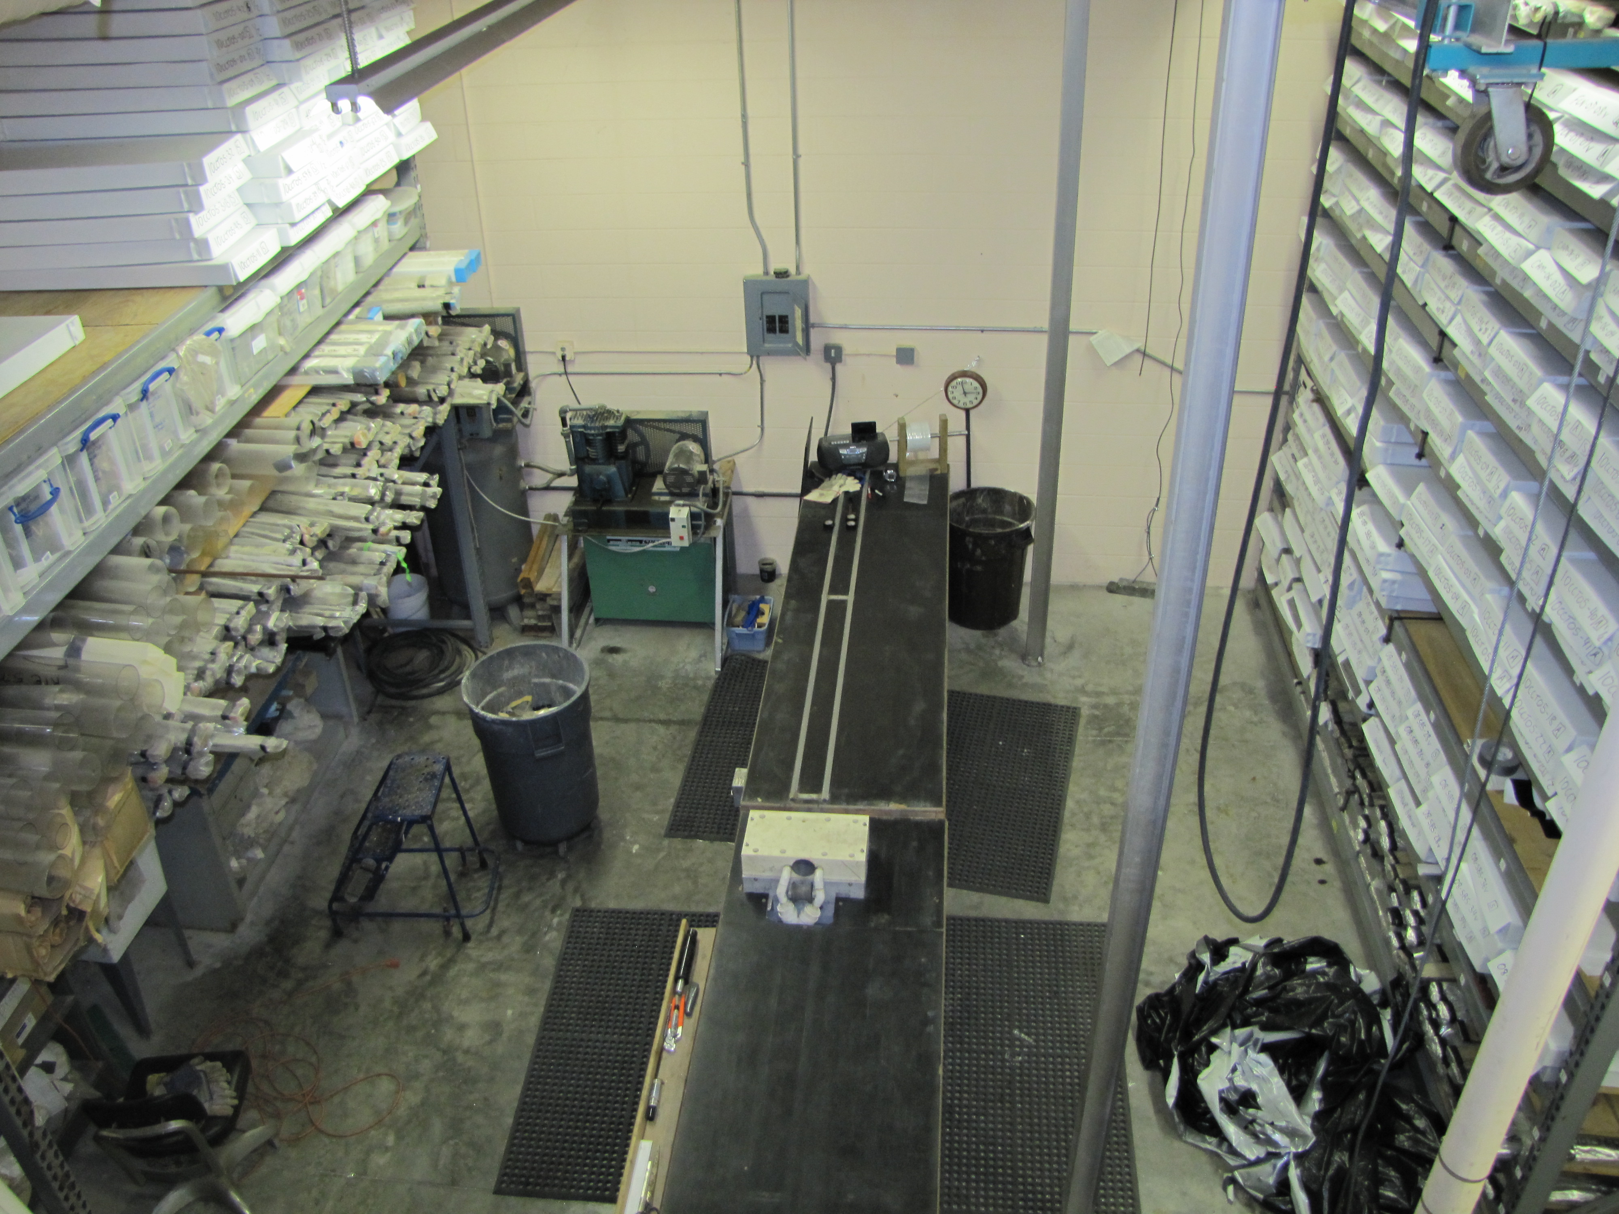
USGS St. Petersburg Coastal and Marine Science Center Core repository
Notes:
Our core repository is very small and very full. The core lab includes standard core racks, roll away racks, a mezzanine which contains more core racks and some analytical equipment. The mezzanine was added about 5 years ago and is a useful avenue to increase space. Most of our samples are grab samples, auger samples or vibracores. For most of our projects we store the cores at collaborator sites. All cores acquired in Florida are sent up to the Florida Geological Survey at FSU. We did have a large core repository at the University of New Orleans that had hundreds of cores collected around Louisiana, But that facility was completely flooded by hurricane Katrina and everything was lost. We have also sent cores to Texas and South Carolina. Also shown is our core barrel cutter, essentially two horizontal circular saws that cut the barrel as the core is pushed through.

Slide 3
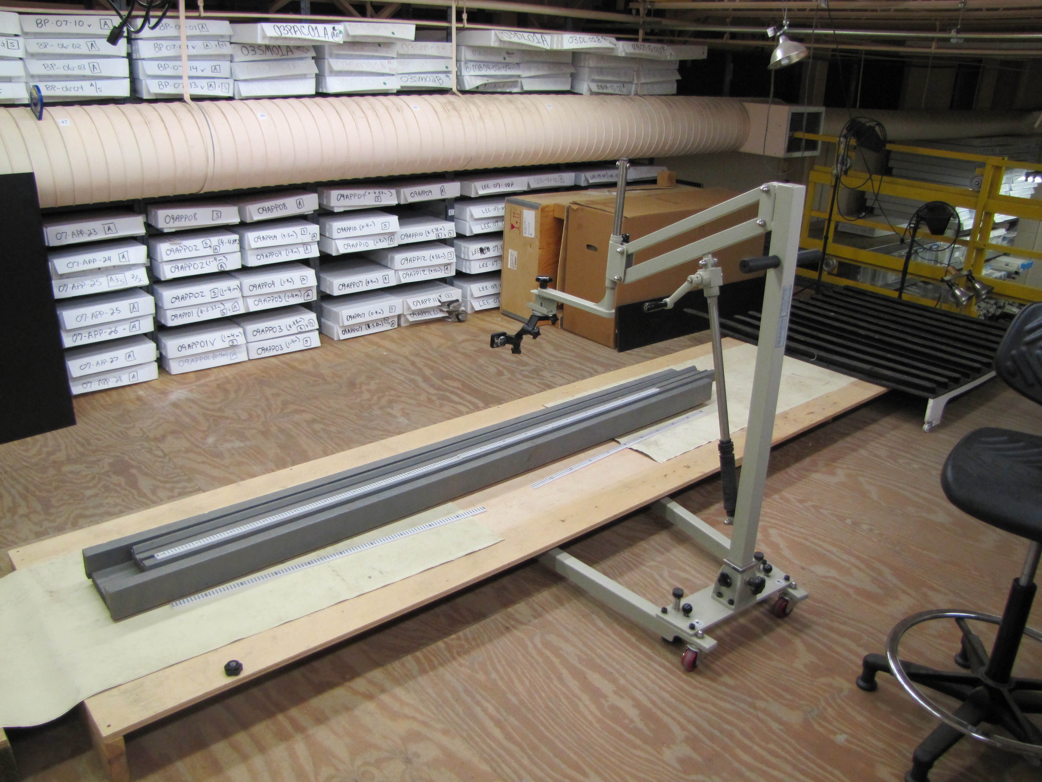
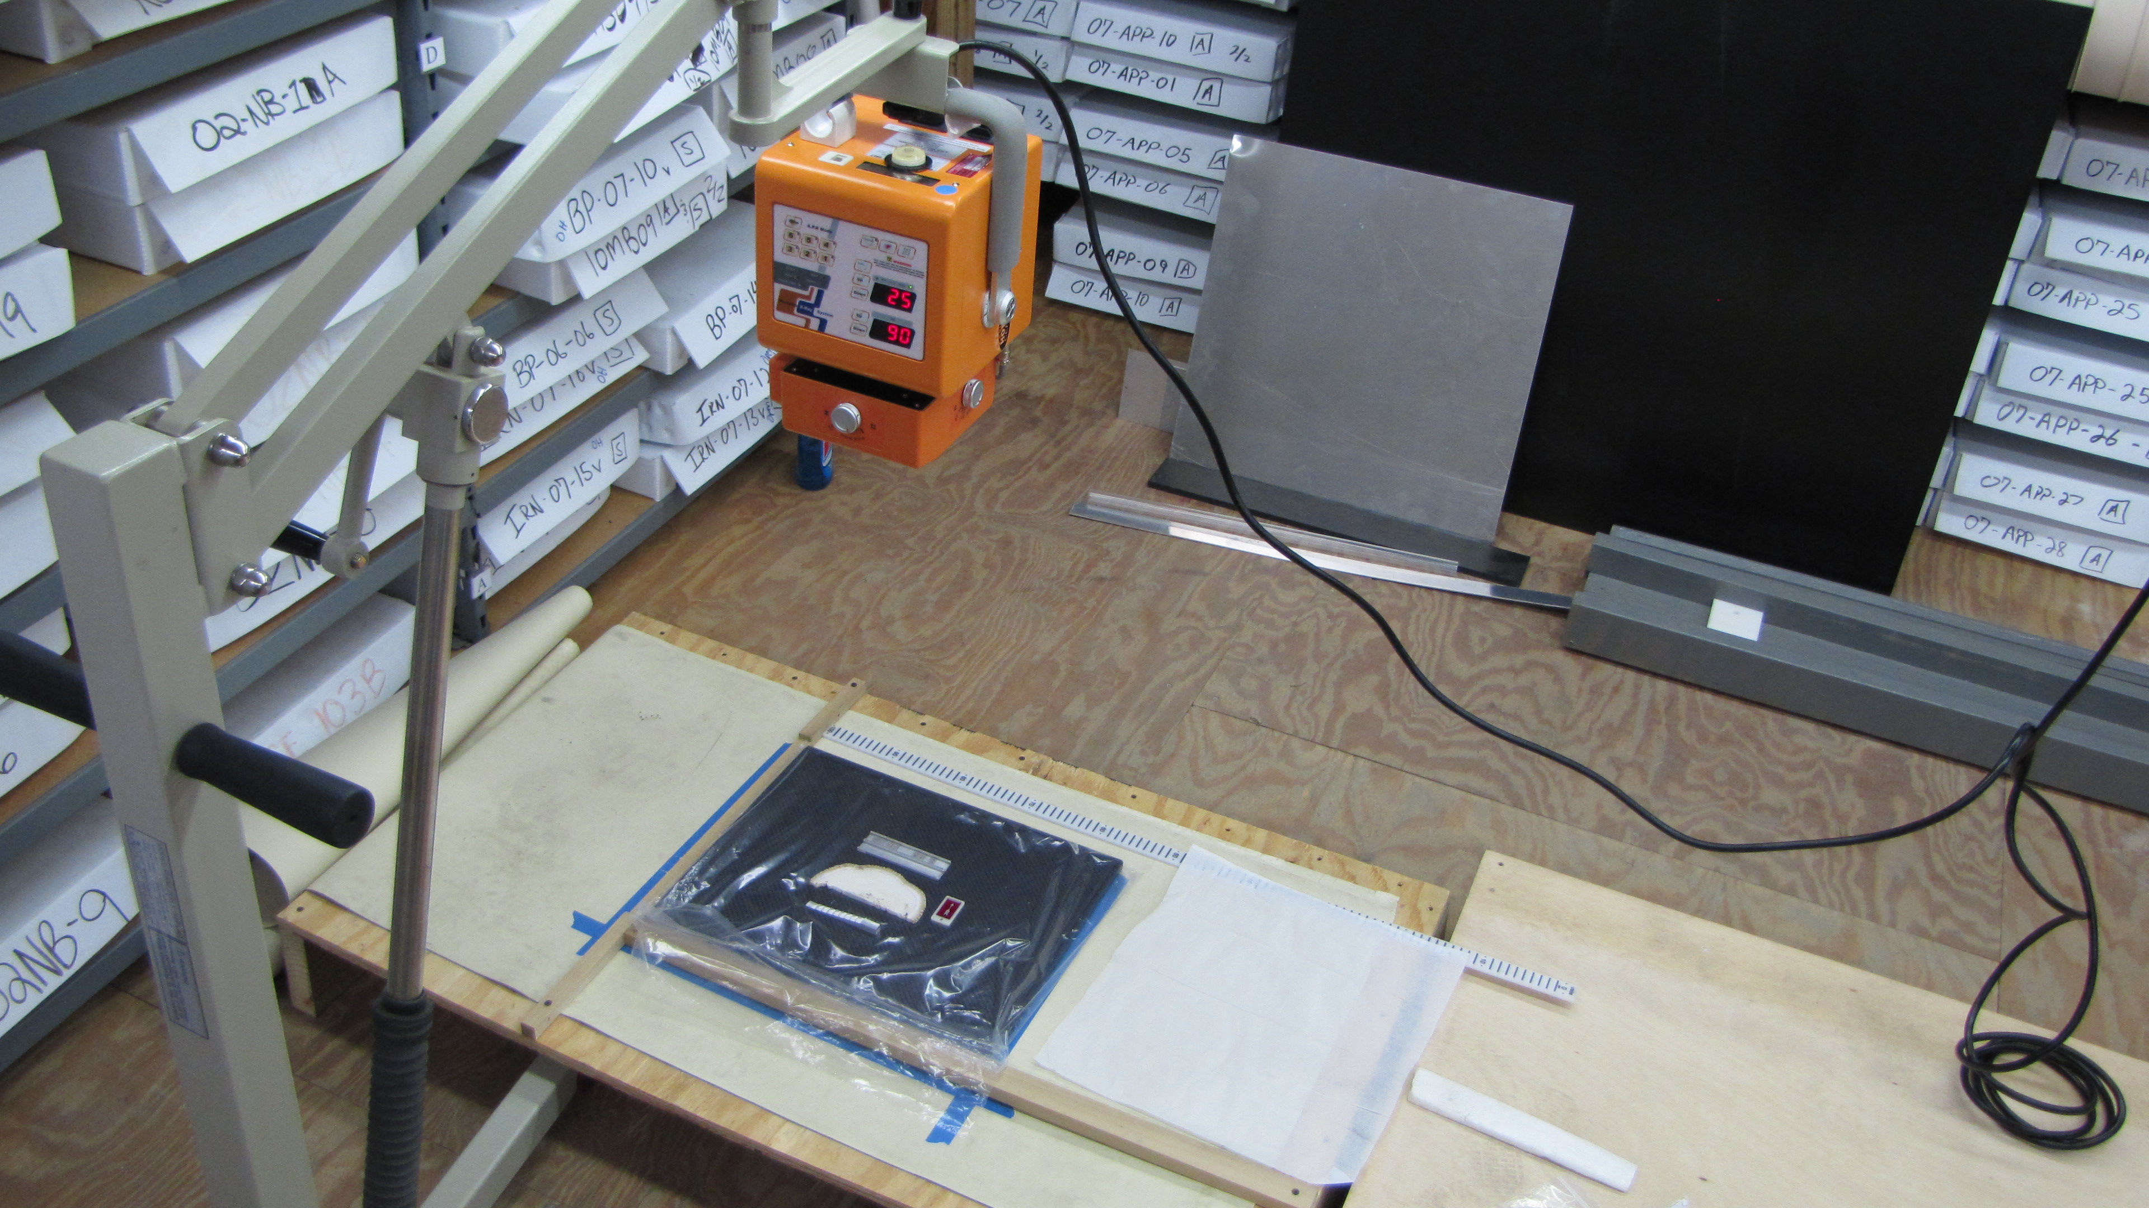
USGS St. Petersburg Coastal and Marine Science Center Core repository
Notes:
The core lab contains a limited amount of analytical tools including a camera and x-ray table. As you can see every nook and cranny is filled with core boxes.

Slide 4
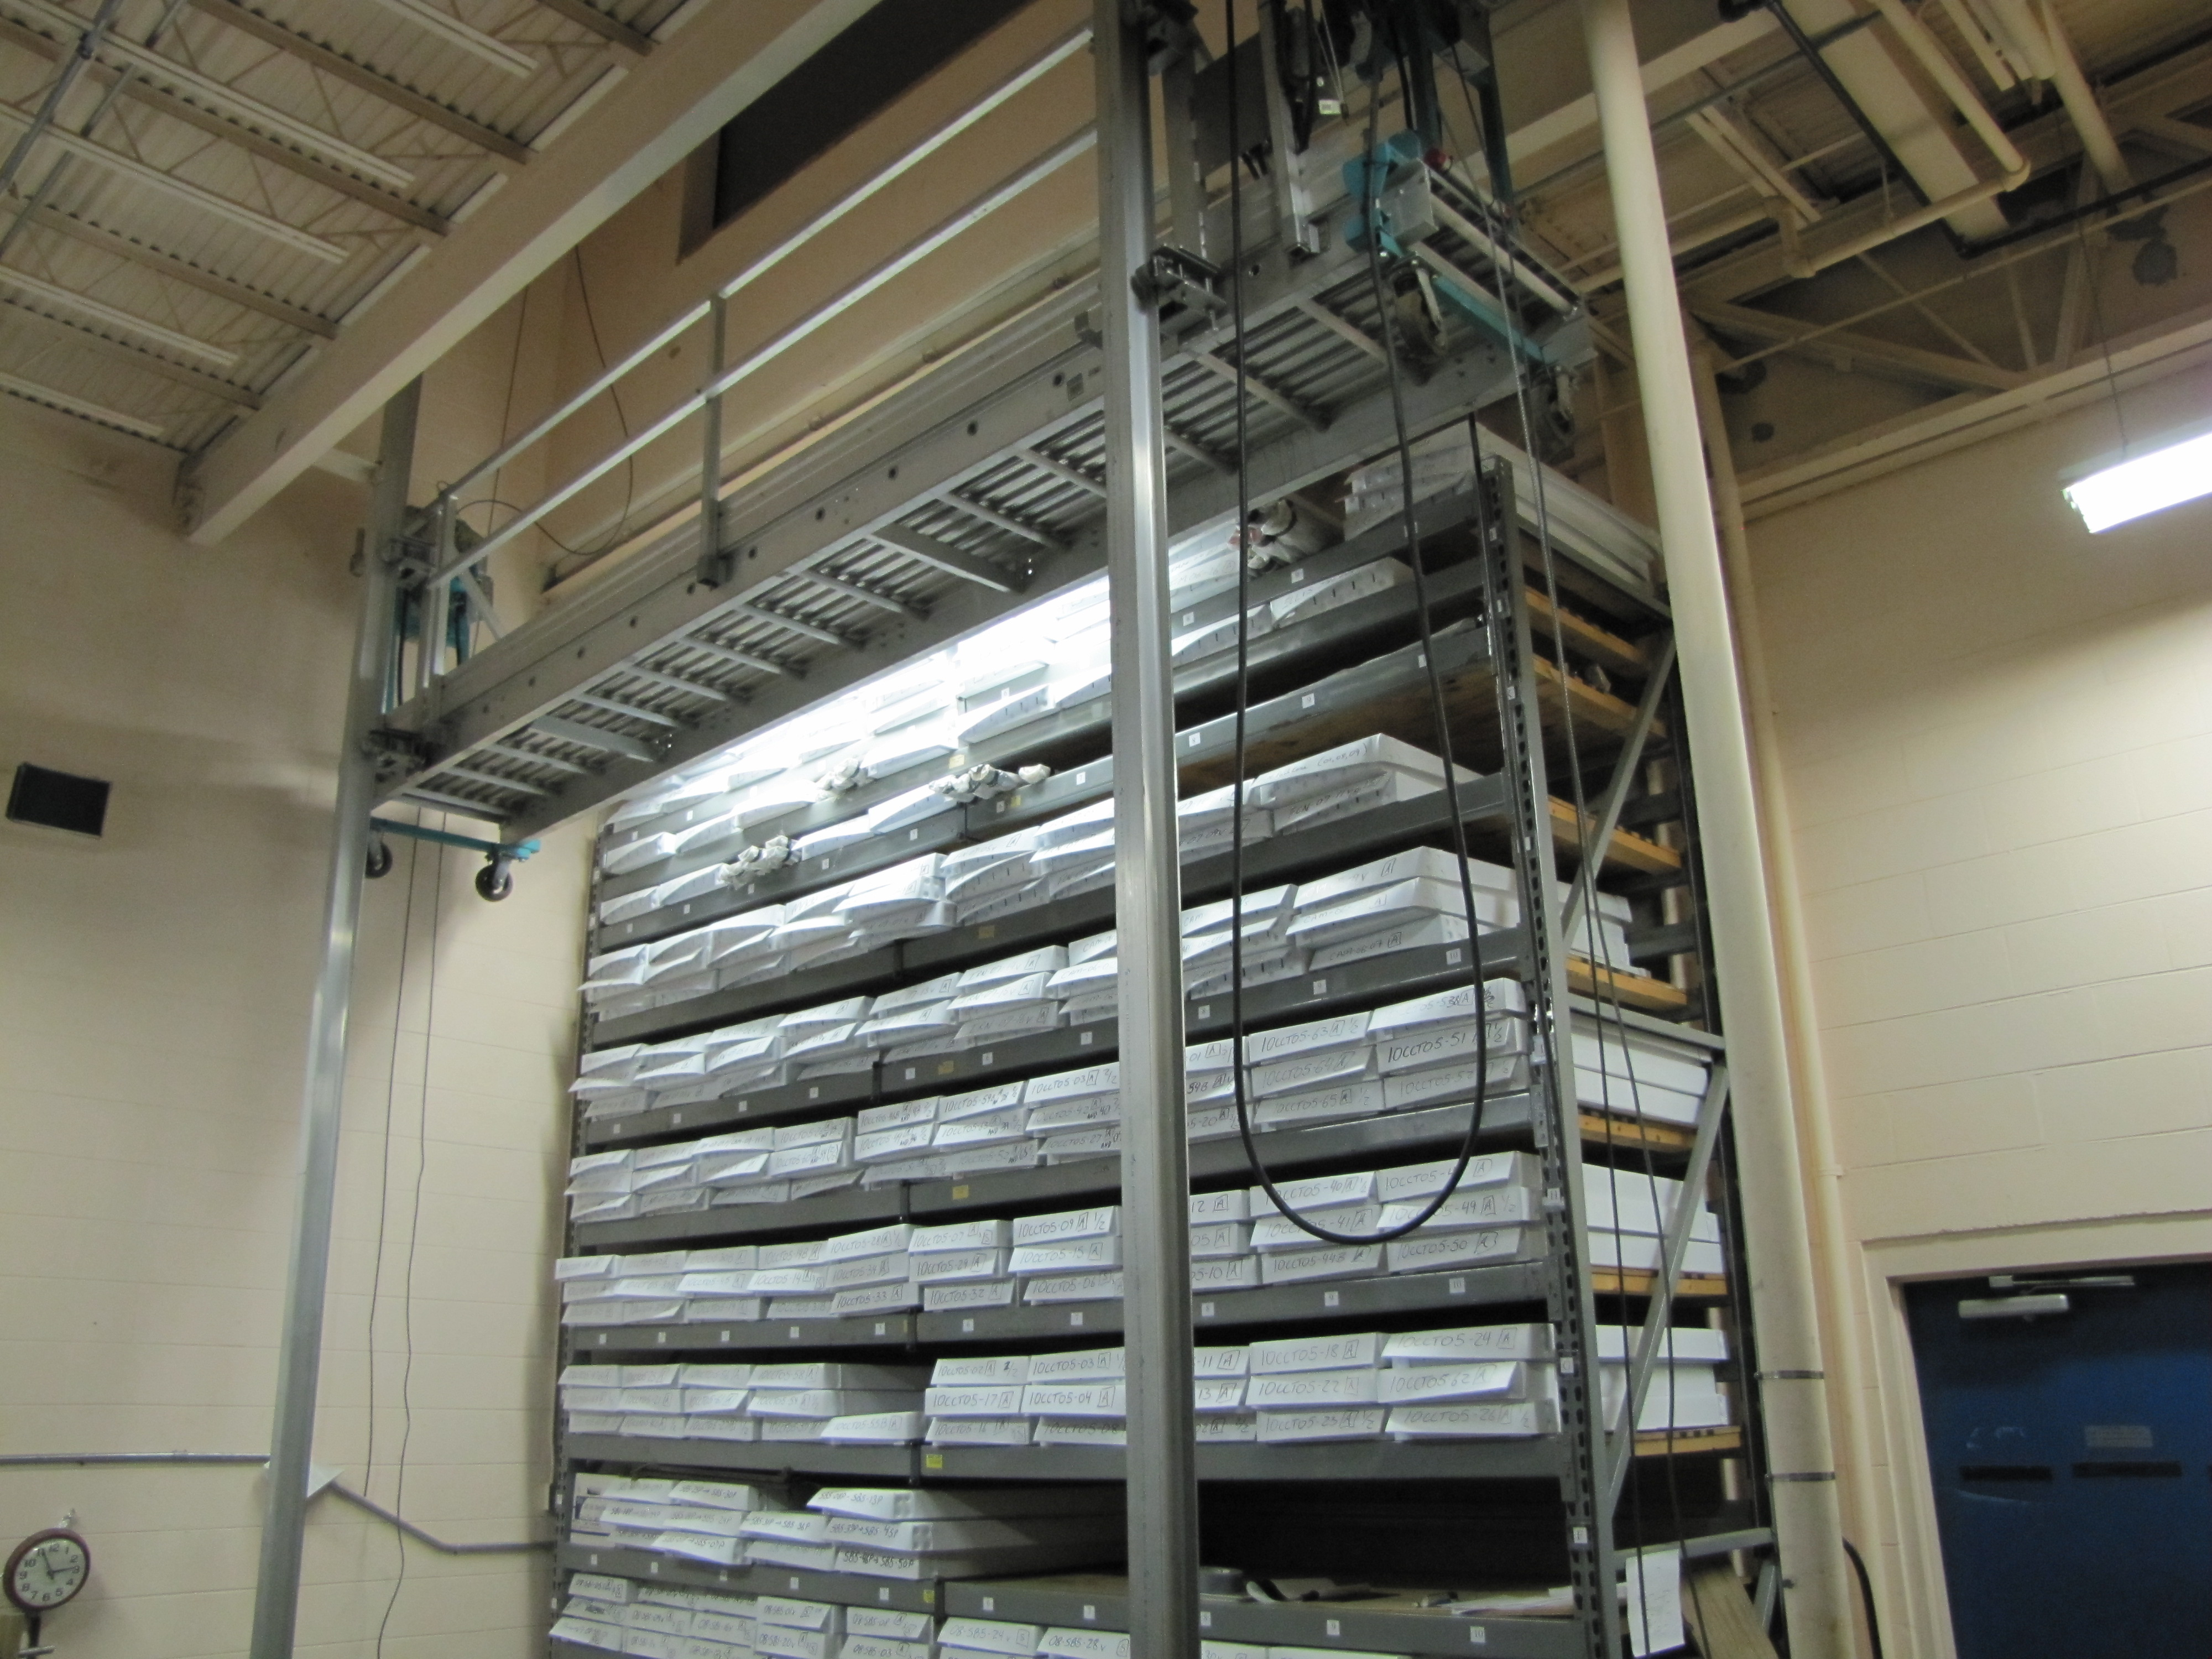
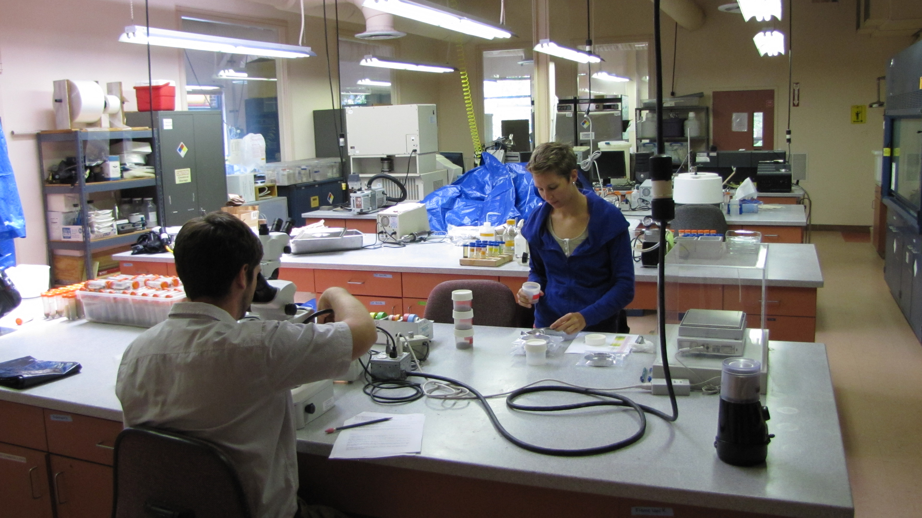
To sed lab
Notes:
The core facility includes an elevator that is used to access the samples and bring them to one of the core labs upstairs. This lab has most of our equipment for physical analysis such as petrology and grainsize analysis. The lab in the back is our wet lab for geochemical work, and our other labs focus on microbiology and isotope work.

Slide 5
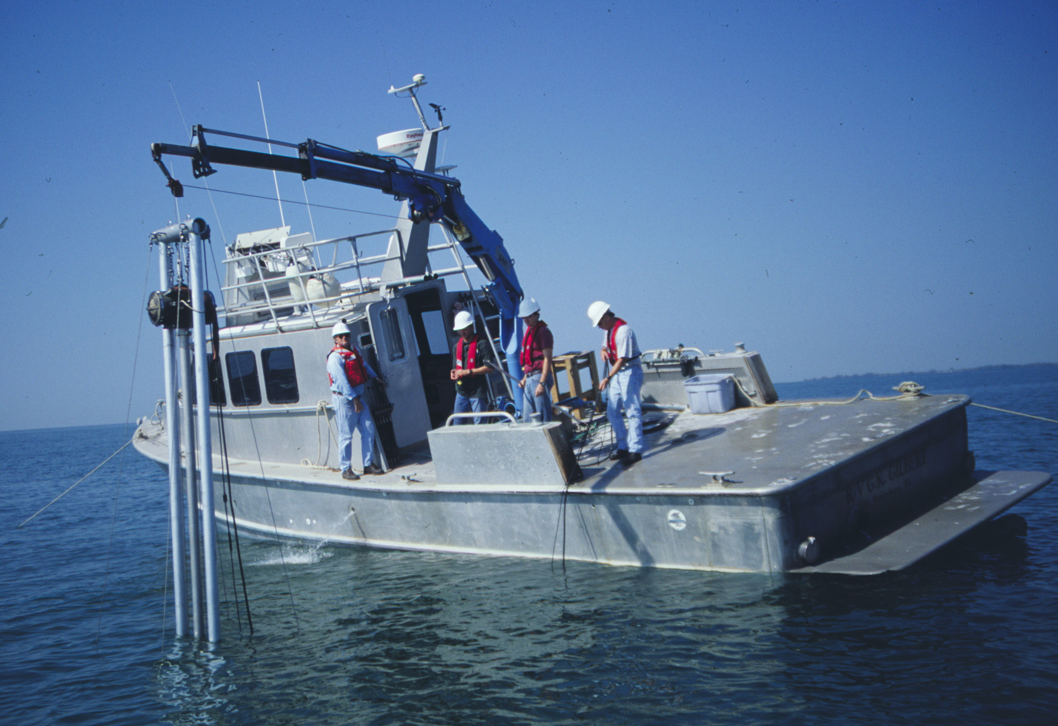
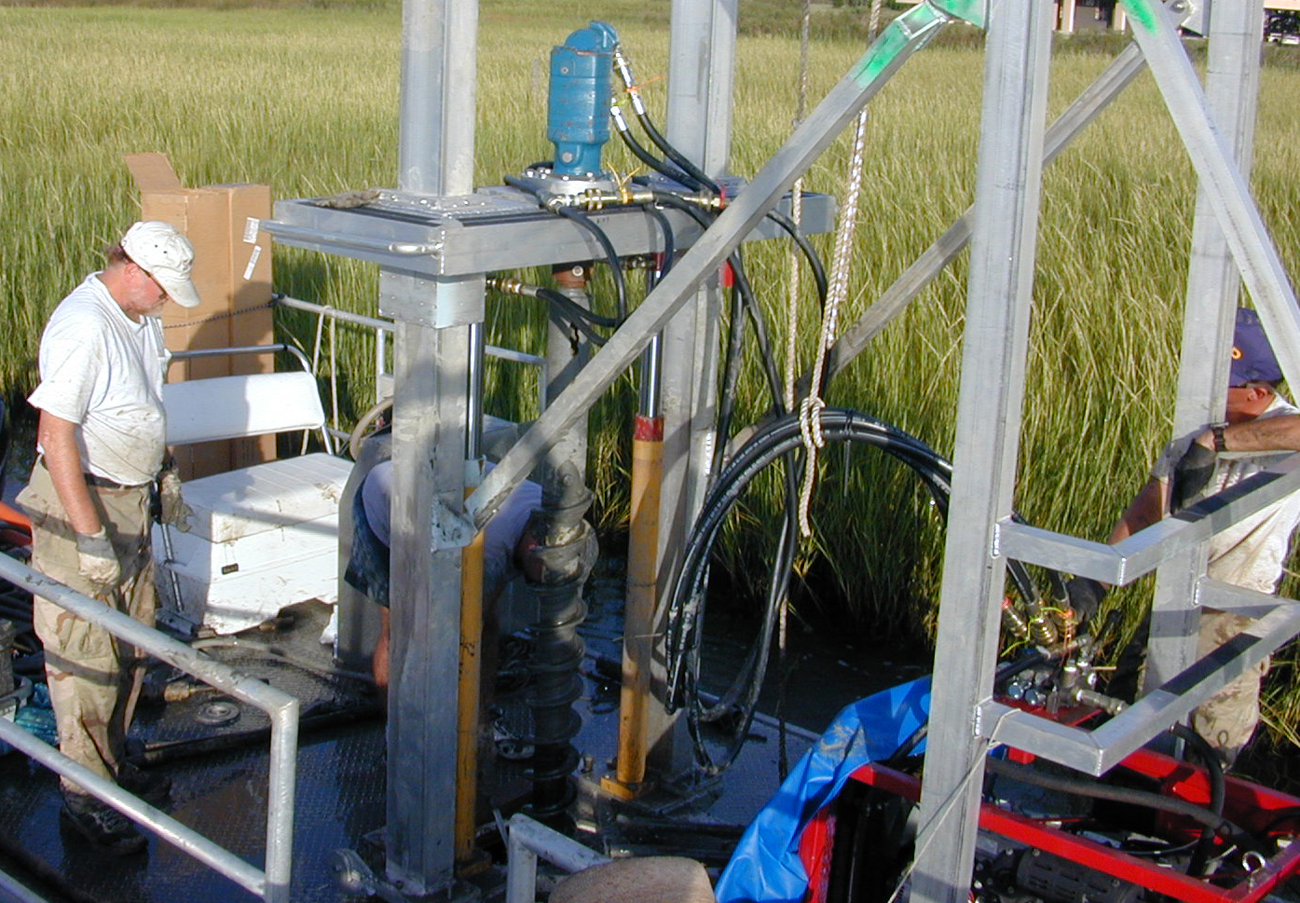
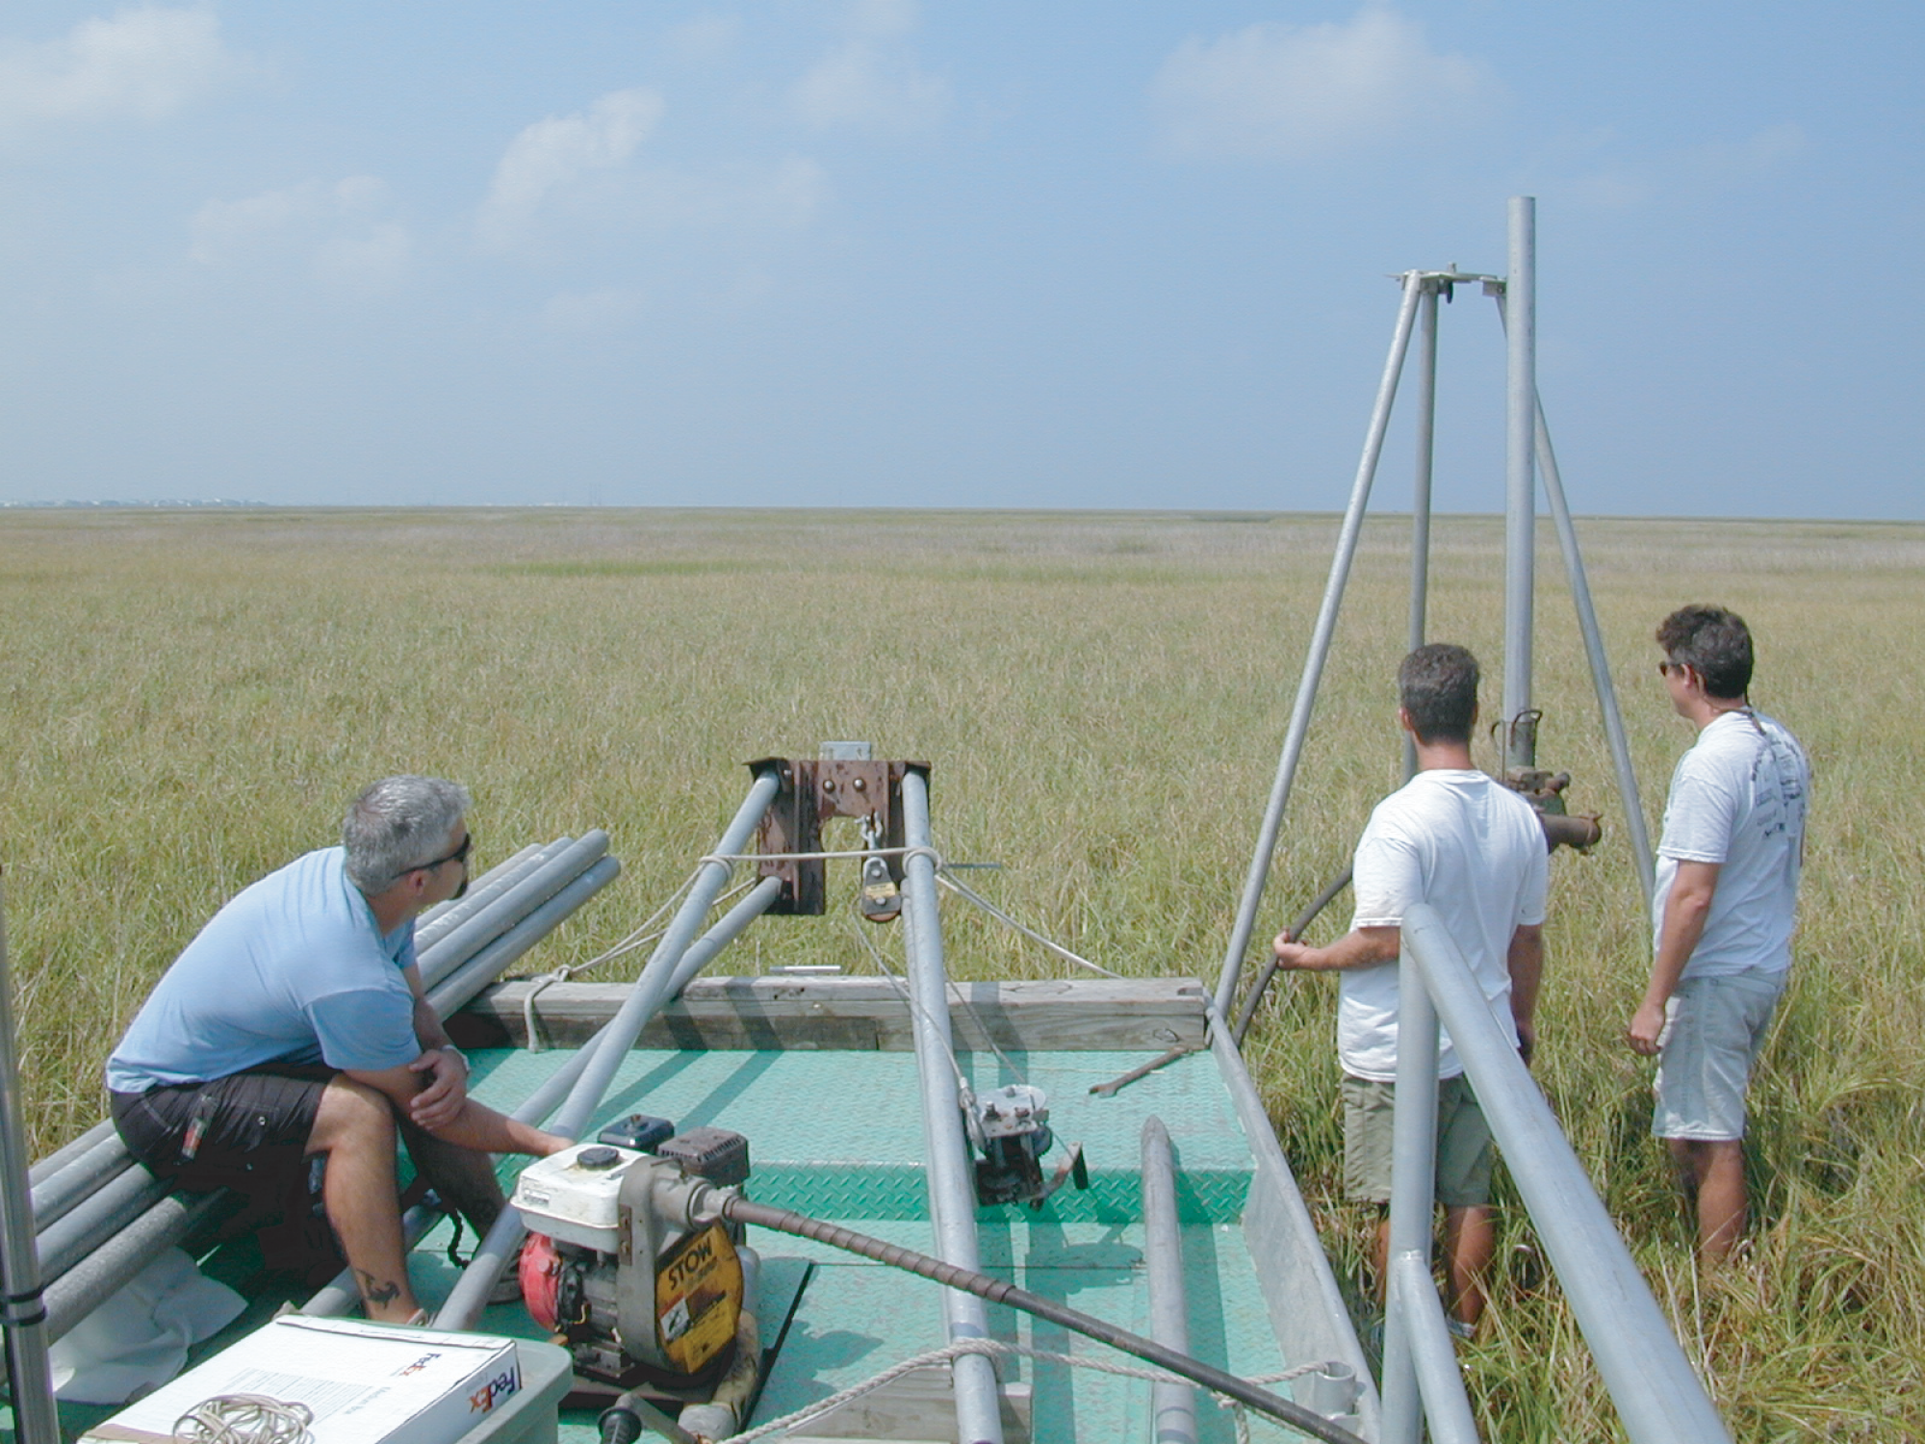
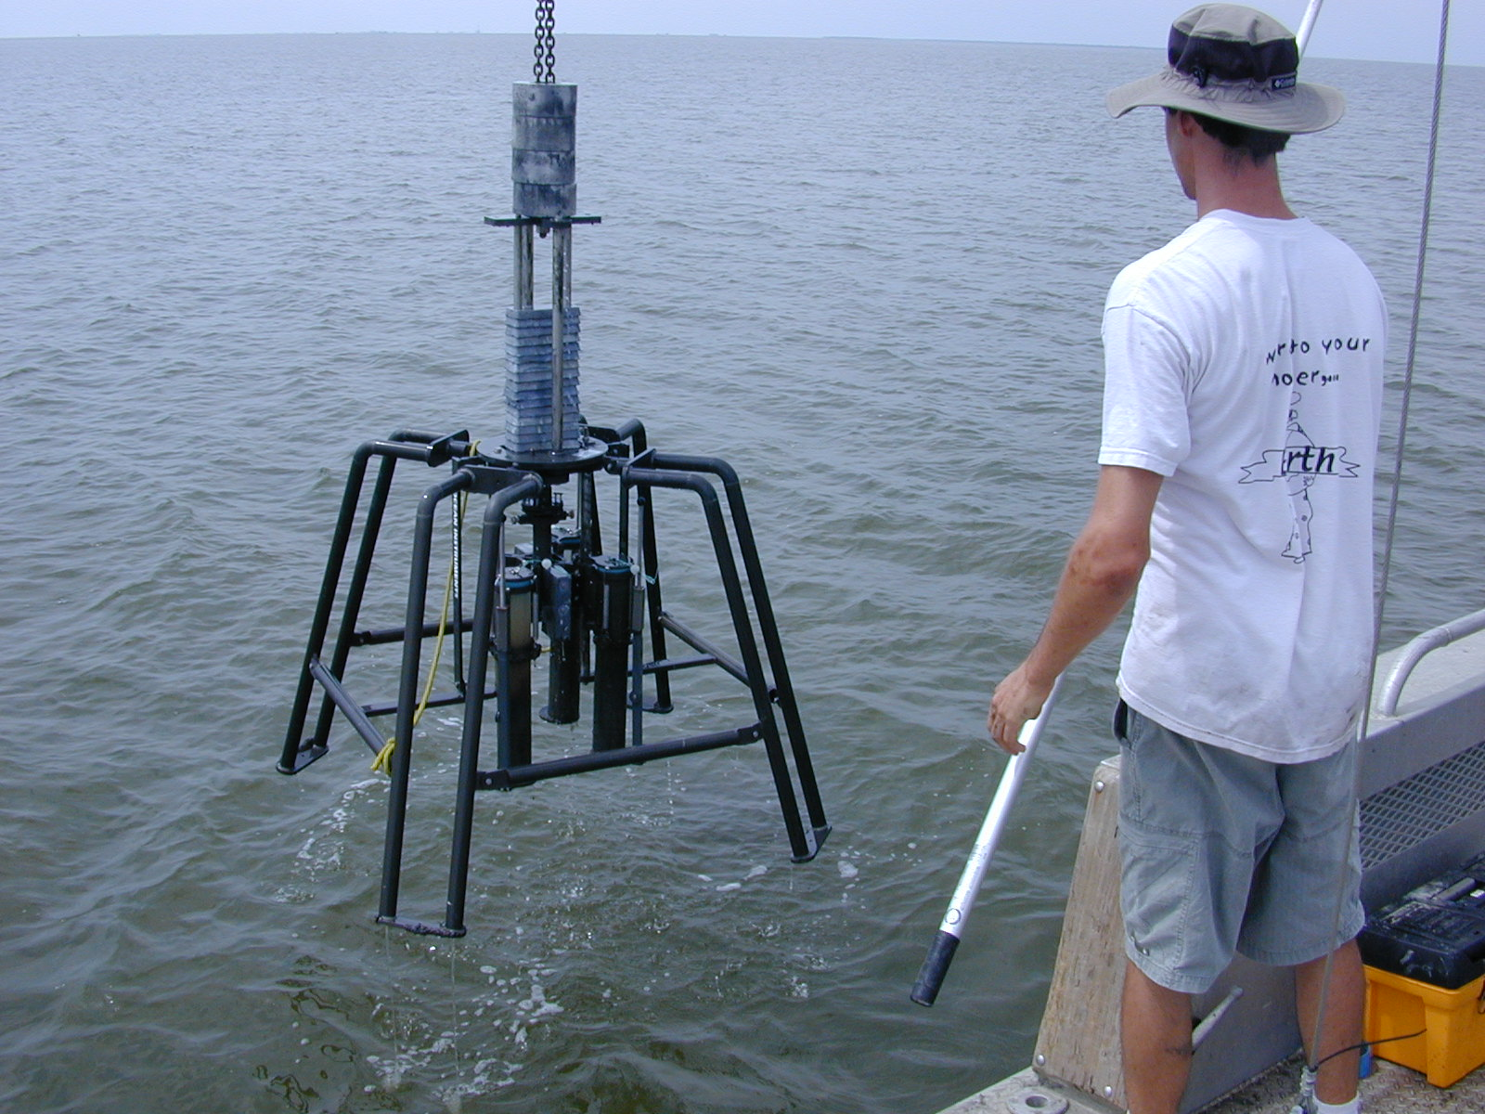
•Core samples: push, auger, drill vibracore, gravity, piston, boxcore…
•Grab samples
•Sample splits for microfossil, isotope, geochemistry, grainsize analysis
Notes:
Samples included in the repository include a variety of core samples, mainly vibracore, auger, push core and grab samples. Most of the cores are from the gulf coast, both marine and and on land. We used to have a refridgerator van Some samples are frozen in chest freezers. Used to have a reefer van but it died.

Slide 6
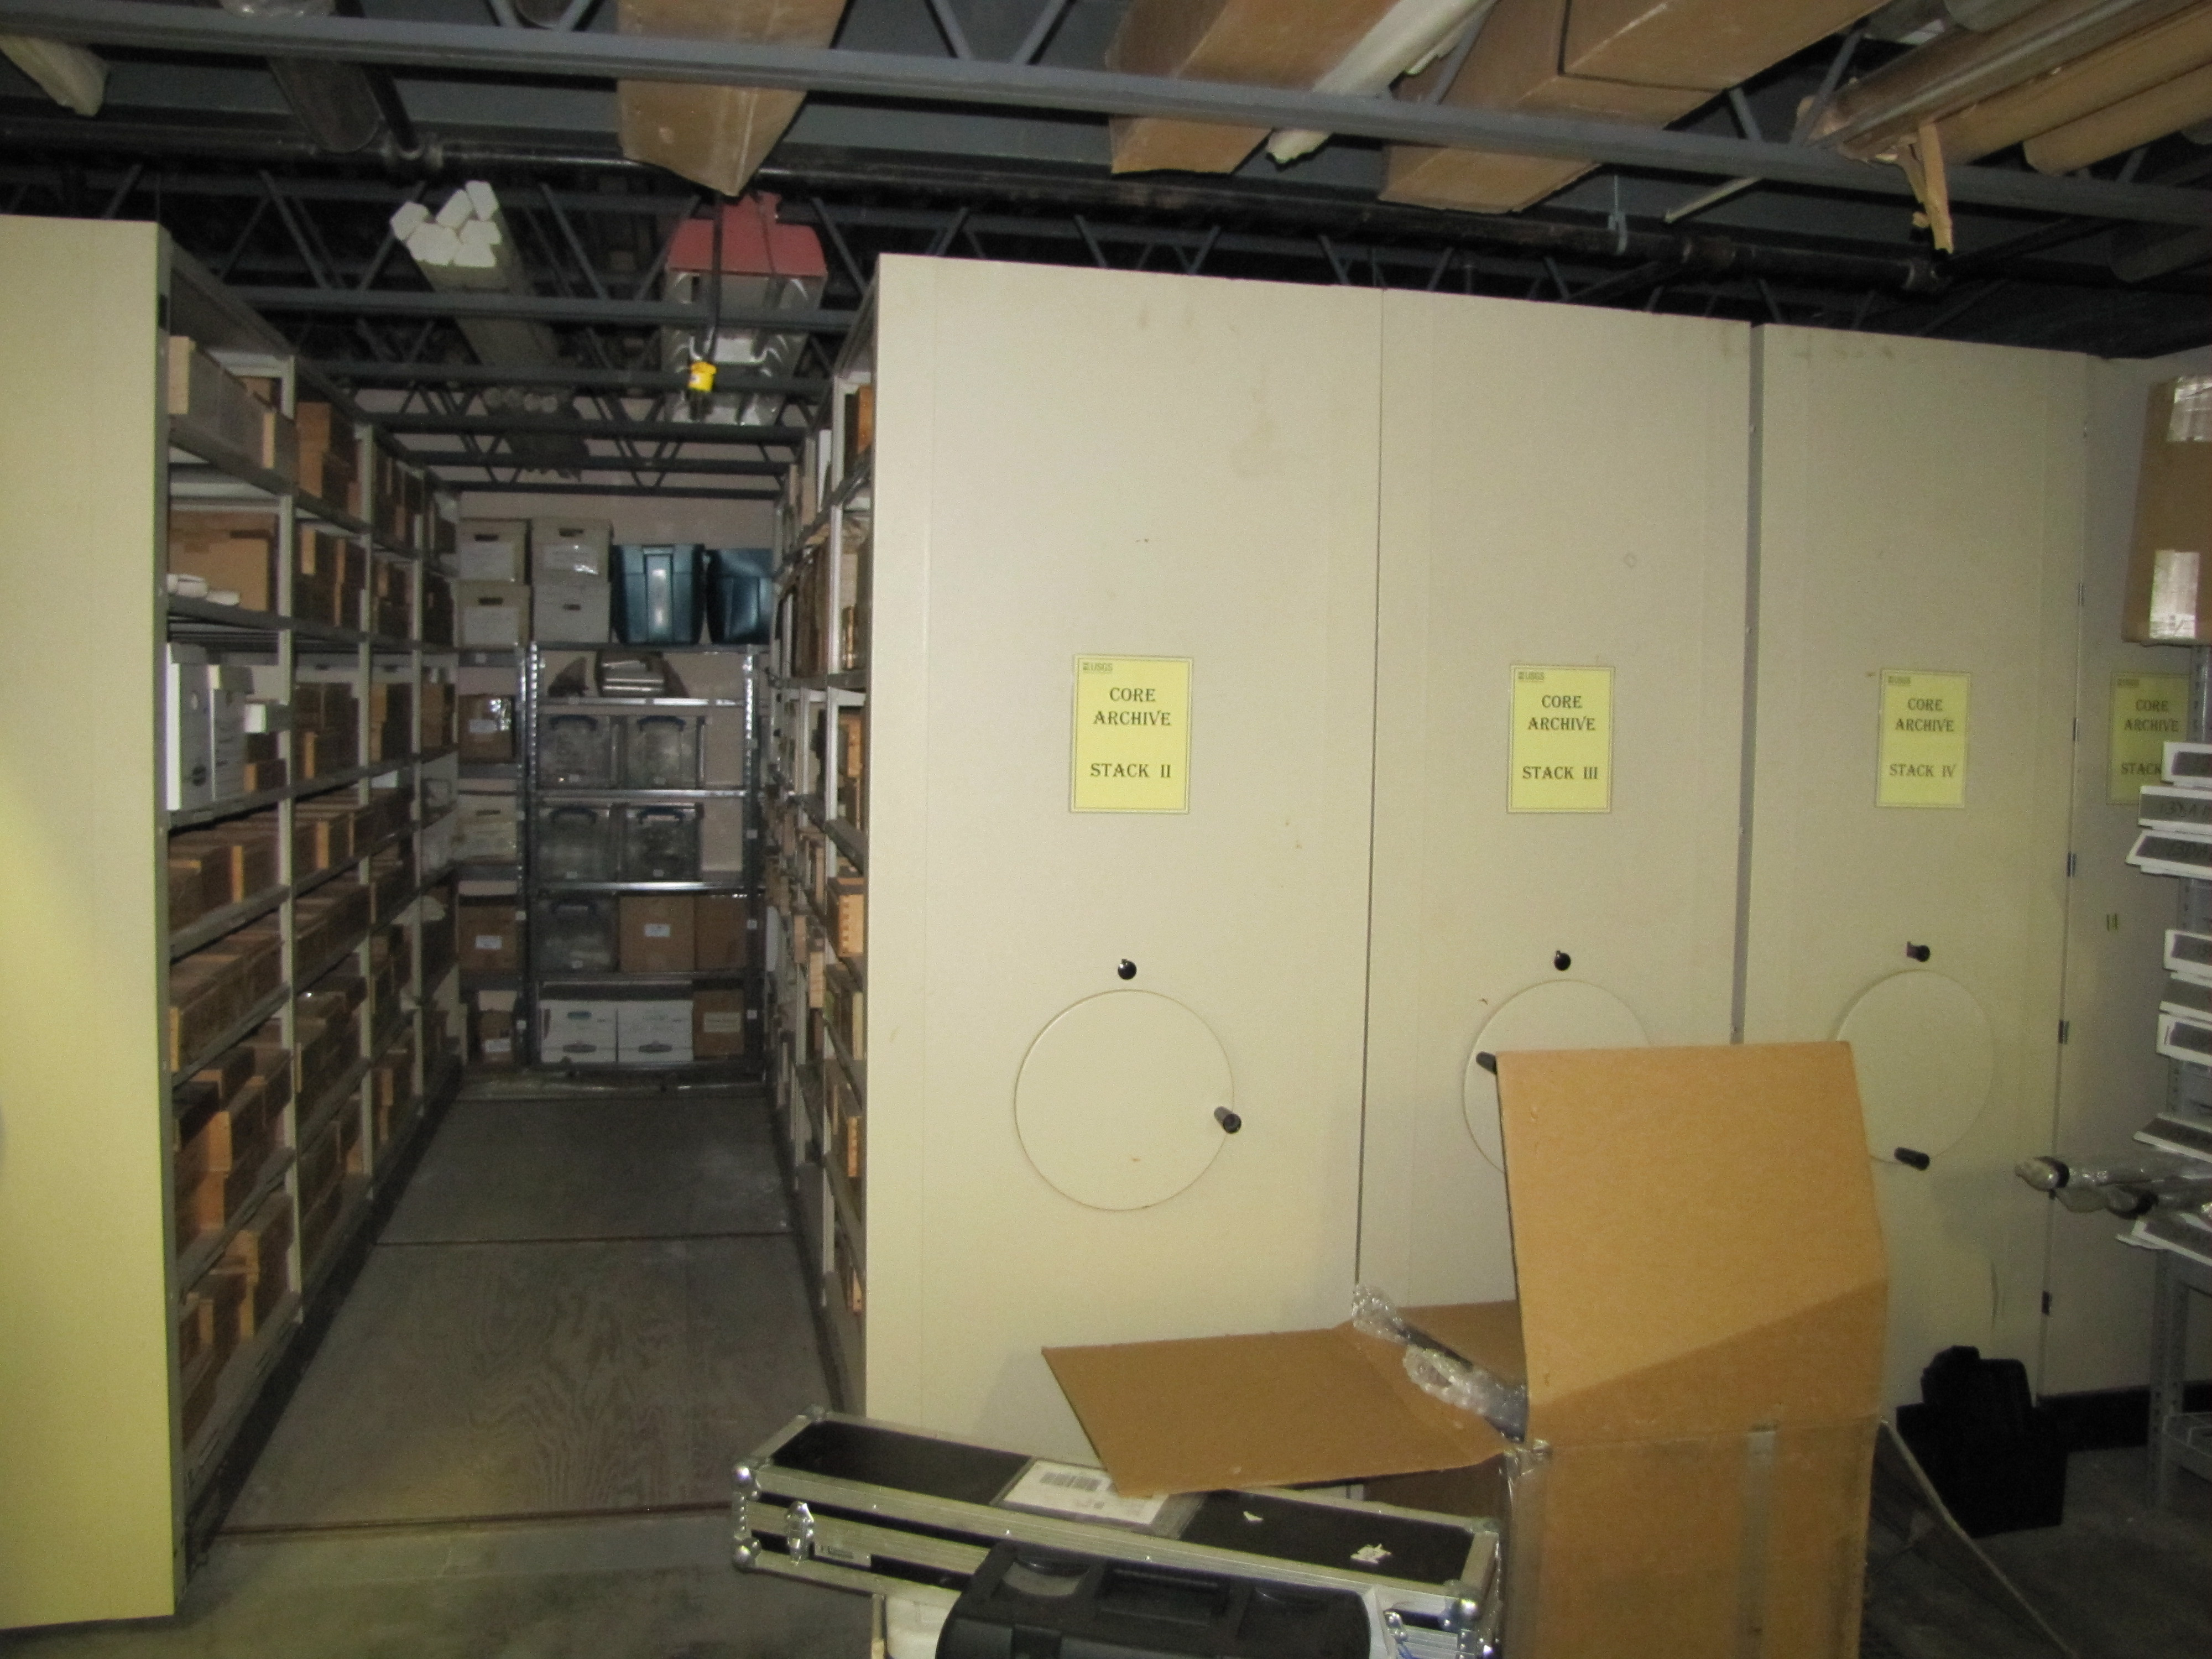
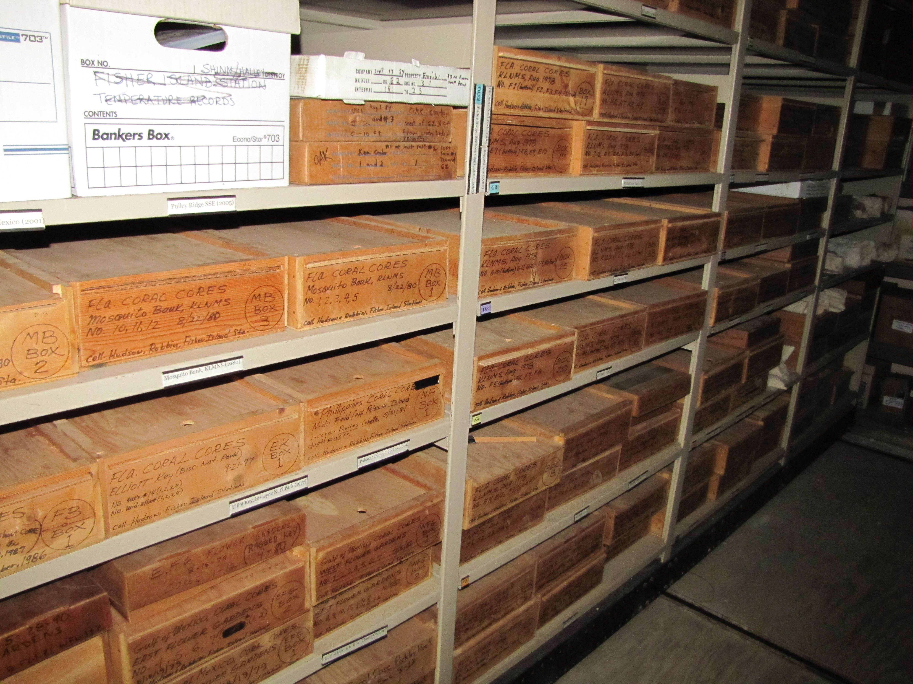
Gulf and Caribbean coral core repository
Notes:
One unique part of our collection is our coral core samples. These are hundreds of coral cores acquired in the late ‘80s and early 90’s from the gulf of mexico and caribbean. They are stored in labeled wooden boxes in the rolling core racks

Slide 7
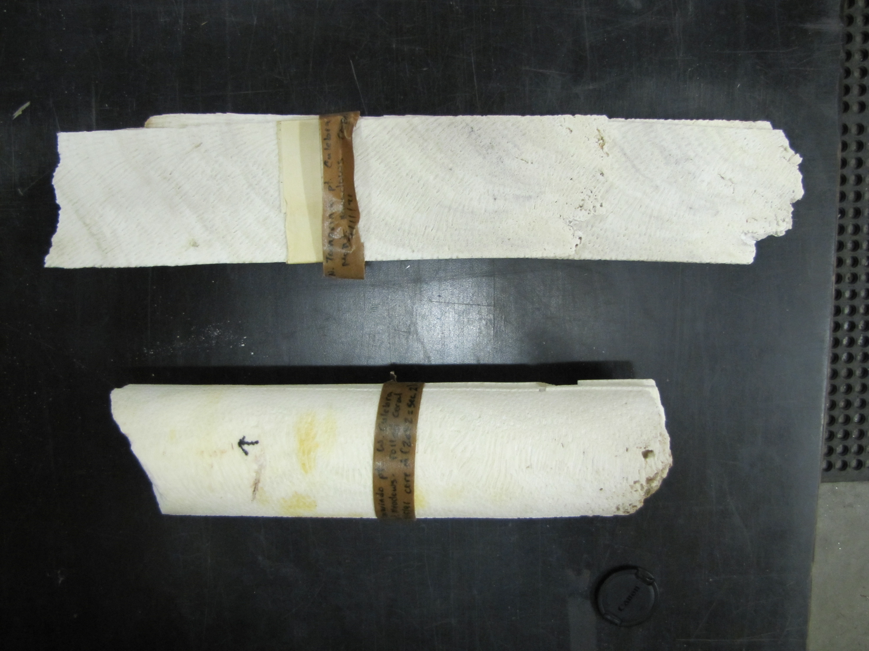
Gulf and Carribbean coral core repository
Notes:
Here is an example of some of the coral cores. They are circular of course when they are acquired but are then slabbed for analysis. They have been used for climate change, ocean acidification, african dust, and pollutant studies among others. It is a very unique and valuable collection

Slide 8
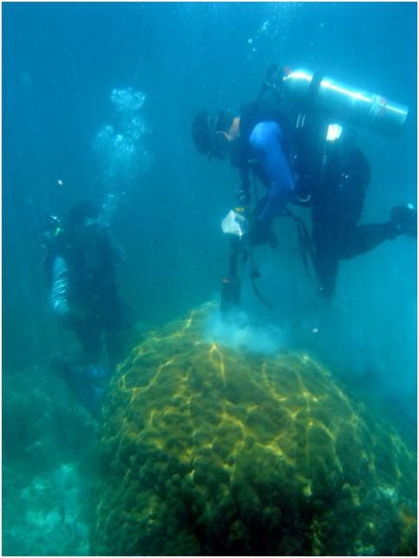
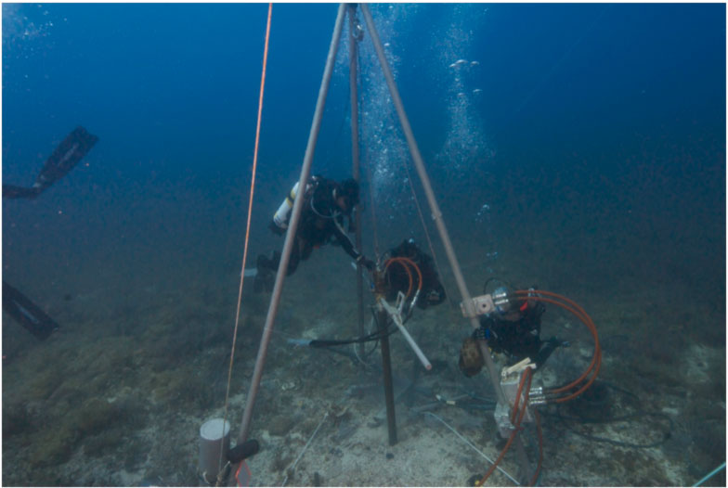
Gulf and Carribbean coral core repository
Notes:
Part of it’s uniqueness is simply because it is very difficult to aquire the cores. What the diver on the right is doing you simply cannot get a permit to do anymore. On the right we are drilling directly into the limestone. It is a hard and expensive effort that isn’t done very much anymore, so we take special care of the cores afterwards.

Slide 9
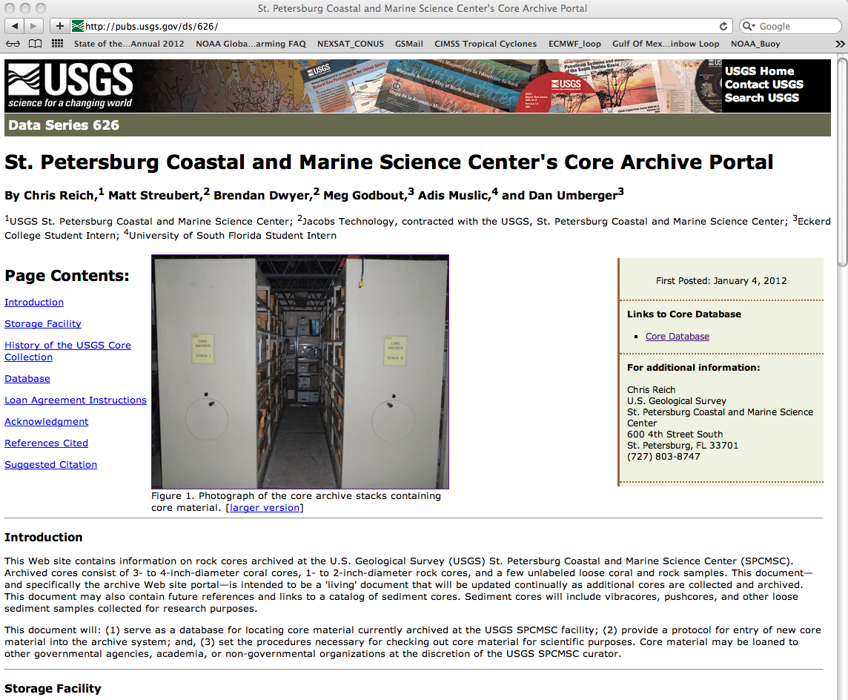
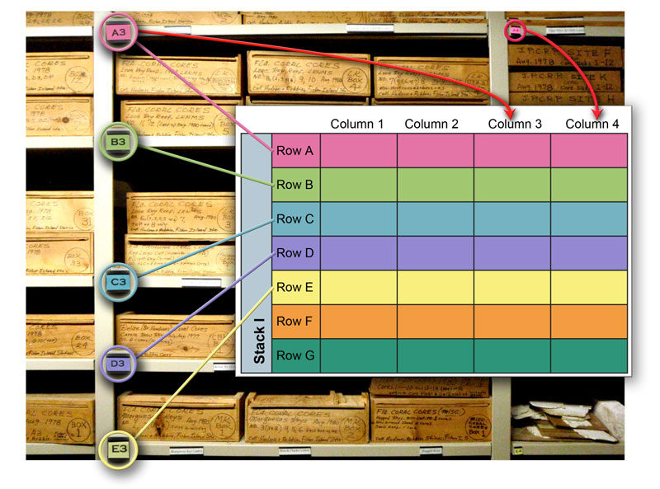
Gulf and Carribbean coral core repository
Notes:
The coral cores have been documented in a data series. The data series includes a core database that records the current status of the cores. There is a link on the data series website that take you to a core viewer

Slide 10
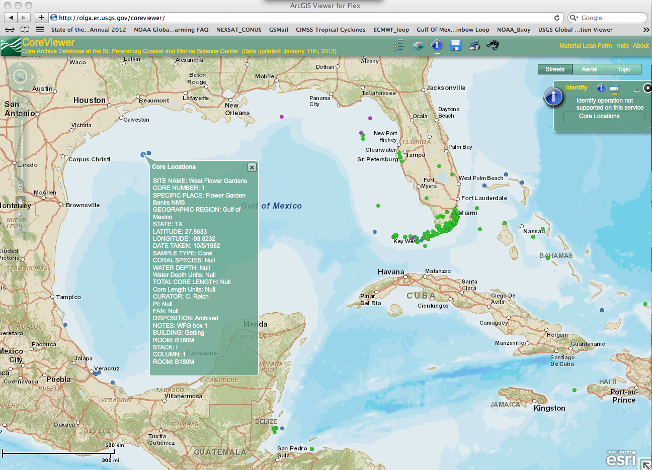
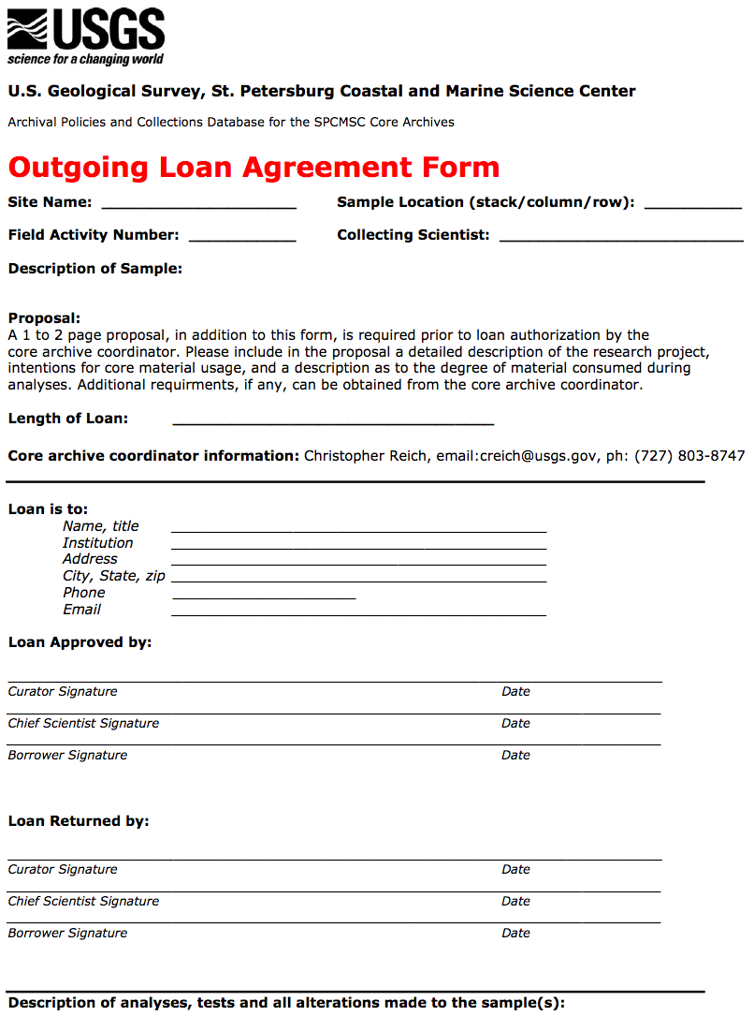
SPCMSC Core Viewer
Notes:
The care viewer has all of the information about the cores, including their exact location. We do loan out these cores to researchers, there are some in Germany right now.

Slide 11
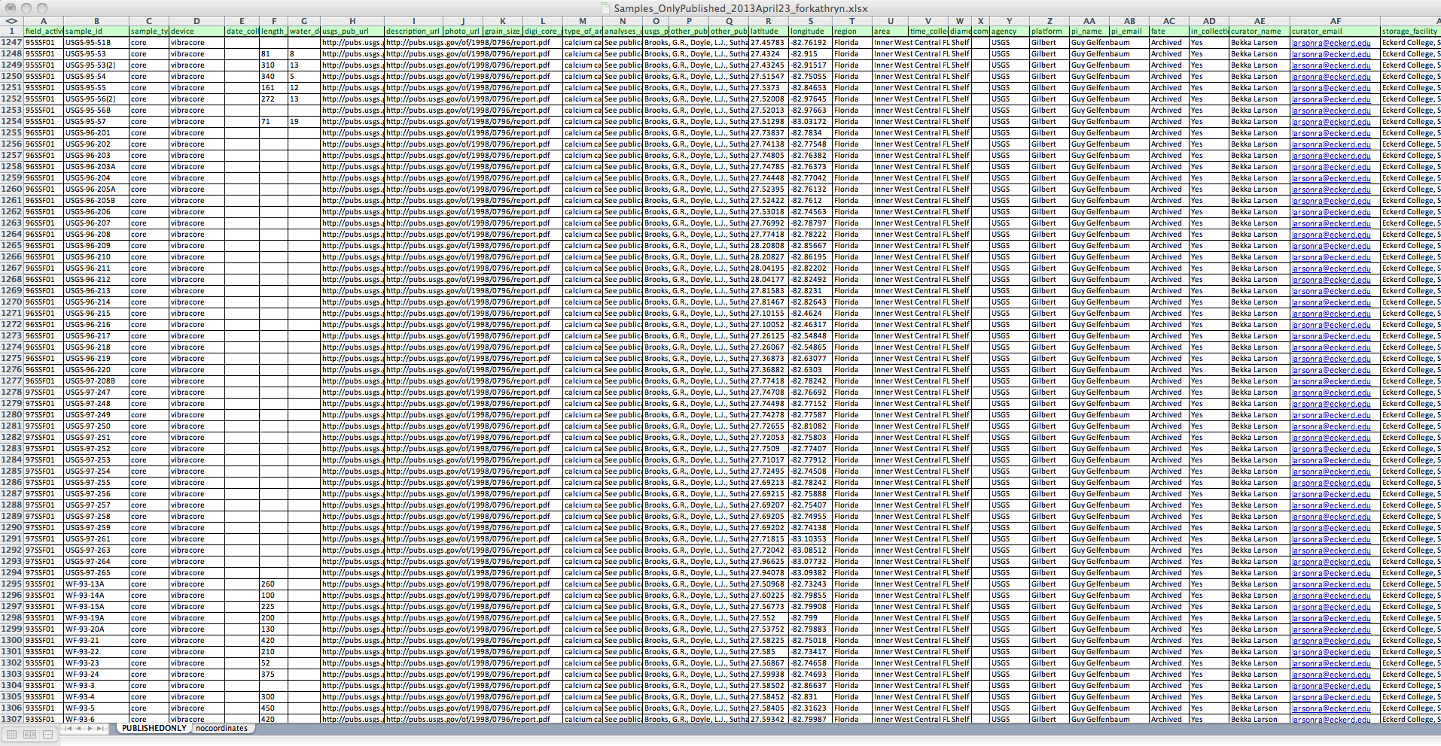
SPCMSC Core Database (all cores)
FAN, ID, Type
Publications
Repository
1,307 entries
Notes:
Don’t try to read the text on this image, but currently we have 1,307 samples and cores entries in a spreadsheet that includes the field activity number, associated publications, repository information, and whatever else we can think of.

Slide 12
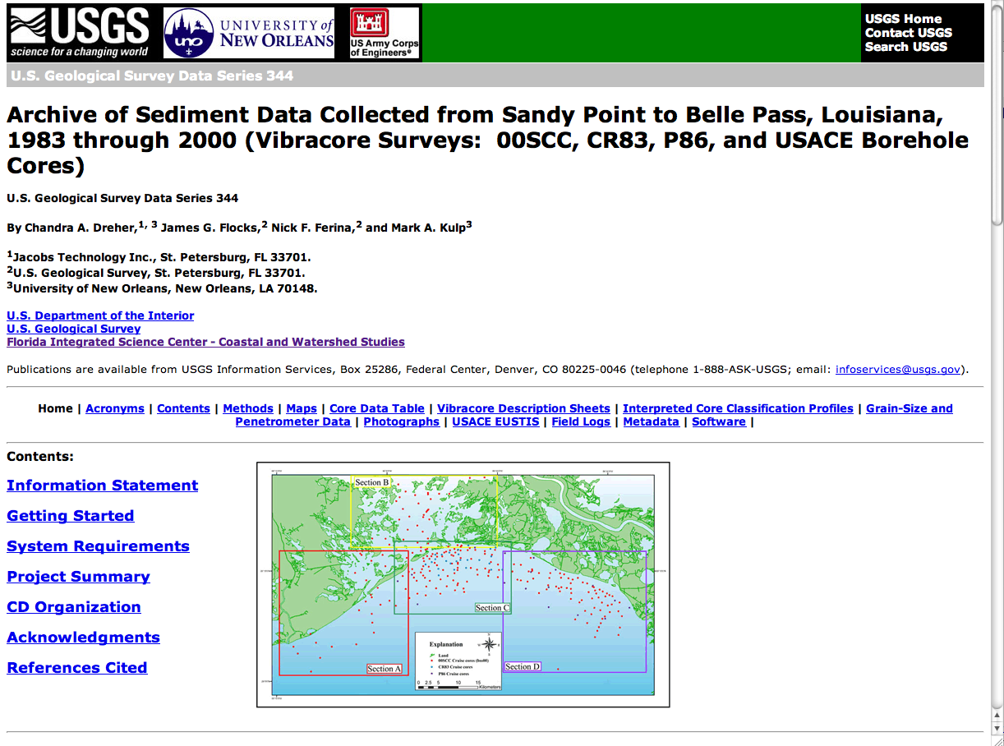
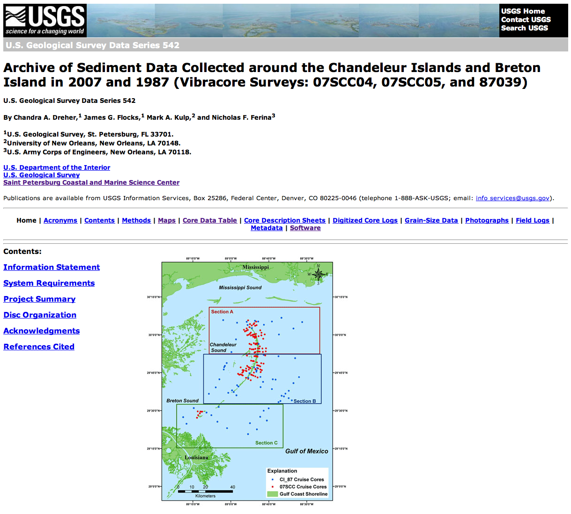
Published Data Series
Maps
Photographs
Description sheets
Analytical Data
Digitized
Description
Sheets
Notes:
Our core archiving process typically includes a published dataseries of core information. These data series include maps, photographs, description sheets, analytical data, and meta data of course. Once we get the core information into a data series it is published and easy to incorporate into other databases. On unique thing we do is digitize the visual information from our core descriptions sheets.

Slide 13
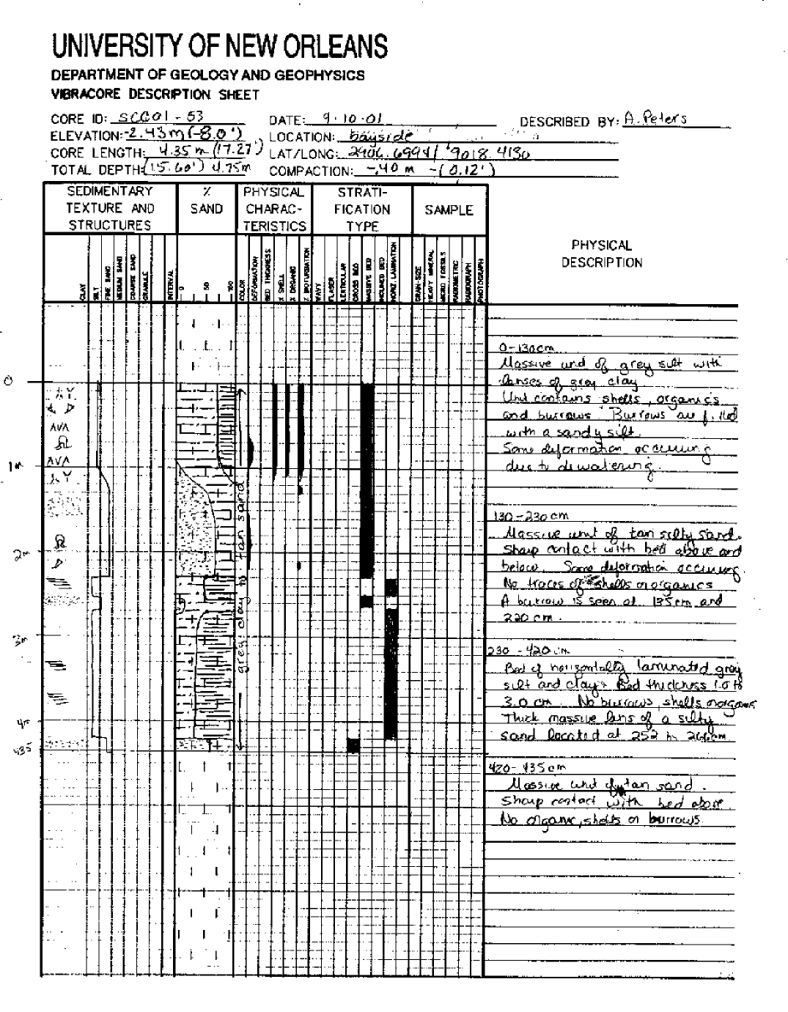
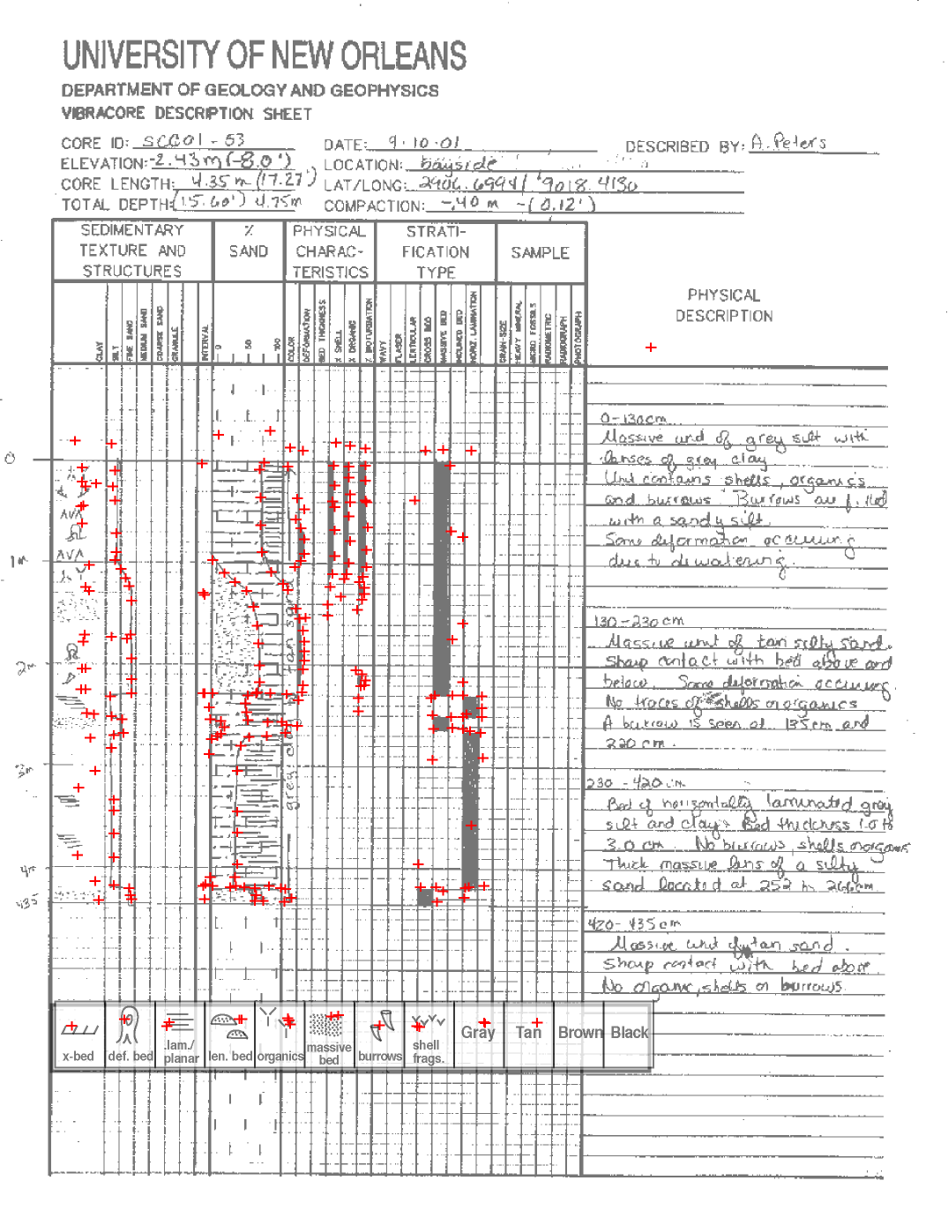
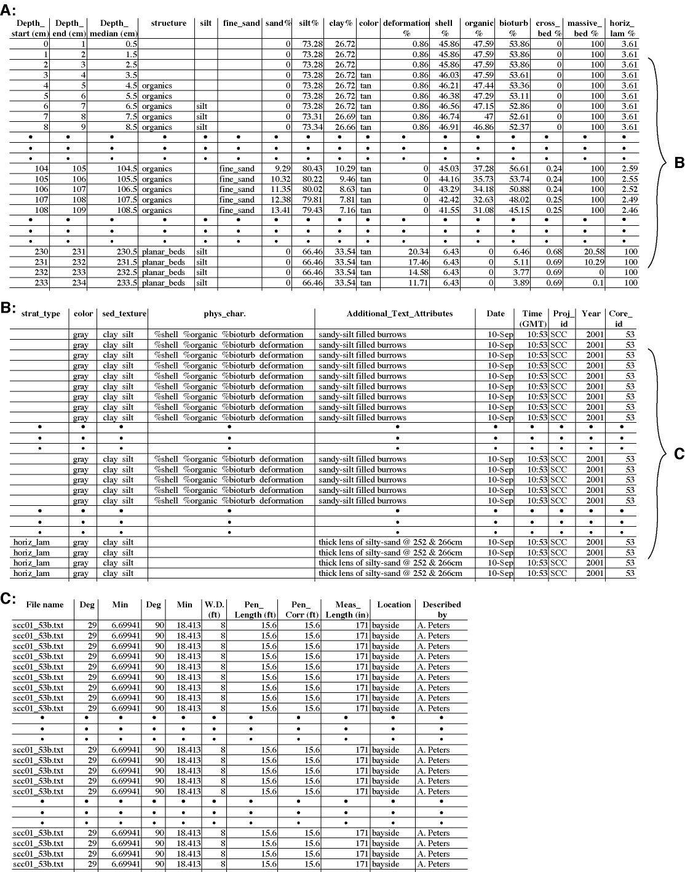
Data conversion and Database development Sedimentologic data
Notes:
We have developed a process by which we capture the described information on the sheets and annotate them into spreadsheets. For example the sand, silt, clay percentages are digitized and entered as values. The visual descriptions such as laminations, shells, bioturbation, and organics are noted by depth and transferred to the spreadsheet.

Slide 14
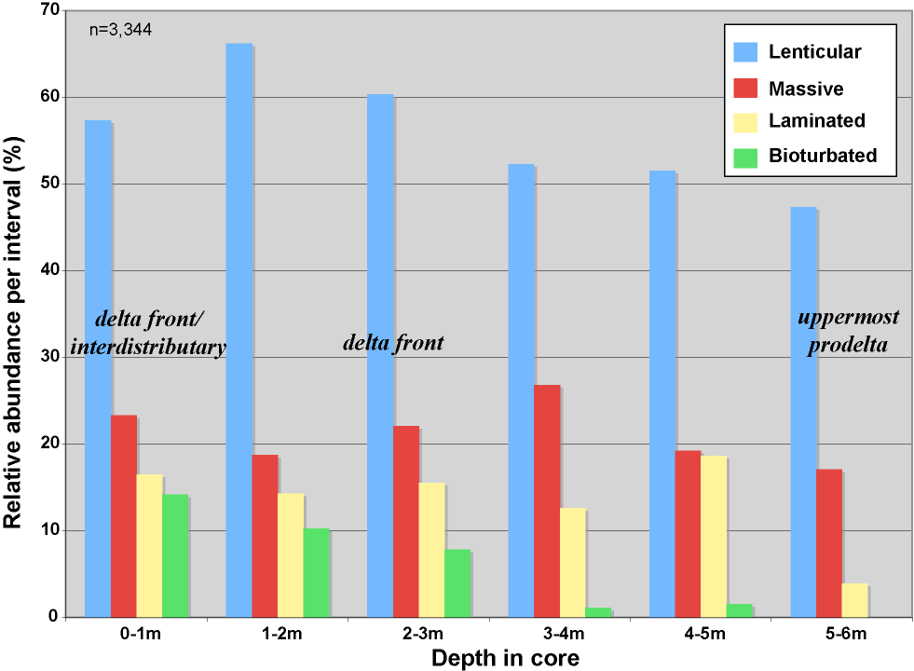
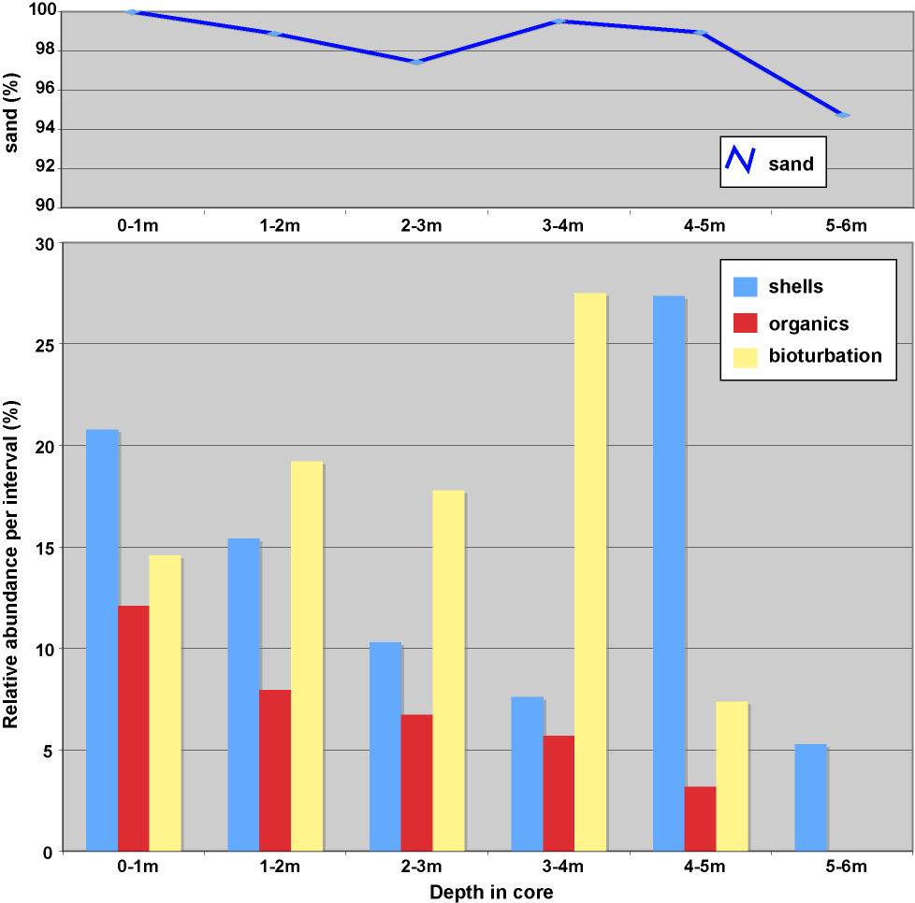
Data conversion and Database development Sedimentologic data
Notes:
This allows us not only to enter this information into spreadsheets but also to make comparisons that are difficult to get at. For example the top graph shows the relative abundance of bedding tops per depth intervals in some mississippi river delta cores, the bottom graph shows the relative abundance of shells and organics per depth intervals

Slide 15
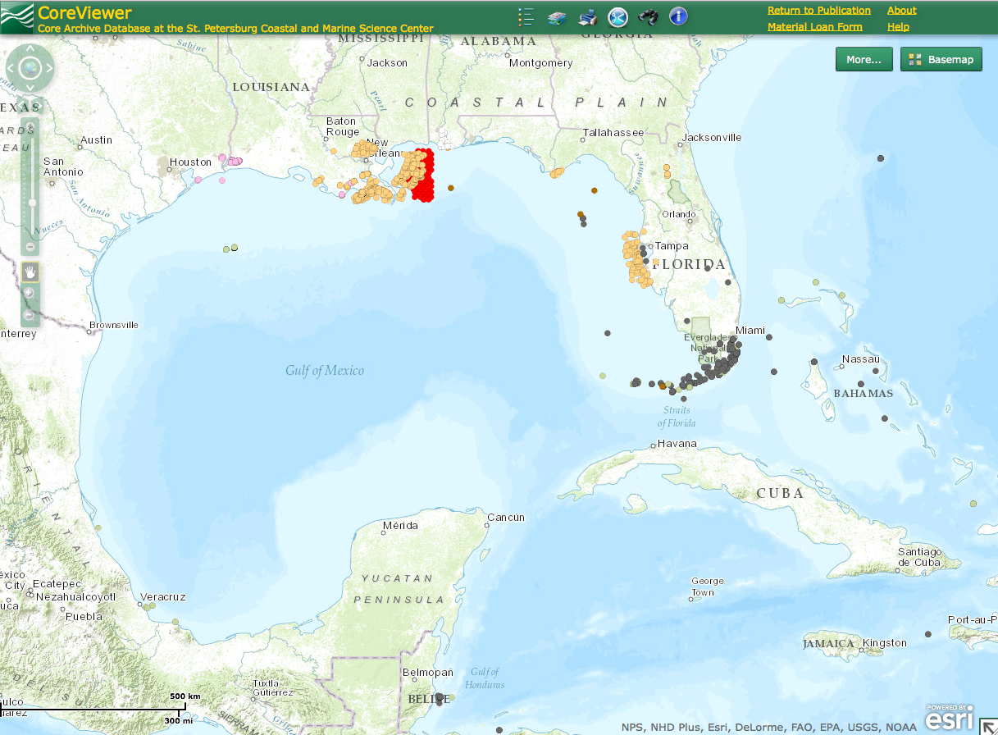
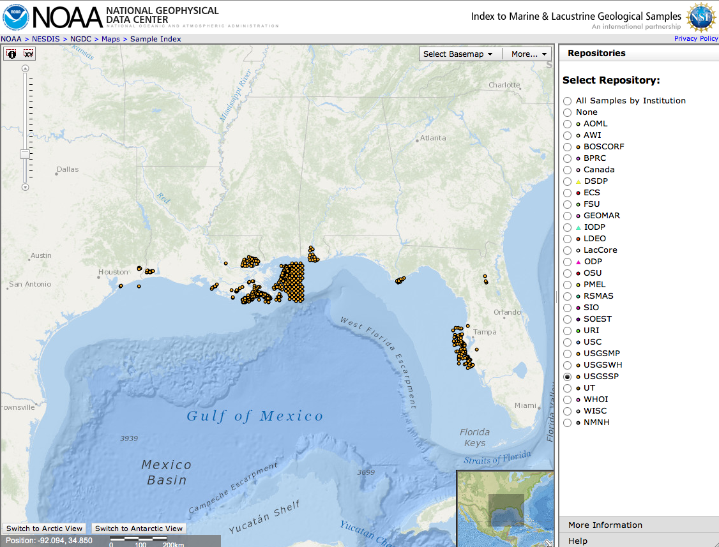
SPCMSC Core Database (all cores)
USGS Core viewer
NGDC samples viewer
GeoMapApp
Others:
usSEABED
LASEDS
State databases (e.g. SONRIS, OASIS, ROSS)
Notes:
Finally all of our core data is being entered into the data core viewer, along with the relavent information. And as mentioned earlier the database is incorpated into the NGDC and GeoMap App. Other databases include usSEABED, and LASED, LASED is Louisiana centric. Others include resource databases developed buy the gulf states such as sonris in louisiana, oasis in alabama, and ross in florida. The data is also being incorporated into the Coastal and Marine GeoData system

Slide 16
USGS St. Petersburg Coastal and Marine Science Center Core repository
Contacts:
Jim Flocks: core curator (ran out of chairs)
jflocks@usgs.gov
Shawn Dadisman: data manager
sdadisman@usgs.gov
Heather Schreppel: database development
hschreppel@usgs.gov
Kathryn Smith: database development
kelsmith@usgs.gov
Kyle Kelso: core facilities manager
kkelso@usgs.gov
Julie Bernier: core facilities manager
jbernier@usgs.gov
Molly McLaughlin: laboratory manager
mmclaughlin@usgs.gov
Notes:
Contact information. We all wear numerous hats but if you have any questions or need to contact us this group can best address your needs.

