Slide 1
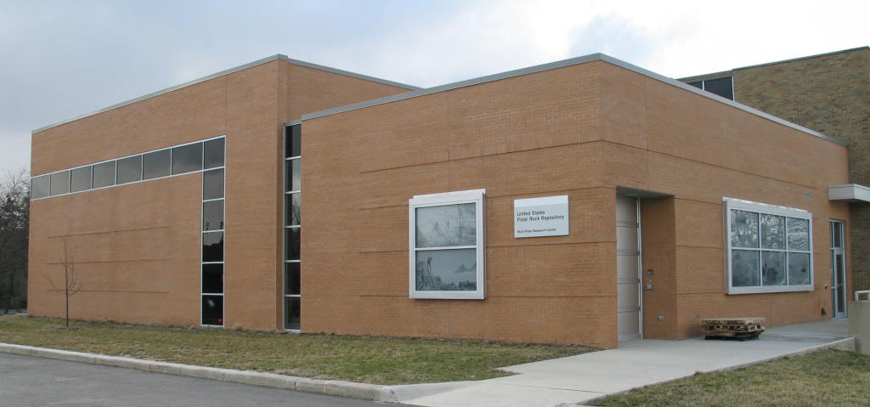
Polar Rock Repository
Established in late 2003 to preserve polar rock samples for future research, education and exhibit use
Staff: 0.75 FTE curator, 0.5 FTE undergraduate, 0.1 FTE for IT/office support

Slide 2
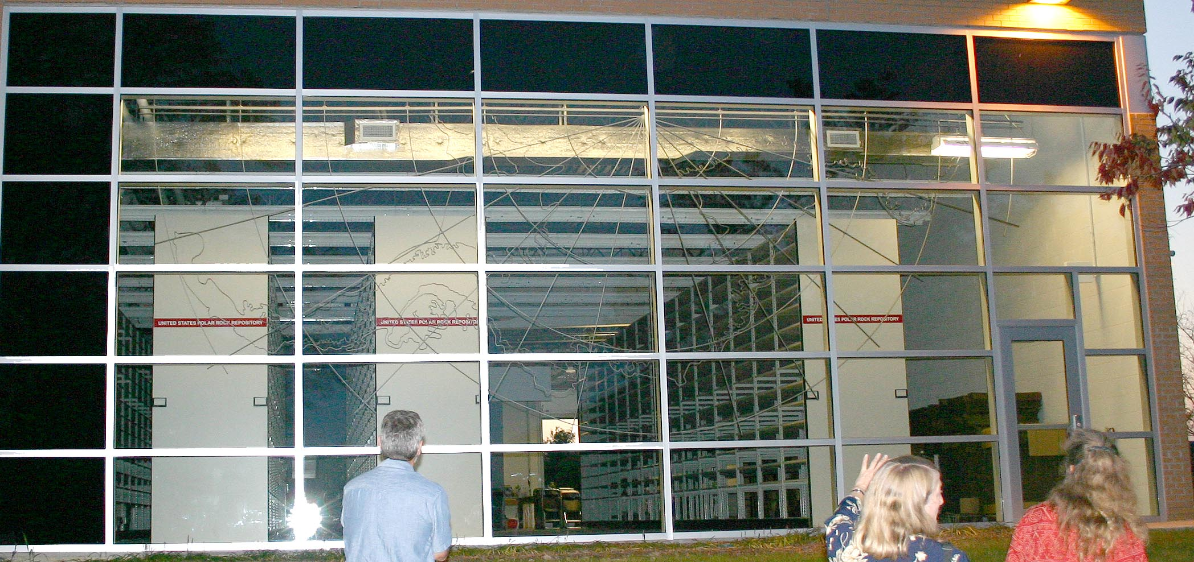
27120 Rock Samples
1115 Unconsolidated (till)
887 Eltanin Dredge samples
1014m DVDP Cores
218 Fossils
88 Modern Plants (lichen & moss)

Slide 3
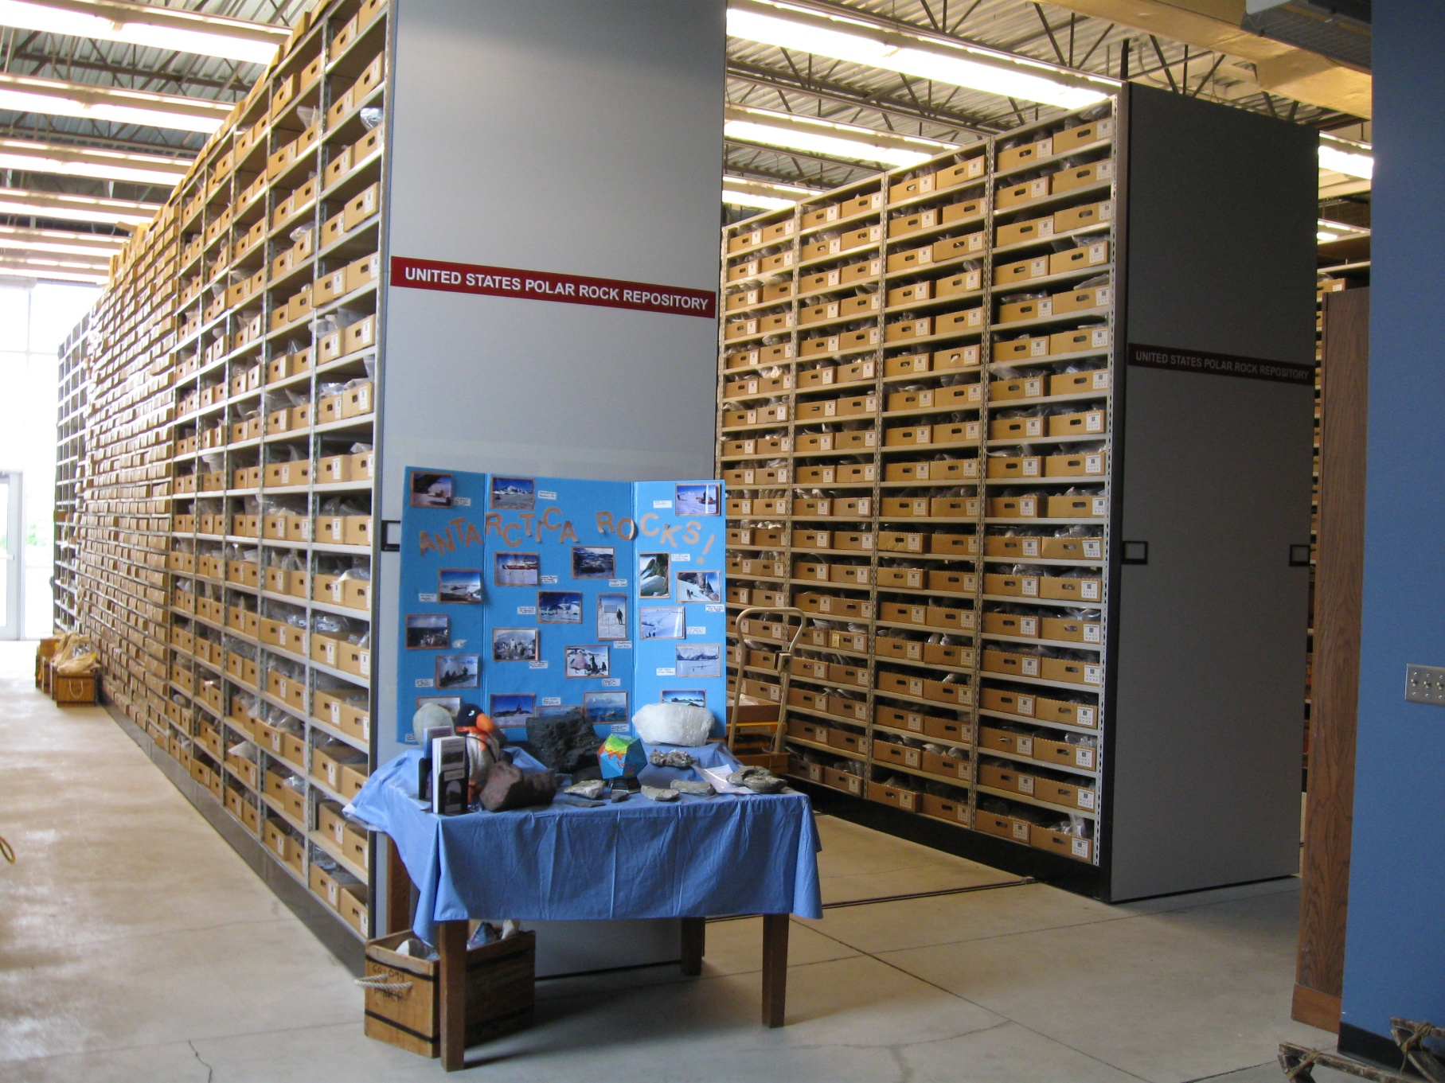
Shelving is 12' high and can accommodate ~80,000 samples.

Slide 4
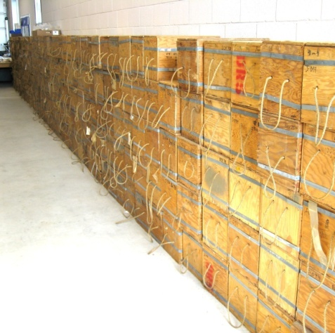
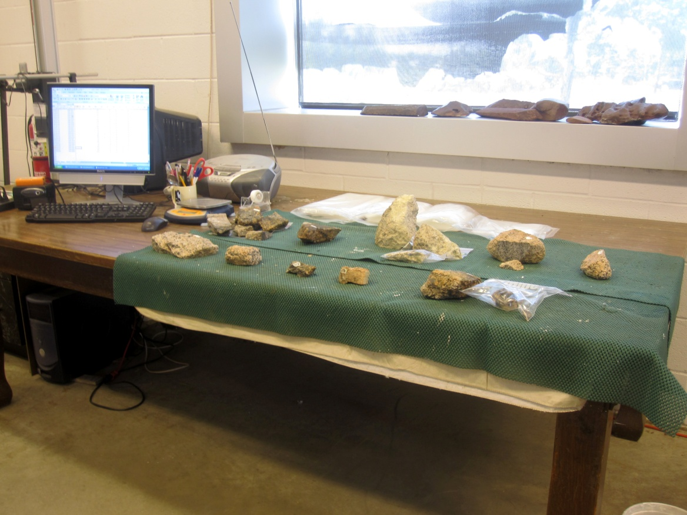
CATALOGING PROCESS
1. Samples arrive on pallets and are stacked for cataloging.
2. Samples are weighed , measured for magnetic susceptibility and relabeled with a repository number.

Slide 5
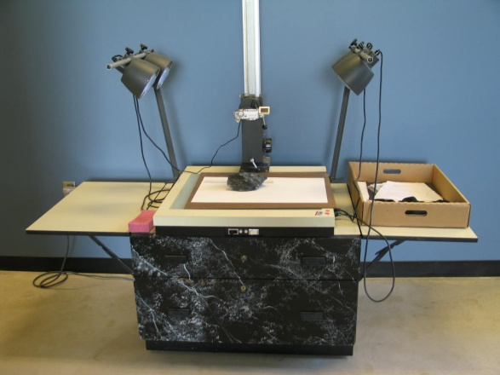
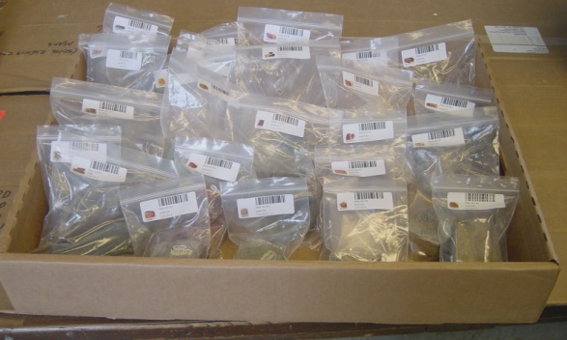
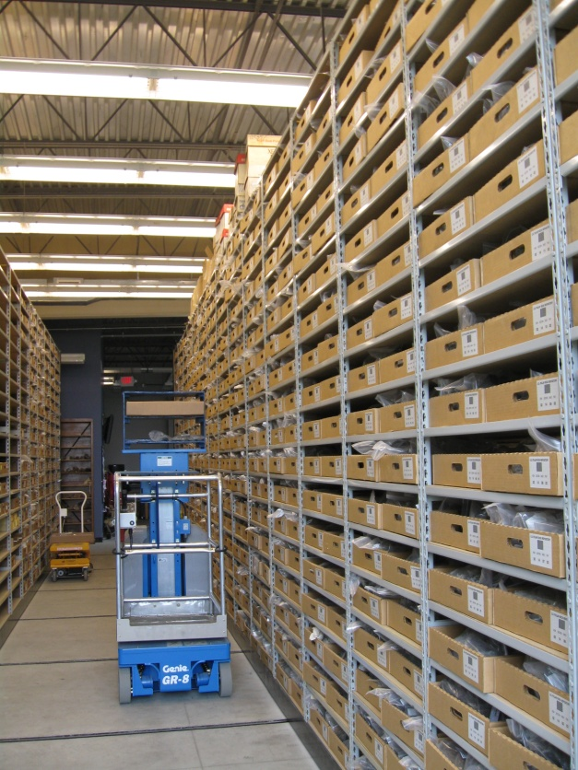
3. Digital photos are taken (front and back)
4. Samples are put into labeled plastic bags .
5. Samples are put into trays and onto the shelves

Slide 6
A small % of samples are from pre-breakup, bordering continents.

Slide 7
The PRR uses a commercial museum database software program called Emu for cataloging and loaning samples. Annual license: $4k.

Slide 9
The USPRR sample numbers have been put on the field maps
Field camps are noted for logistics planning

Slide 11
Glacial Geology and Biological Information

Slide 12
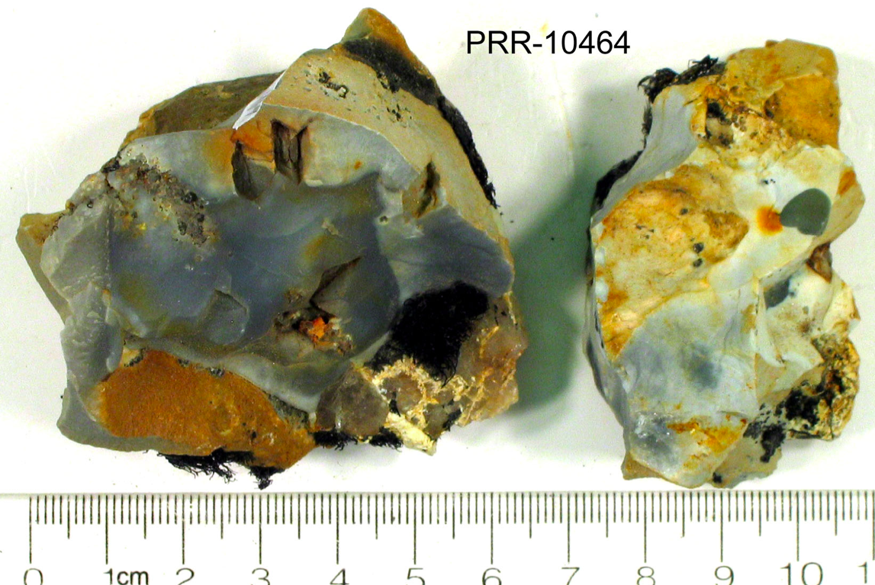

Slide 13
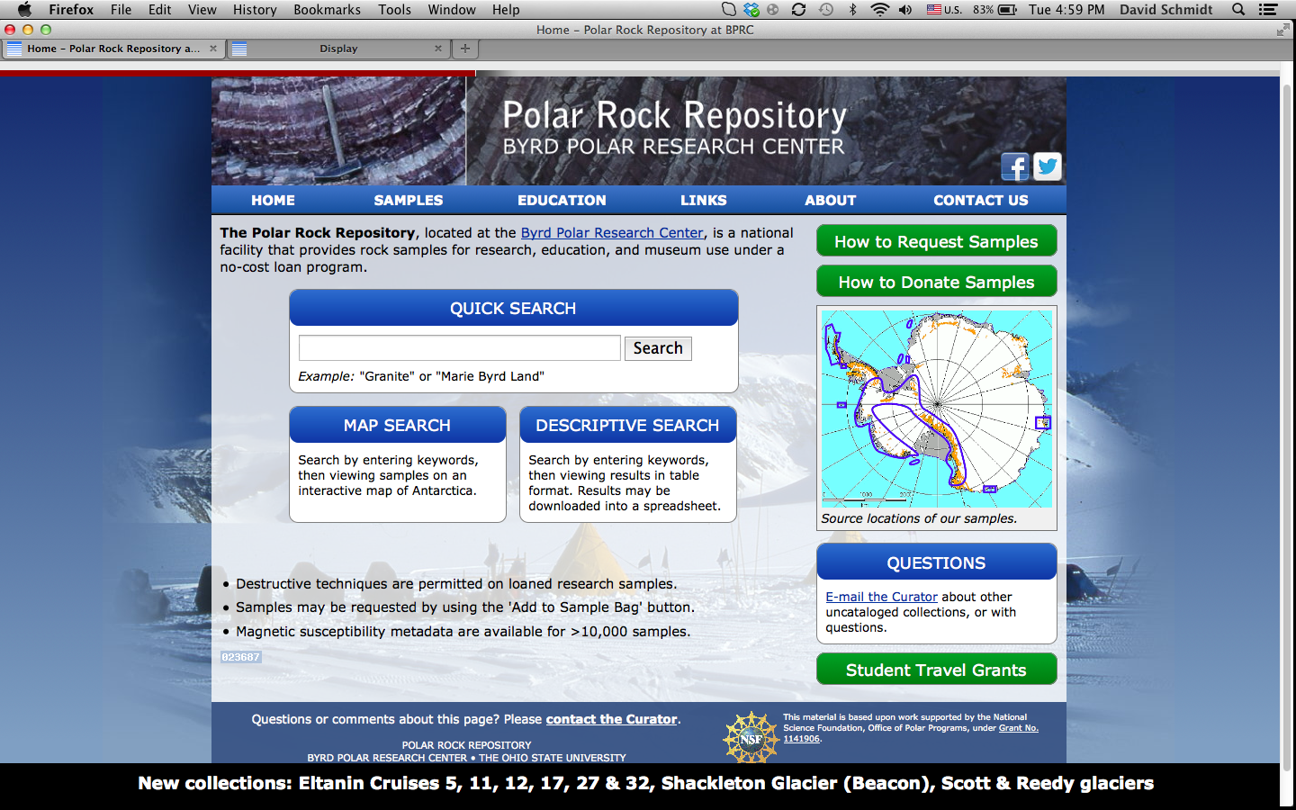

Slide 14
Detailed Search using
multiple search terms

Slide 15
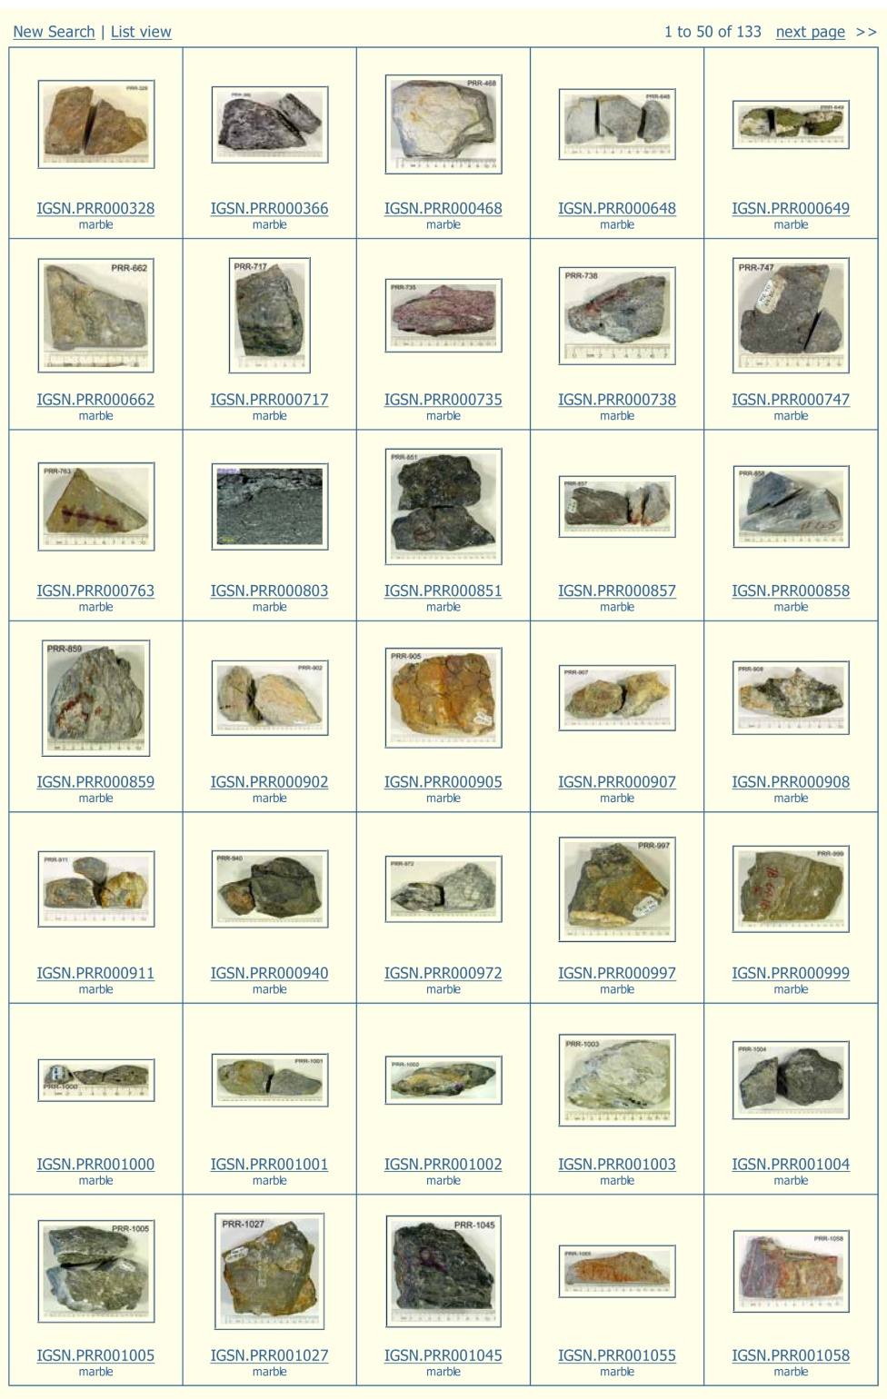
Contact Sheet showing thumbnail images of search results.

Slide 16
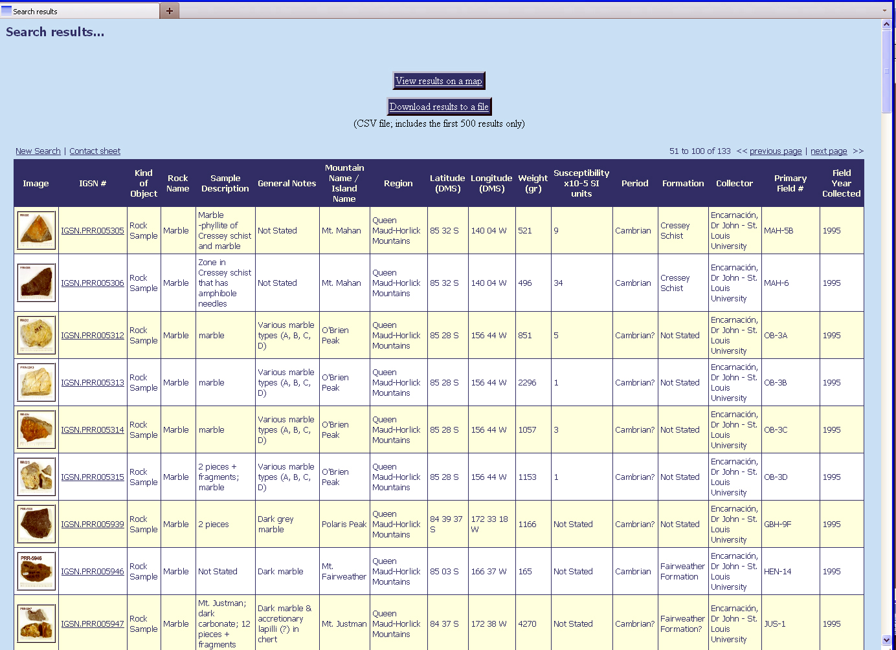
Search Results for Marble

Slide 17
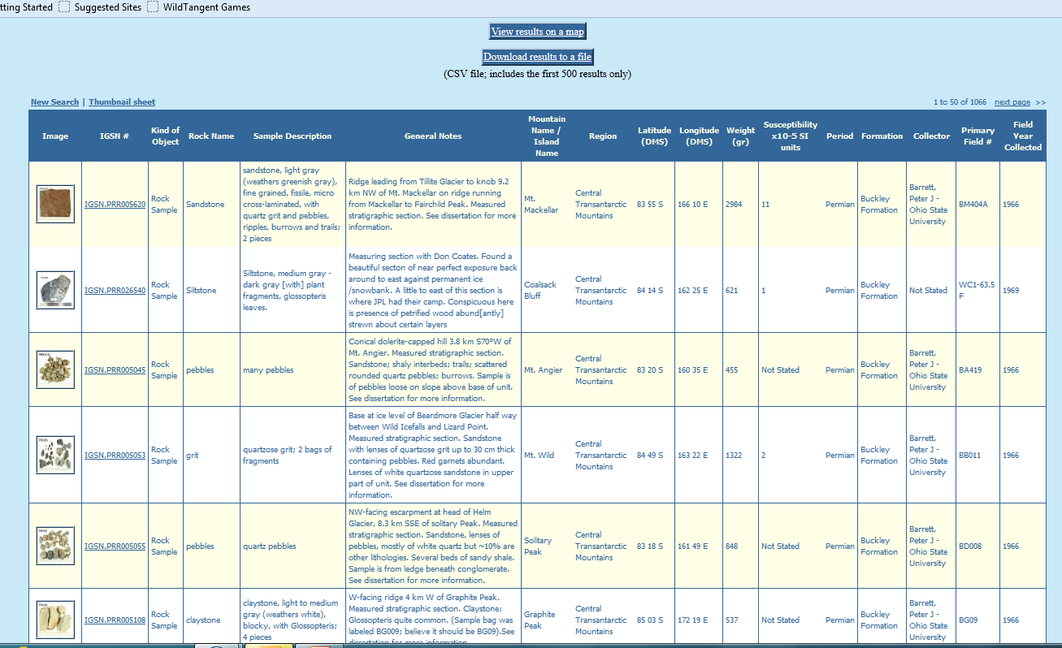
Search Results can be downloaded into a CSV file

Slide 18
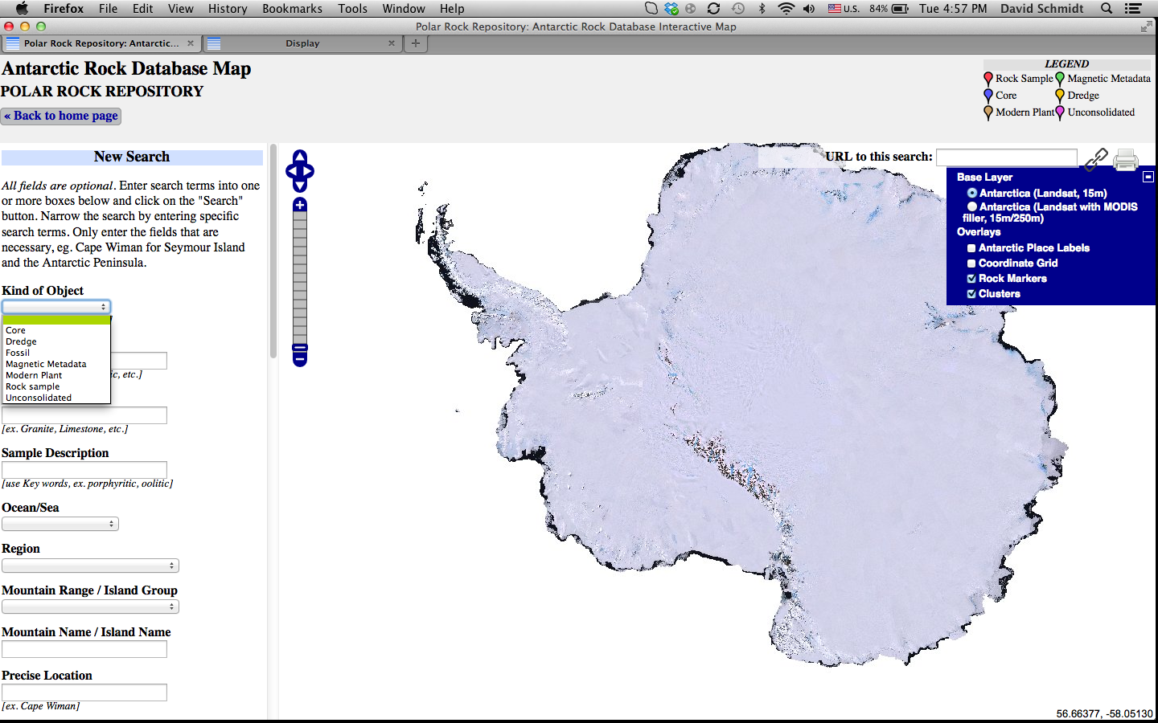
Map Search Feature

Slide 19
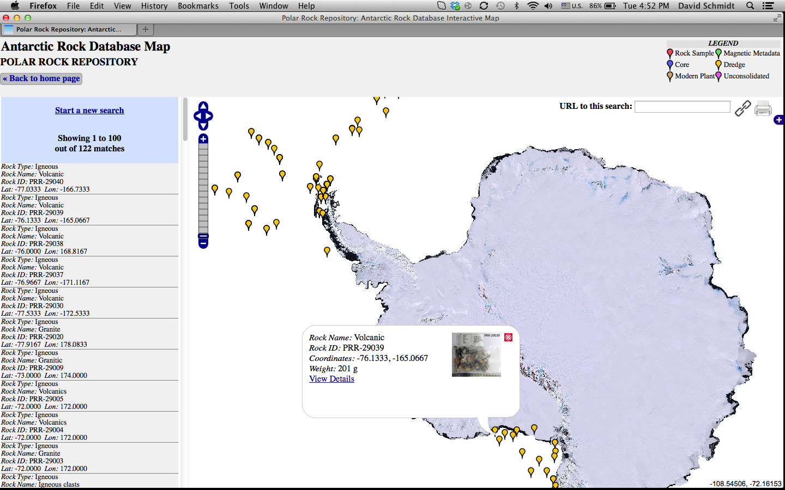

Slide 20
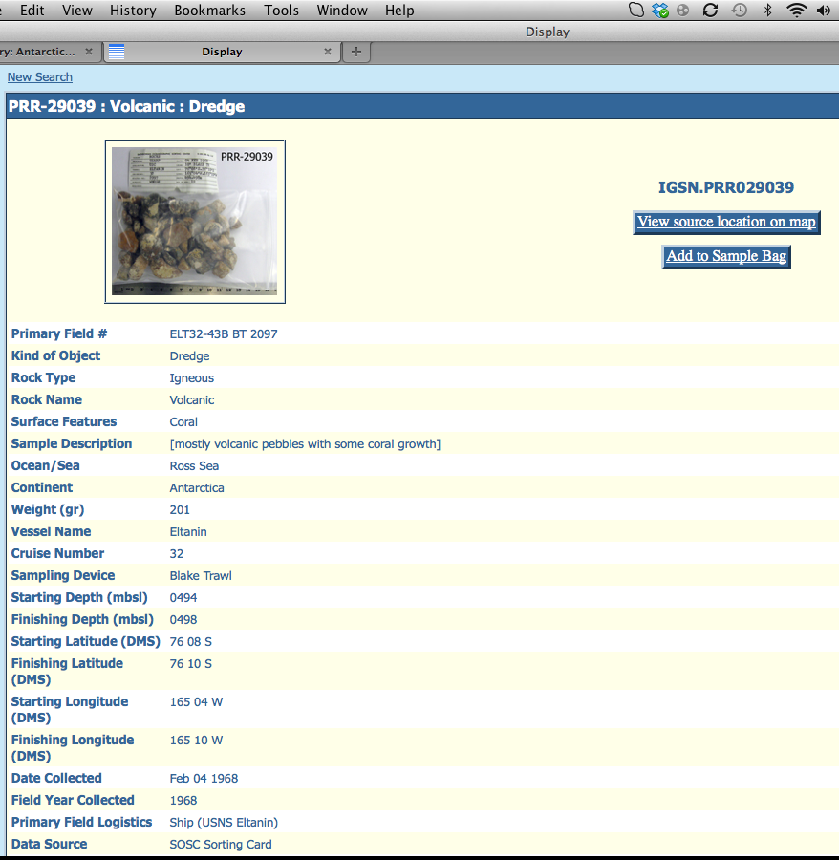
Sample Information and Sample Bag

Slide 21
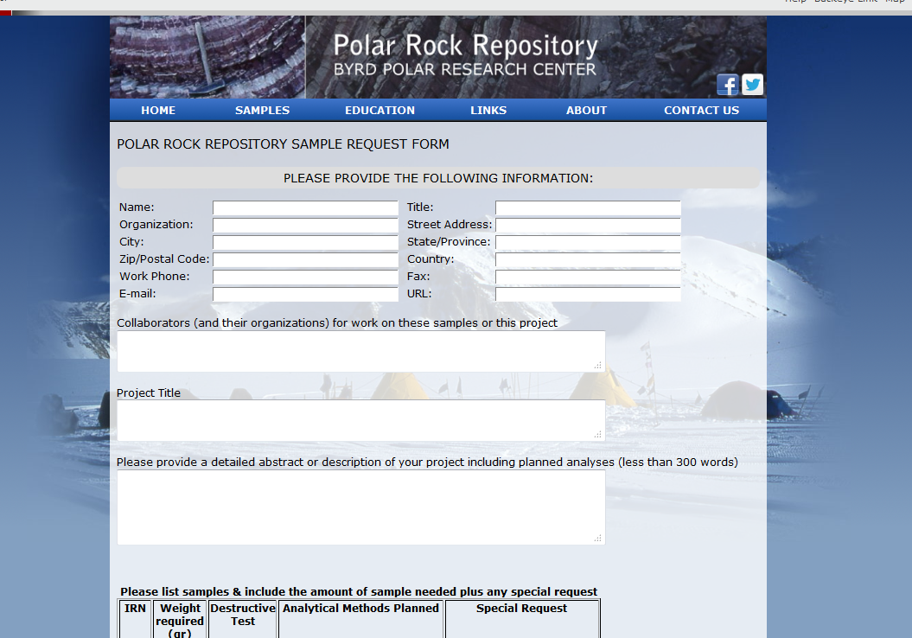
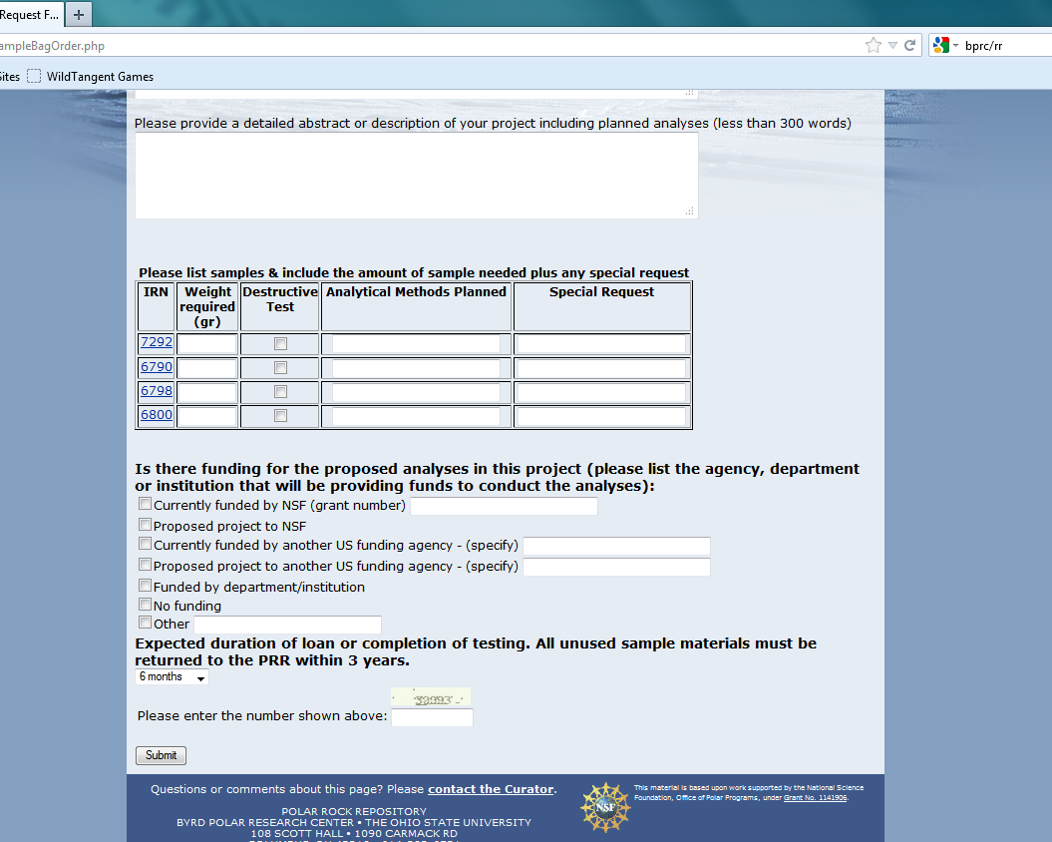
Loan Request Form

Slide 22
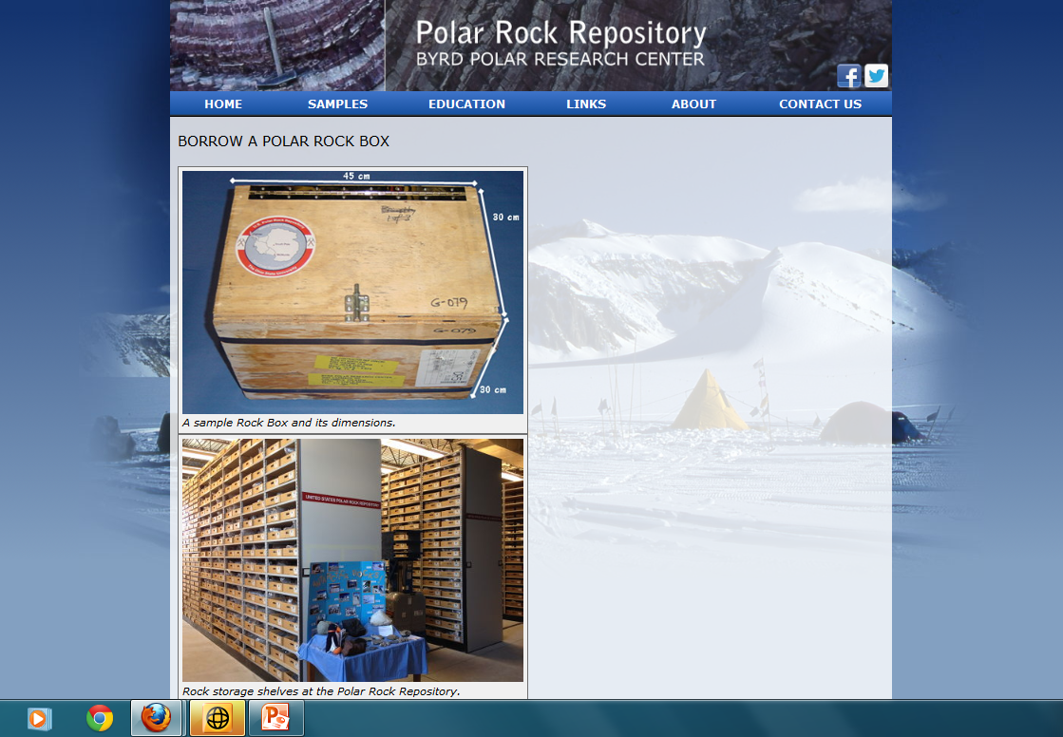
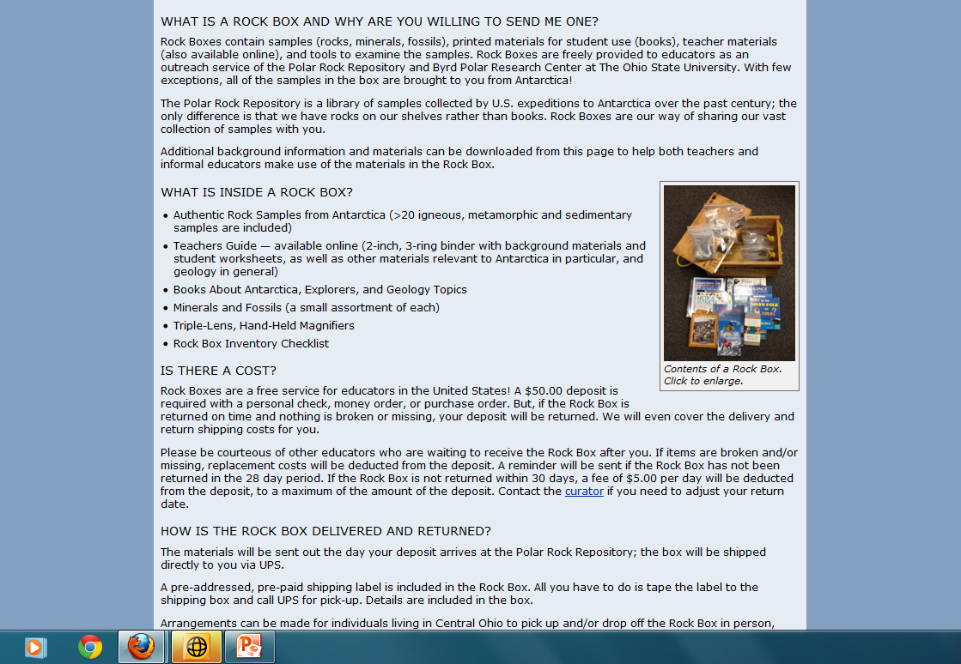
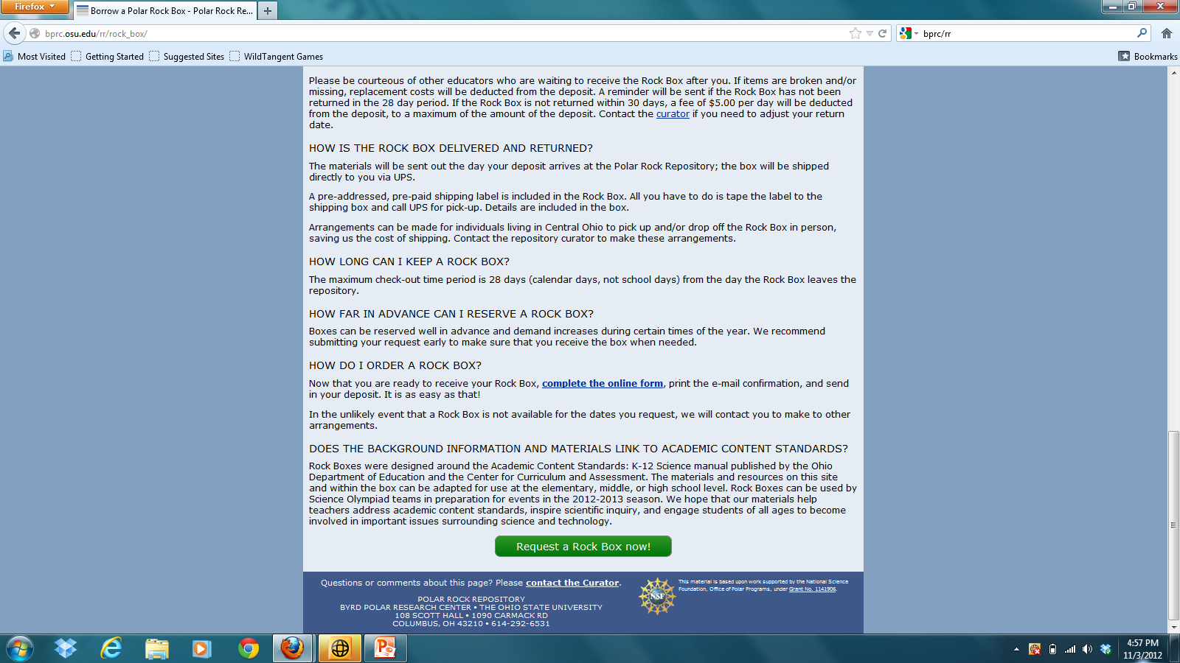
EDUCATIONAL OUTREACH
POLAR ROCK BOX
Freely loan rock samples to educators
Includes >35 samples of rocks, minerals &fossils
Polar books and learning materials

Slide 23
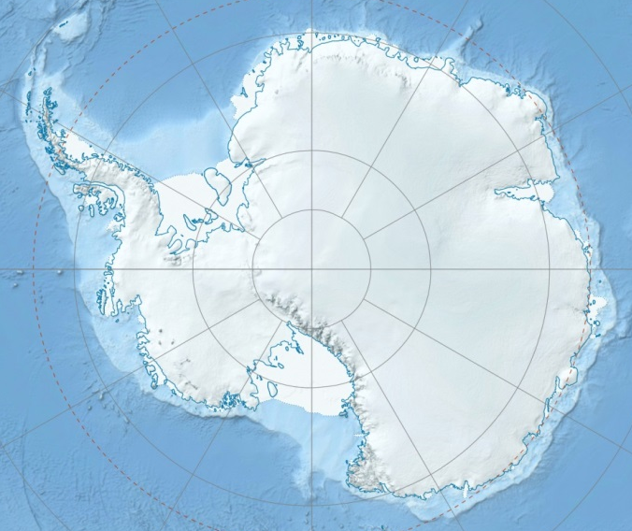
NSF Funded Research Sample Loan Locations 4/1/12 – 3/31/13

Slide 24
PRR outreach efforts over the last 8 years have reached >18,000 people (~70% were children 5 to 13 years old).

Slide 25
PRR Sample Loans since 2004

